Slide 1

An M-19-21 discussion
Lisa Haralampus
Director, Records Management Policy and Outreach
November 16, 2022
ARMA NOVA Chapter Meeting

Slide 2
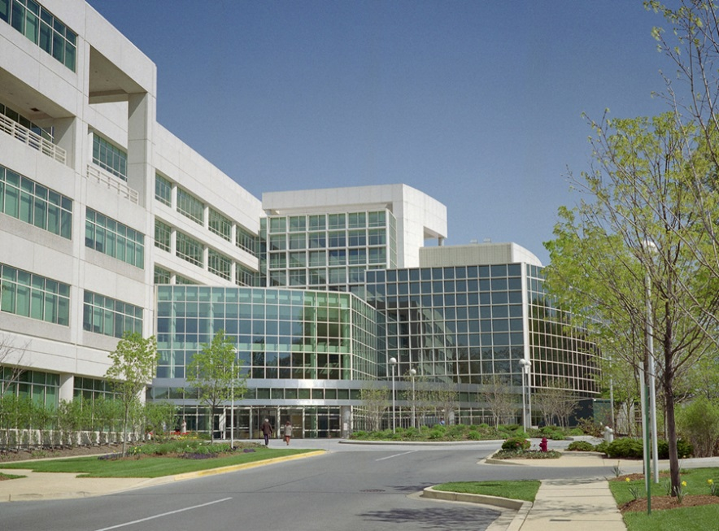
About the Office of the Chief Records Officer for the U.S. Government
Our mission: Lead Federal records management by providing guidance, training, oversight, appraisal and assistance to promote the effective management of Federal records as business assets.
Our vision: Records are integral to each agency's mission and are managed electronically with minimal end-user intervention, resulting in the
effective governance of information assets.
Our numbers: 80+ staff, 16 locations, including College Park, MD as NARA HQ

Slide 3
M-19-21
Ensure that all Federal records are created, retained, and managed in electronic formats, with appropriate metadata.
Consistent with records management laws and regulations, develop plans to close agency-operated storage facilities for paper and other analog records, and transfer those records to Federal Records Centers operated by NARA or commercial storage facilities.
Forthcoming OMB Memo with June 30, 2024 deadline
Exceptions Guidance in NARA Bulletin 2020-01
Digitization Standards for Permanent Records

Slide 4
Federal Records Management in FY23
New OMB memo extending M-19-21 due dates | 1st Q | AROC Recertification (inaugural effort) | 2nd Q - 3rd Q
Updated NARA Bulletin 2020-01 | unknown | Federal Agency Records Management (FARM) annual reporting cycle | 2nd Q (Jan 9 - Mar 10)
Regulations with digitization standards for permanent records and new GRS 4.5 | 2nd Q (Jan) | Resubmission of Capstone NA-1005 forms (inaugural effort, once every 4 years) | 2nd Q (Jan 1 to Apr 1)
Supporting digitization guidance products | FY23 thru FY24 | New bulletin expanding Capstone for electronic messages and updated GRS 6.1 | 2nd Q (Jan)
Updated regulations containing EMPA language for electronic messages | 1st Q | ERA 2.0 Rollout | 2nd Q
New bulletin on storing radiographic film records | 1st Q | New bulletin on records created on collaboration platforms | 4th Q
Updated regulations containing reviewing records schedules every 5 years | 2nd Q (Jan) | Meet the new Archivist | Unknown

Slide 5
CONNECT WITH US!
Visit our website Federal Records Management
Subscribe to Records Express - The Federal Records Management Blog
Sign up for Federal Records Management Emails - AC Memos
Attend BRIDG - Bi-monthly Records and Information Discussion Group
Follow Federal Records Management Training on Facebook and Twitter
Send us an email at rm.communications@nara.gov
CONNECT WITH ME!
Lisa Haralampus
lisa.haralampus@nara.gov
301-837-1744

