Slide 1
A Playbook for Responding to Pandemic-Related Records And Beyond
Notes:
John

Slide 2


Speakers
Susan Cisco, Ph.D., CRM, FAI
IG Consultant
John Isaza, Esq., FAI
VP of Information Governance
Notes:
John

Slide 3

Agenda
Why the Research Group was Formed
Research Methodology and Findings
Defining Retention Control Model
Pandemic-Related Retention Schedule
Using the Playbook
Notes:
John

Slide 4

COVID-19 Records Research Group
Nine organizations representing eight industries
  Air Transportation
  Accounting, Auditing, and Bookkeeping Services
  Chemicals and Allied Products
  Food Manufacturing
  National Commercial Bank
  Petroleum, Petroleum Products
  Petroleum Refining
  Transmission, Electric Power
Also participating were attorneys, John Isaza, FAI, and Omero Bañuelos; Dr. Susan Cisco, CRM, FAI
Notes:
Susan

Slide 5

Research Methodology
Record Types
Proposed 25
  Expanded to 41
Notes:
Susan

Slide 6
Impact Criteria
Privacy and Data Protection Concerns
Volume of Records
Regulatory Concerns
Legal Liability and Litigation Concerns
Retention Concerns
Archival Value
Notes:
Susan

Slide 7
Business Function | Record Type | Impact Rating
HUM (Human Resources) | Employee case and contact tracing including records of calls to positive cases and contacts. | 24.81
HUM (Human Resources) | Employee biometric information including recorded temperature readings. | 22.74
HUM (Human Resources) | Employee quarantine records, includes housing arrangements. | 21.38
FAC (Facilities) | Customer and visitor biometric information including recorded temperature readings. | 20.57
HUM (Human Resources) | Health questionnaires of employees, contractors, customers, and visitors. | 19.22
HUM (Human Resources) | Disclosure of COVID-19 test results to a workplace contact or health official. | 18.64
HUM (Human Resources) | Report for Employees/Visitors Presenting Symptoms at Work. | 18.04
HUM (Human Resources) | Documentation of health conditions in the higher risk category. | 17.76
HUM (Human Resources) | Company response to temperature screenings and survey questions that do not meet the threshold for access to the facility. | 17.67
ACC (Accounting, Finance, and Treasury) | Salary protection records | 16.04
Research Findings
Top Ten Record Types
Notes:
Susan

Slide 8
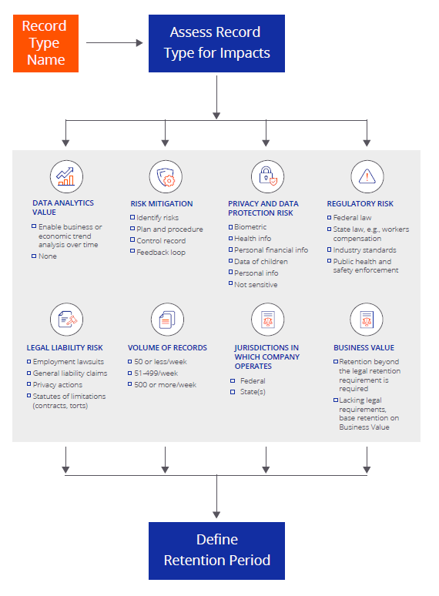
Defining Record Retention Control Model
Notes:
John
Use Vaccine Records as an example and walk through the control model.

Slide 9
Defining Record Retention Control Model
Jurisdictions in which Company Operates
Federal
State(s)
Notes:
John
Use Vaccine Records as an example and walk through the control model.

Slide 10
Defining Record Retention Control Model
Regulatory Risk
Federal law
State law, e.g. workers compensation
Industry standards
Public health and safety enforcement
Notes:
John
Use Vaccine Records as an example and walk through the control model.

Slide 11
COVID-related Documents Requested by OSHA*
Accommodation of sick employees
Corrective action taken
Documentation of corrected condition
Emergency action/response
Hazard communication, identification and control
Illness records
Photographs/video
Plan for outbreaks in the workplace
Policies and Protocols related to employee exposure
Policies regarding access to medical records
Procedures for reporting and responding to COVID illness or potential illness
Procedures for dealing with worker exposure to the virus
Procedures for dealing with workers who report having COVID
Protective equipment required and/or furnished to employees
Respiratory etiquette and hand hygiene
Routine environmental testing
Sanitation practices and procedures
Safety and health related documents
Signage
Specific preparations undertaken
Training and education of employees
Travel policies
*NOTE: This list may not be all inclusive. Please consult your legal advisor for more information.
Slide compiled by Karen Monsen, Partner, Caldwell East & Finlayson PLLC 2021

Slide 12
Defining Record Retention Control Model
Privacy and Data Protection Risk
Biometric
Health info
Personal financial info
Data of children
Personal info
Not sensitive
Notes:
John
Use Vaccine Records as an example and walk through the control model.

Slide 13
Defining Record Retention Control Model
Legal Liability Risk
Employment lawsuits
General liability claims
Privacy actions
Statutes of limitations (contracts, torts)
Notes:
John
Use Vaccine Records as an example and walk through the control model.

Slide 14
Defining Record Retention Control Model
Volume of Records
50 or less/week
51-499/week
500 or more/week
Notes:
Susan
Use Vaccine Records as an example and walk through the control model.

Slide 15
Defining Record Retention Control Model
Business Value
Retention beyond the legal retention requirement is required
Lacking legal requirements, base retention on Business Value
Notes:
Susan
Use Vaccine Records as an example and walk through the control model.

Slide 16
Defining Record Retention Control Model
Risk Mitigation
Identify risks
Plan and procedure
Control record
Feedback loop
Notes:
Susan
Use Vaccine Records as an example and walk through the control model.

Slide 17
Defining Record Retention Control Model
Data Analytics Value
Enable business or economic trend analysis over time
None
Notes:
Susan
Use Vaccine Records as an example and walk through the control model.

Slide 18
New Pandemic-Related Record Series
Record Series Code | Record Series Name | Record Series Description | Retention Period | Trigger Event | Defining Authorities | Record Types
FAC100 | COVID-19 Health and Safety Information for Visitors and Other Third Parties | COVID-19 related health and safety information for visitors and other third parties. Includes recorded temperature readings by organization and customer health information. | 5 Years | Creation | Business Need | • Company Response to Visitors Temperature Screenings and Survey Questions • Health Questionnaires of Visitors • Location Data of Third Parties within a Facility • Reports for Visitors Presenting Symptoms at Work • Threshold Determination Records - Third Party • Visitor Biometric Information
HUM070 | Personnel Files - Medical (Non-Hazardous Exposure) | Individual employee and contractor non-hazardous exposure medical history. Includes vaccine certificates and health passports for employees who have been tested for COVID-19 antibodies / have recovered from the virus. Refer to HUM120 for COVID-19 negative test results and HUM130 for COVID-19 related general facility health information . | 5 Years | Termination | Regulatory Requirement - 29 C.F.R. § 1910.1018(q)(2)(iv) | •Accommodations of Sick Employees • Case and Contact Tracing Records • COVID-19 Positive Test Results • Disclosures of Positive Employee COVID-19 Test Results to a Workplace Contact or Health Official • Employee COVID-19 Illness Records • Health / Vaccine Passports • Threshold Determination Records • Vaccine Certificates • Vaccination Orders • Vaccination Reaction Records • Vaccination Refusals
HUM120 | COVID-19 Test Results - Negative | Employee and contractor COVID-19 test results which are negative. Includes disclosure of negative test results to a workplace contact or health official. | 5 Years | Creation | Business Need | • COVID-19 Negative Test Results • Disclosures of Negative Employee COVID-19 Test Results to a Workplace Contact or Health Official
HUM130 | COVID-19 Health and Safety Information | COVID-19 related general facility health information for employees and contractors. Includes recorded temperature readings by organization and self- assessments. Refer to HUM070 for non-hazardous exposure medical records for employees and contractors. | 5 Years | Creation | Regulatory Requirement 29 C.F.R. § 1910.119(m)(7) | • Company Response to Employee Tempera+A1:H20ture Screenings and Survey Questions • Corrective Actions Taken • Documentation of Corrected Conditions • Documentation of Employee Health Conditions in the Higher Risk Category • Employee Biometric Information • Facility Quarantine Records • Health Questionnaires of Employees and Contractors • Location Data of Employees • Reports for Employees Presenting Symptoms at Work • Signage Conveying COVID-19 Health and Safety Information
Notes:
John
31 of the 41 record types classified in most organizations’ existing record series
10 record types [below] generated 4 new record series
This is what the schedule looks like in Virgo

Slide 19
Playbook 2.0
Third-Party Data Collection
Biometric Data
Health Passports, Health Certifications, Vaccine Passports
New Regulations
Cal. Lab. Code § 6409.6
CDC 41 CFR 71.20
Additional Themes & Uses
Notes:
John – 10 minutes

Slide 20
Using the Playbook
Getting Ahead
of the Curve
Communication & Collaboration
Elevating the Role of the IG Professional
Benchmarking
Notes:
Susan

Slide 21

Getting Ahead of the Curve
Prepare for new record types as they are not a consideration in business continuity and disaster preparedness plan
“This Playbook is a unique opportunity for my organization to be ahead of the curve in proactively identifying records produced by a “once in a career” event. Too often, records & information governance professionals are left playing catch-up in response to the implementation of new products, processes and technologies. The Playbook will allow us to quickly identify, evaluate and analyze our record-keeping response to the current pandemic and account for it in the construct of a mature records and information management program.”
Research Participant
Industry: National Commercial Bank
Notes:
Susan
New record types are not typically considered in business continuity/disaster preparedness plans

Slide 22

Benchmarking
Organizations should compare their response to the pandemic with others and close any gaps
“This Playbook will provide a solid framework for talking through the information governance decisions and planning that will be required to incorporate the many records that will be created and retained as a result of the COVID-19 pandemic into the Records and Information Management Program. Having a Playbook to provide a structure for discussion with the various stakeholders about the various risks, plans, controls, monitoring and recordkeeping will help focus and drive the conversation and ensure all of the significant issues are covered. Many other organizations have provided input and many others will be utilizing it so it is a useful benchmarking tool as well. I have learned a lot from working with this panel of experts and look forward to leveraging the Playbook in my organization.”
Research Participant
Industry: Food Manufacturing
Notes:
Susan
The Playbook enables organizations to compare their response to the pandemic with others and close any gaps

Slide 23
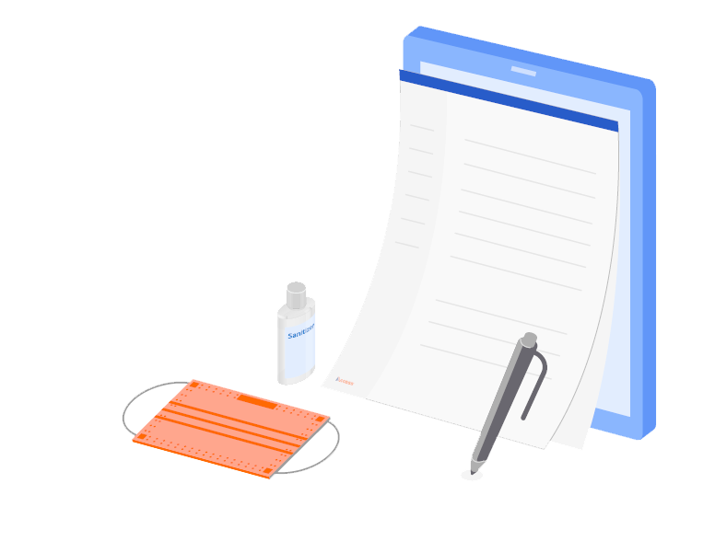
Communication & Collaboration
Utilize the Playbook to open the door for discussion across departments
“I’ve already made use of the work of this working group by reviewing the list of content types with our HR and Legal departments, as well as the project team that is coordinating our pandemic response. We do not collect or create a lot of the content types on the list, but we did identify a few that we are going to incorporate into our Records Retention Schedule. There are a couple that we need to discuss in terms of how the records are stored and protected. And I’ve talked with our pandemic project team about the usefulness of preserving their records for future generations.”
Research Participant
Accounting, Auditing, and Bookkeeping Services
Notes:
Susan
The Playbook opens the door to discussion with internal stakeholders

Slide 24
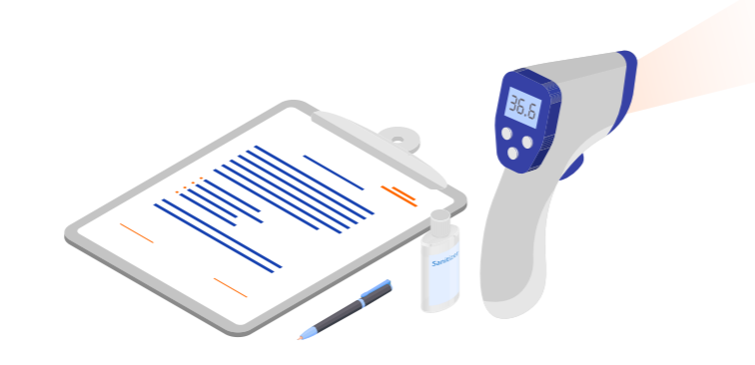
Elevating the Role of the IG Professional
Leveraging Playbook's Record Retention Control Model Positions IG professionals for more of a "seat at the [leadership] table"
"Using the Playbook’s model for record retention when ingesting pandemic records puts IG professionals on the frontlines through their ownership and knowledge in planning for disasters. Also, it promotes them as decision makers in planning for future disasters, mergers and acquisitions, and other significant corporate events."
Research Participant
Notes:
Susan

Slide 25
Download the Playbook
Notes:
https://learn.accesscorp.com/pandemic-records-playbook

Slide 26
Speakers
Susan Cisco, Ph.D., CRM, FAI
IG Consultant
John Isaza, Esq., FAI
VP of Information Governance
Notes:
John

