Slide 1
ARMA NOVA:
NARA Digitization Regulations Update
Kevin De Vorsey, Michael Horsley, John Martinez, Andy Potter
Records Management Policy and Standards
October 24, 2023

Slide 2
Agenda
Background
Success Criteria
Digitization Quality Management Guide
Exceptions Process
Questions

Slide 3
Guidance on Approach
Nov 2014: Federal Records Act (FRA) Amendments
Feb 2018: NARA Strategic Plan
Jun 2019: OMB Memo M-19-21
Dec 2022: OMB Memo M-23-07
“The Archivist shall promulgate regulations requiring all Federal agencies to transfer all digital or electronic records to the National Archives of the United States in digital or electronic form to the greatest extent possible.” (FRA 2014)
“The Archivist shall promulgate regulations establishing . . . standards for the reproduction of records by photographic, microphotographic, or digital processes with a view to the disposal of the original records.” (FRA 2014)
“No later than June 30, 2024, NARA will issue updated regulations and guidance to provide clear standards for fully electronic recordkeeping. NARA will also issue regulations and clear policies that permit agencies to digitize permanent records created in analog formats and, where appropriate, dispose of analog originals.” (M-23-07)

Slide 4
Digitization Standards for
Permanent Records
36 CFR Subpart E -- Digitizing Permanent Federal Records
1236.40 Scope of this subpart
1236.41 Definitions for this subpart
1236.42 Records management requirements
1236.44 Documenting digitization projects
1236.46 Quality management requirements
1236.48 File format requirements
1236.50 Digitization requirements for permanent paper and photographic prints
1236.52 Digitization requirements for permanent mixed-media files
1236.54 Metadata requirements
1236.56 Validating digitized records and disposition authorities

Slide 5
Scope
Scope of this Subpart:
This regulation applies to records that can be scanned using reflective techniques, such as:
Paper records (all sizes and types)
Printed photographs
Mixed Media Records
But not materials that are scanned using transmissive or other techniques, such as:
Photographic negatives
Motion picture film
Microforms
A/V records

Slide 6
Supporting Products
New GRS 4.5, updated GRS 5.2, and FAQs
New FAQ on previously digitized records
Updated FAQ on temporary records
New FAQ on permanent records
Quality management guide
Success criteria
Small scale digitization best practices
Blog posts on Records Express
Training modules, job aids

Slide 7
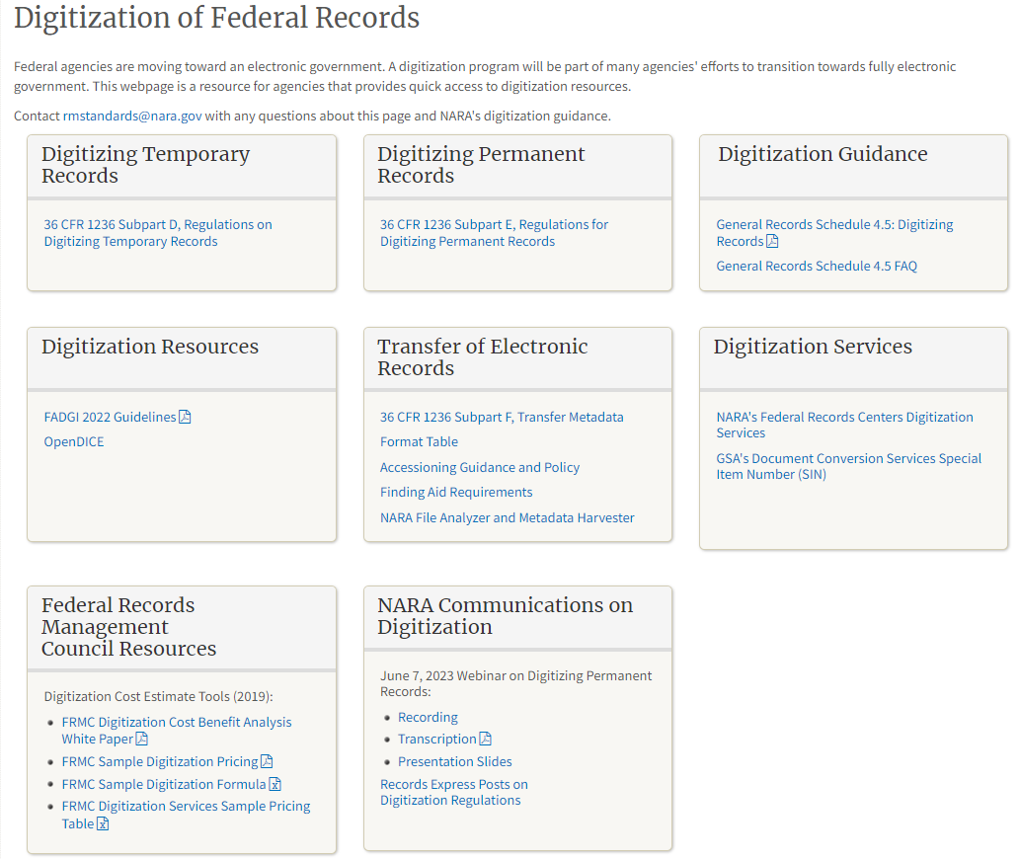
https://www.archives.gov/records-mgmt/policy/digitization

Slide 8
Success Criteria for Digitization

Slide 9
Purpose
Supports agency officials with information about digitizing, managing, and transferring permanent records
Assists agencies in digitizing permanent records and meeting federal records management requirements in laws, regulations, and NARA-issued policy.
If not properly managed, digitization can result in incomplete/insufficient digital record quality to serve all of the same business purposes as the originals.
Helps agencies to adhere to the requirements in 36 CFR 1236 subpart E, and other recordkeeping requirements to help mitigate many of the risks inherent in digitization.
Provides high-level success criteria for digitizing permanent records, which are organized around four key concepts: Policies, Access, Systems, and Disposition.

Slide 10
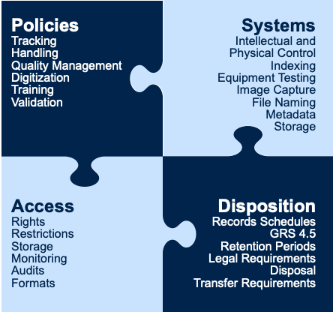
Success Criteria Categories

Slide 11
Policies and Procedures
What Success Looks Like
Policies for:
Roles and responsibilities
Procedures for handling source records
Digitizing source records
Quality management
Managing digital records
Validating digitization processes
Disposition

Slide 12
Systems
What Success Looks Like
Agencies must have systems in place capable of digitizing, managing, accessing, preserving, and transferring permanent records in acceptable digital formats with required metadata.
Systems for managing source records
Systems for creating digitized records
Systems for managing digitized records

Slide 13
Access
What Success Looks Like
Records must remain usable and retrievable.
Access is dependent on agencies establishing and maintaining intellectual and physical control of records throughout their lifecycle to support an agency’s ability to carry out its business functions.
Your agency can provide access to meet internal agency needs and accommodate responses to requests for information.
Access for source records
Access for digitized records

Slide 14
Disposition
What Success Looks Like
Paper and analog source records
Digital records

Slide 15
Questions to ask
As you decide to digitize permanent records
As you inventory records for digitization
As you prepare to digitize your records
About documenting your digitization projects
About quality management
About file formats and metadata
About mixed-media records
About validation
About disposition

Slide 16
Digitization Quality Management Guide

Slide 17
Digitization Quality Management Guide
Quality management (QM) is the overall management function and underlying activities that determine quality
Quality assurance (QA) is a proactive quality management (QM) activity focused on preventing defects.
A QA program is heavily dependent on quality control (QC) data to search for patterns and trends.

Slide 18
Quality Management: Plans and Documentation
The plan defines the work activities, and outlines a sequence of high-level planning and management activities
The plan defines the work activities relating to the digitization of source records
The plan includes the policies, functions, roles, responsibilities, requirements, and objectives of the project

Slide 19
Quality Assurance: Specifications and Standards
Quality assurance describes the mandatory requirements, specifications, and standards that a digitization project must meet.
The major components of a digitization product are image quality, metadata quality, and file format compliance.
QA focuses on the processes used to create project deliverables to ensure that products conform to the standards and specifications

Slide 20
Quality Control: Testing and Analysis
Quality Control (QC) uses tools and equipment to ensure the project deliverables are systematically and continually met.
QC activities or techniques are used to achieve and maintain product quality, process, and service.
QC testing and analysis is used to identify malfunctioning equipment, improper settings, human error, and take corrective actions.

Slide 21
Quality Control: Inspection
Inspection is the process of measuring, examining, testing, or otherwise comparing the product with the requirements.
The inspection process incorporates sampling techniques to identify the percentage of errors that occur
The inspection process uses objective measurements, as well as subjective methods to ensure quality.

Slide 22
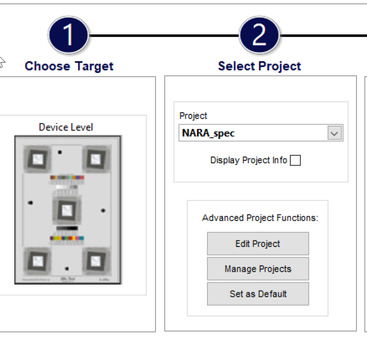
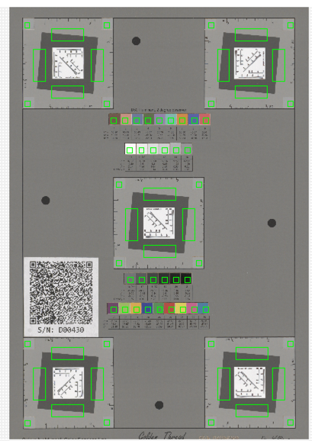
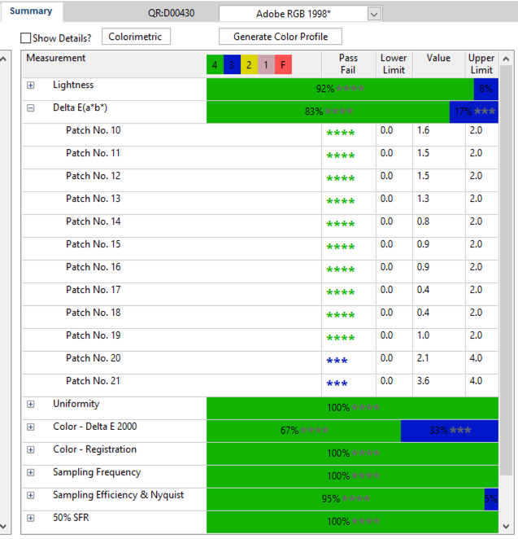
Image analysis workflow
Identify scanned target
Verify Regions
of metrics
Analyze and report

Slide 23
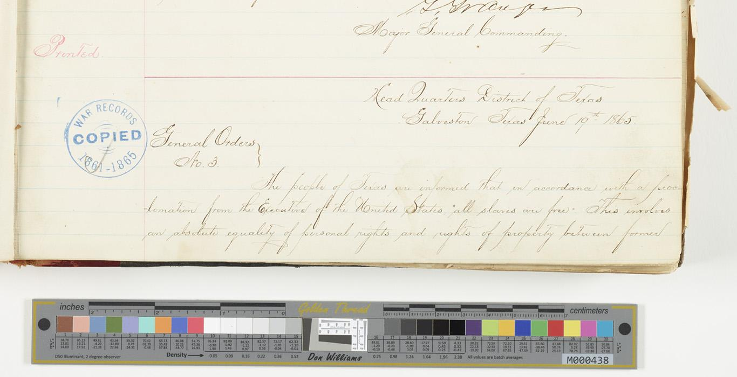
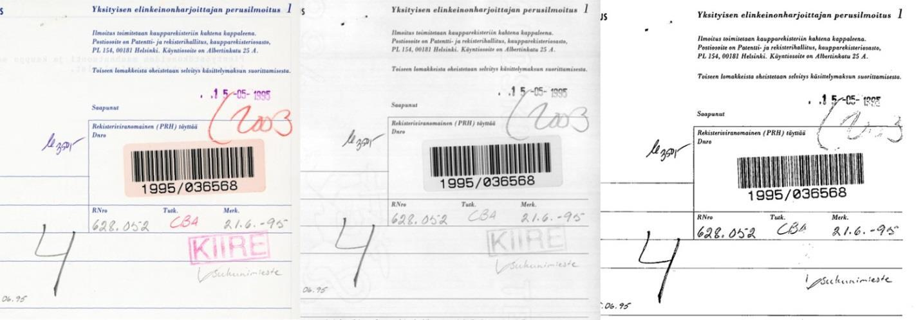
Why do we need standards?
Color Grayscale Bi-tonal (Black and White)
General Order #3 (Juneteenth) NAID: 182778372
Accurately capture information in the source record
(Color, tone, resolution, legibility, free from defects)
Provides objective, repeatable, and measurable requirements
Creates a common technical framework for capture, quality management, and preservation

Slide 24
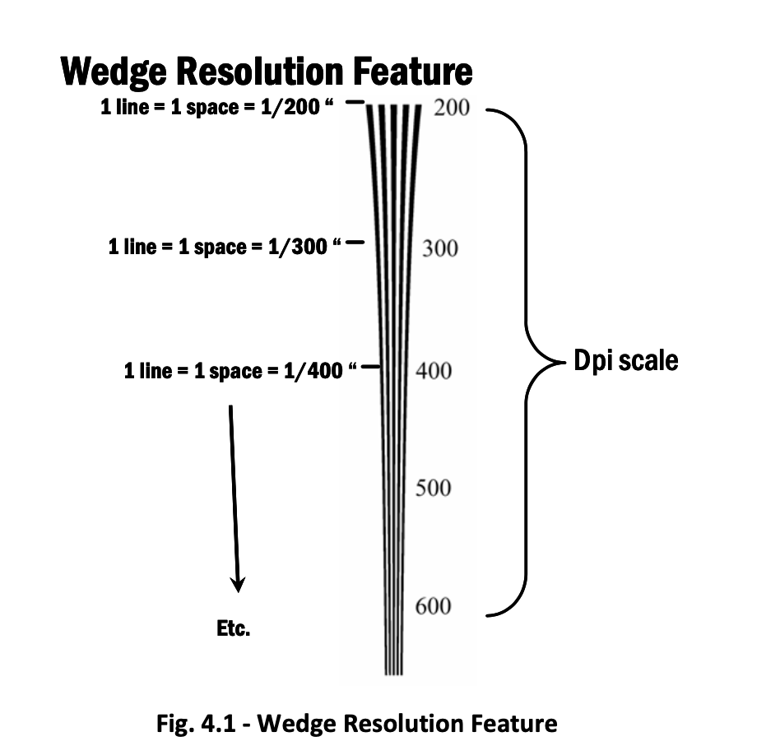

Image quality and dispelling the myth of dpi
Human vision varies by individual, is inaccurate, subjective
Image quality is a product of several image performance factors
Resolution: “the ability of an imaging system to resolve detail in the object that is being imaged”
It is not measured by “dpi”
Measured by MTF/SFR analysis
line pair subjective human interpretation
dpi “flute” target
subjective human interpretation
slant edge target objective machine sfr/mtf analysis

Slide 25
Validation vs Verification
"Are you building the right thing?"
Validation is the records management step where agencies review the project and affirm that the digital records comply with the standards in the regulations, and can be used for the same business purposes as the source records.
"Are you building it right?"
Verification is the final step in the QM process that ensures that the products were created according to the specifications.

Slide 26
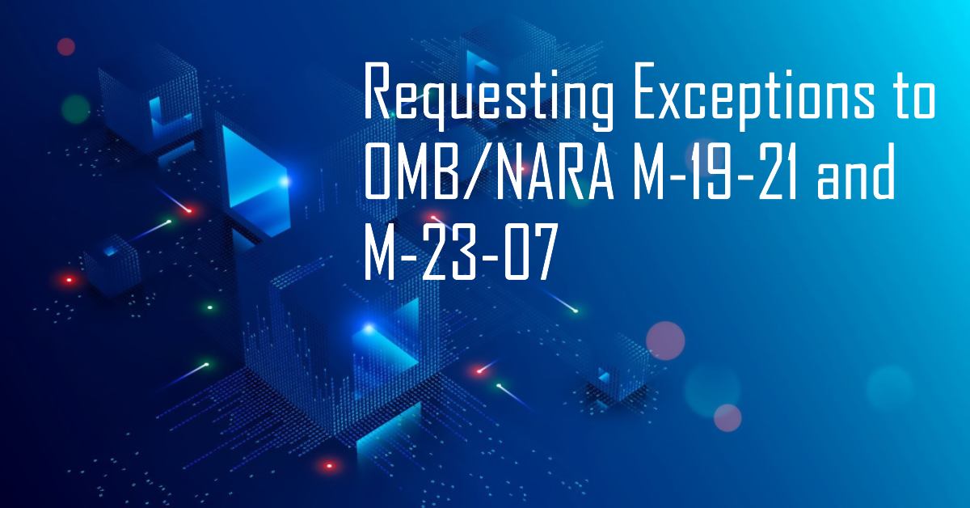

Slide 27
OMB/NARA M-19-21 and M-23-07
NARA Strategic Plan 2018-2022 (February 2018)
  3.2 By December 31, 2022, NARA will, to the fullest extent possible, no longer accept transfers of permanent or temporary records in analog formats and will accept records only in electronic format and with appropriate metadata.
M-19-21 Transition to Electronic Records (June 28, 2019)
  This memorandum specifically focuses on records management, and directs Federal agencies to transition recordkeeping to a fully electronic environment that complies with all records management laws and regulations.
M-27-03 Update to Transition to Electronic Records (December 23, 2022)
  This memorandum reinforces the requirements established in M-19-21, reaffirms the underlying goal of the transition to electronic records, and updates the previous target dates described in M-19-21.

Slide 28
Exceptions To-Date
First set of limited exceptions granted (2nd Quarter, FY 23)
Second set of limited exceptions granted (3rd Quarter, FY 23)
Third set of limited exceptions granted (4th quarter, FY 23

Slide 29
NARA Bulletin 2020-01, Guidance on OMB/NARA Memorandum Transition to Electronic Records
Common questions and provides clarification to OMB/NARA Memorandum, Transition to Electronic Records (M-19-21)
Item 14 is important for agencies working to develop requests
  14. How should we develop our exception request?

Slide 30
Justifying Exception Requests
Agencies must develop a comprehensive business case for their plans to transition to electronic records and provide it to NARA. The business case covering all requested exceptions should address considerations related to the categories below, including but not limited to the following:
A plan for the prompt and orderly transition to full compliance with the requirements of M-19-21,
Detailed description of agency policies requiring analog recordkeeping,
Cubic footage of the records affected,
The NARA-approved records schedule, item number, and description. If the records are unscheduled, please include a description and proposed retention and disposition,
The cost of digitization services or reference services,
The cost of implementing electronic records management systems to support the goals of M-19-21,
Documentation describing the cost/benefit analysis of digitization,
Legal analysis describing statutory or regulatory barriers, and
Time estimates with supporting documentation for how long an exception would be needed.

Slide 31
Questions?

Slide 32
Thank You
rmstandards@nara.gov

