Slide 1
ARMA International Update
ARMA NOVA
May 20, 2025
PRESENTED BY:
Nathan Hughes, CEO
ARMA International

Slide 2
ARMA INTERNATIONAL
MISSION, VISION, VALUES
WELCOME
Vision: ARMA is the driving force in the promotion and advocacy of information management professionals.
Mission: ARMA International is committed to providing our community of members and information management professionals with industry best practices and opportunities for professional development, ongoing education, and networking.
Values: ARMA International is committed to finding innovative ways to provide our personal and professional communities with guidance, learning, development, and opportunity. We value the open exchange of ideas, good governance, free flow of information, and thought leadership by seeking diversity, inclusivity, and equity in all its forms.

Slide 3
ARMA Strategic Goals
Maintain stability within the organization
Pursue Beneficial Partnerships
Maintain a Sustainable Volunteer Structure
Maintain Financial Stability and Growth
Increase the Influence of the Organization in the Information Management Profession

Slide 4
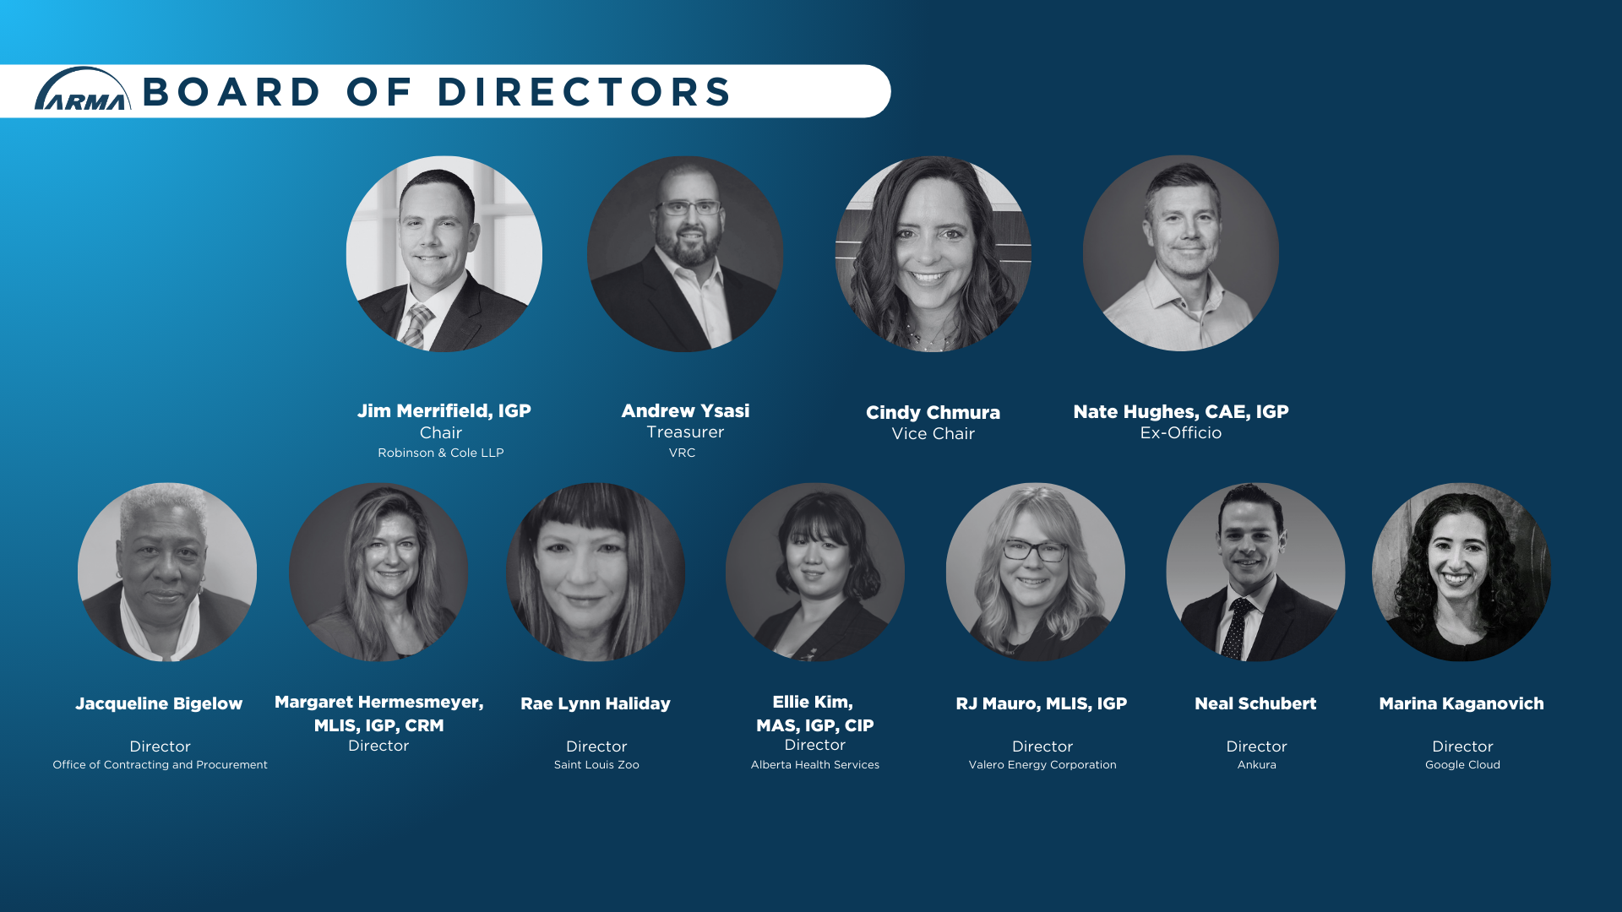

Slide 5
4,600+
Number of Members
700+
Members who Volunteer
80+
Number of Chapters

Slide 6
ARMA MEMBER BENEFITS
Community of over 4600 members internationally
Peer network of RIM/IG professionals
Online learning, monthly webinars, and in-person conferences
Certificate and Certification Programs
Career and job resources
myARMA Online Community
Discounts and resources with partner organizations
Volunteer and leadership opportunities
Discounts on education, certificate and certification programs

Slide 7
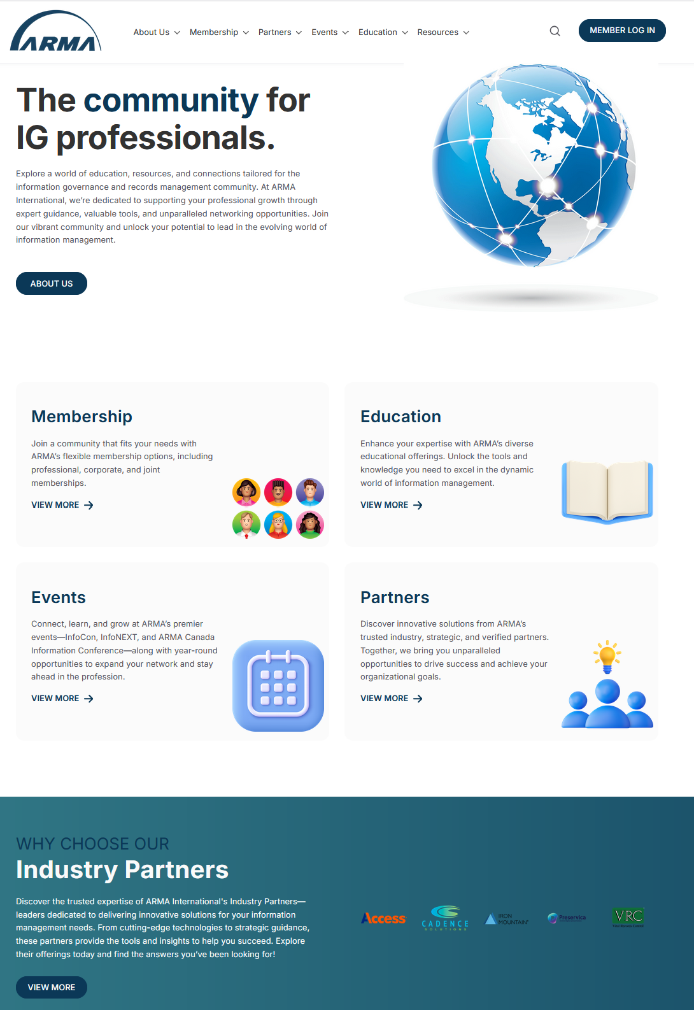
ARMA Website and System Updates
New website launched March 4, 2025
Easier access to information and resources
Robust capabilities for chapters
Better support for our members

Slide 8
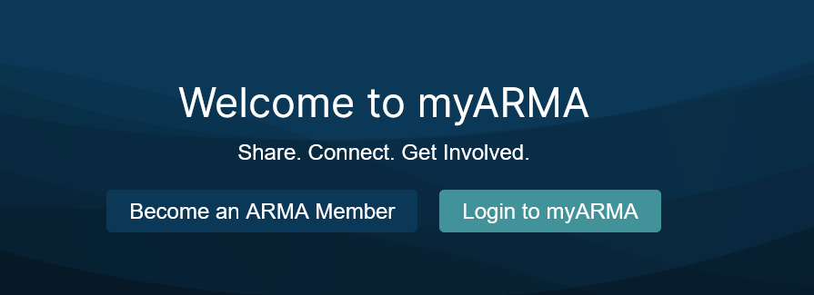
myARMA Community
Enhanced Resource for Members
  Easier access to resources, membership accounts, and connecting with other ARMA members
All members have access to:
  Special Interest and Industry Group Discussions
  Online Library for Resources
  Customizable notifications of group discussions
  Mentorship opportunities
  Connect directly with other members
  Blog Posts

Slide 9
ARMA Chapter Support
CAC (Chapter Advisory Committee)
Chapter Leadership Training
Standardized Materials
Bill Highway System
Board and HQ support

Slide 10
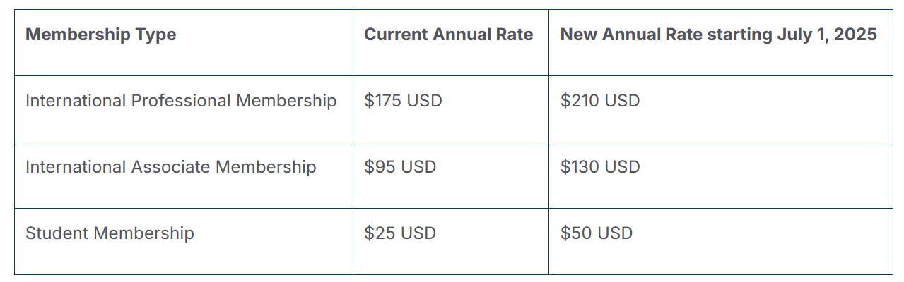
ARMA Membership Dues Increase
Dues Have Not Increased In 18 Years
Effective July 1, 2025
Incentive to Renew Early
Continue Providing Highest Quality Resources, Events and Benefits To Our Members

Slide 11
ARMA EDUCATION BENEFITS
Value for Members
  Discounted pricing on education
  Members-Only resources and webinars
  Coming: Job Aids and other collateral
Certification and ARMA Designations
  IGP Exam update launched July 2022
    Integrates the updated IGIM Model
  Launched February 2023: Essentials of RIM Course Update
  NEW: Development of IGP exam prep pathways
  NEW: Integrated education pathways
International Thought Leadership
  White papers and publications from members for members
  Association international partnerships
  NEW: 2024 IG Maturity Index Survey Report

Slide 12
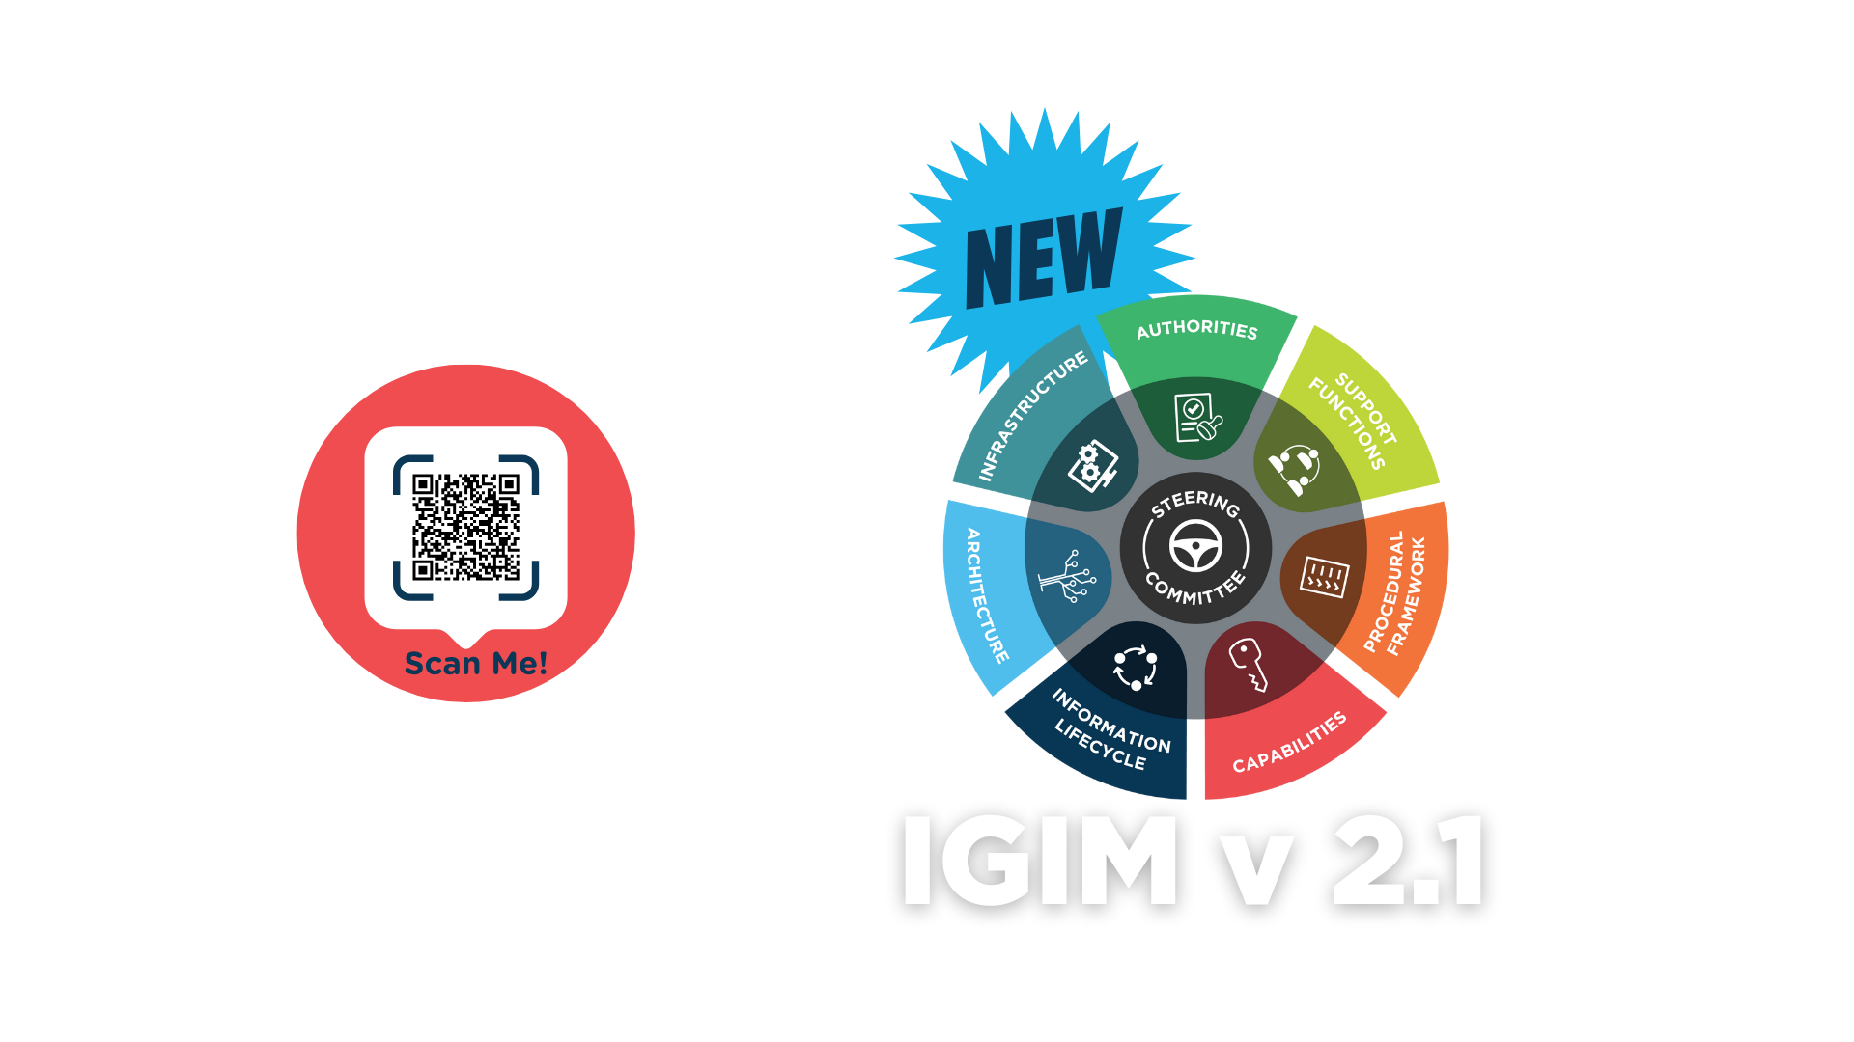
ARMA EDUCATION BENEFITS – cont.

Slide 13
ARMA PARTNERSHIPS
RIMPA GLOBAL (Records and Information Management Professionals Australasia)
  ARMA Professional Members can add a discounted RIMPA Membership at any time!
  RIMPA Membership benefits include:
    Discounted rates to events, workshops, vocational education and RIMPA Live Convention
    Complimentary registration to educational webinars
    Industry specific updates and job listings
    Discounted event registrations with aligned partners and external training partners
ICRM (Institute of Certified Records Managers)
  Joint Recognition Reception at InfoCon
  Endorsement of the Essentials of RIM Certificate Course
  Mutual recognition of complimentary certifications
ACEDS (Association of Certified E-Discovery Specialists)
  Discounts on ACEDS Professional and Government Memberships
  Additional discounts on designated ACEDS certificate and certification programs

Slide 14
ARMA PARTNERSHIPS – Cont.
ARA (Archives & Records Association UK & Ireland)
  Discounts on ARA Membership
CADENCE SOLUTIONS
  Discounted Microsoft Purview Training for ARMA Members
GLOBAL INFORMATION CONSORTIUM (GIC)

Slide 15
ADVISORY COUNCILS
HIGHER EDUCATION
  Comprised of
  Recommendations For Integrations With Higher Ed
FEDERAL GOVERNMENT
  Guiding ARMA to Better Support the Sector
  Consulting on Responses to Legislation
  Federal IG Summit
BUSINESS PARTNER

Slide 16

AIEF (ARMA INTERNATIONAL EDUCATIONAL FOUNDATION

Slide 17
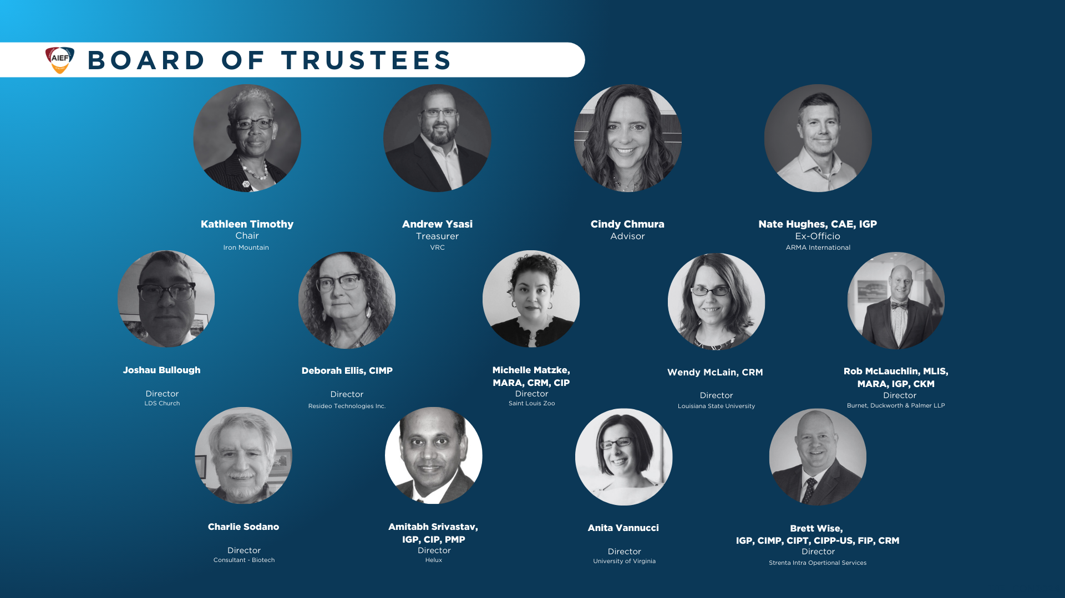

Slide 18
AIEF (ARMA INTERNATIONAL EDUCATIONAL FOUNDATION
Higher Ed and Continuing Education Scholarships
Professional Development Scholarships
Certification Scholarships
Research Support

Slide 19
Coming up in 2025
ARMA CONFERENCES
InfoCon 2025
October 20-22, Phoenix, AZ

Slide 20
VOLUNTEERING WITH ARMA
ARMA Professional Members have volunteer leadership opportunities within the organization and the opportunity to shape the future of the organization and industry.
  Board positions – Local Chapter or ARMA International
  Mentorship – Mentor Match program
  Contributor – articles, whitepapers, webinars
  Committees:
Awards Committee
Chapter Advisory Committee
Content & Standards Development Committee
Financial Planning Committee
Certification Oversight Committee
Conference Education Committee
Elections Committee
New Member Welcome Committee

Slide 21


Slide 22
Questions?
THANK YOU!
ARMAservice@armaintl.org

