Slide 1


Welcome to our May Webinar
ARMA NOVA Goals:
  Increase chapter membership and participation
  Provide opportunities for Learning, Networking and Educational Credits
Events and new meeting formats – Webinars and virtual events
  Easier to network and gain information to advance information governance programs and career
  Staying safe with remote meetings!
Continued partnership with ARMA Metro MD, AIIM and others
Welcome to the 2021 ARMA NOVA Board (https://arma-nova.org)
  President: Dan Beard
  Vice President: Richard Hogg
  Secretary: Jack McFarlane
  Treasurer: Mary Beth Weaver
  Education Director: Elizabeth Adkins
  Director at Large: Liane Cooper
  Membership Director: Elisabeth Butler
Notes:
Dan

Slide 2

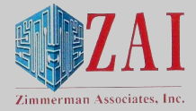







We greatly appreciate the support of our sponsors in making our educational programs possible
PLATINUM
GOLD
SILVER

Slide 3
ARMA NOVA
Upcoming Events
Dan Beard, Chapter President
June 16th – “3 Apples – The History and Future of Privacy”
Speaker: Trevor Hughes, President & CEO, IAPP
Join us on the Board for next year! We are losing a Board Member and need you.
  Network with diverse group of Info Gov professionals
  Build resume with volunteer work and Board experience
  Meet our speakers and grow your skills
  Check out our website for upcoming events:
  ARMA NOVA - Programs (arma-nova.org)

Slide 4
Today’s Event
The Next Big Thing - "Small" Data
Speakers:
Dean Gonsowski, Esq., Chief Revenue Officer, ActiveNav
Matthew Krengel, Esq., Director of Information Governance & Retention Counseling, Cooley LLP

Slide 5
The Next Big Thing - "Small" Data
DATE
Wednesday, May 19th, 2021
Notes:
Dan
Welcome and Intro

Slide 6

Disclaimer
The opinions discussed in today’s presentation are those of the individual and do not represent the firms/companies/entities that they may be affiliated with.

Slide 7
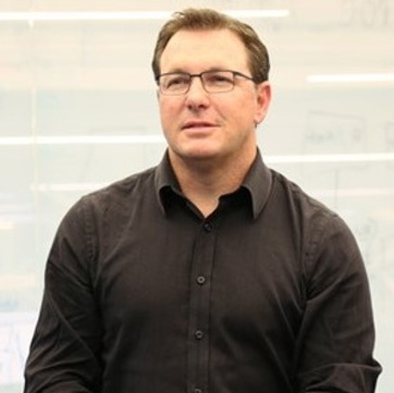


Meet Your Speakers
Dean Gonsowski, Esq.
Chief Revenue Officer
Matthew Krengel, Esq.
Director of Information Governance & Retention Counseling

Slide 8
Agenda
Breach Impact
Regulatory Landscape
Minimization by Design
File Analysis
Ephemeral Data
Takeaways

Slide 9
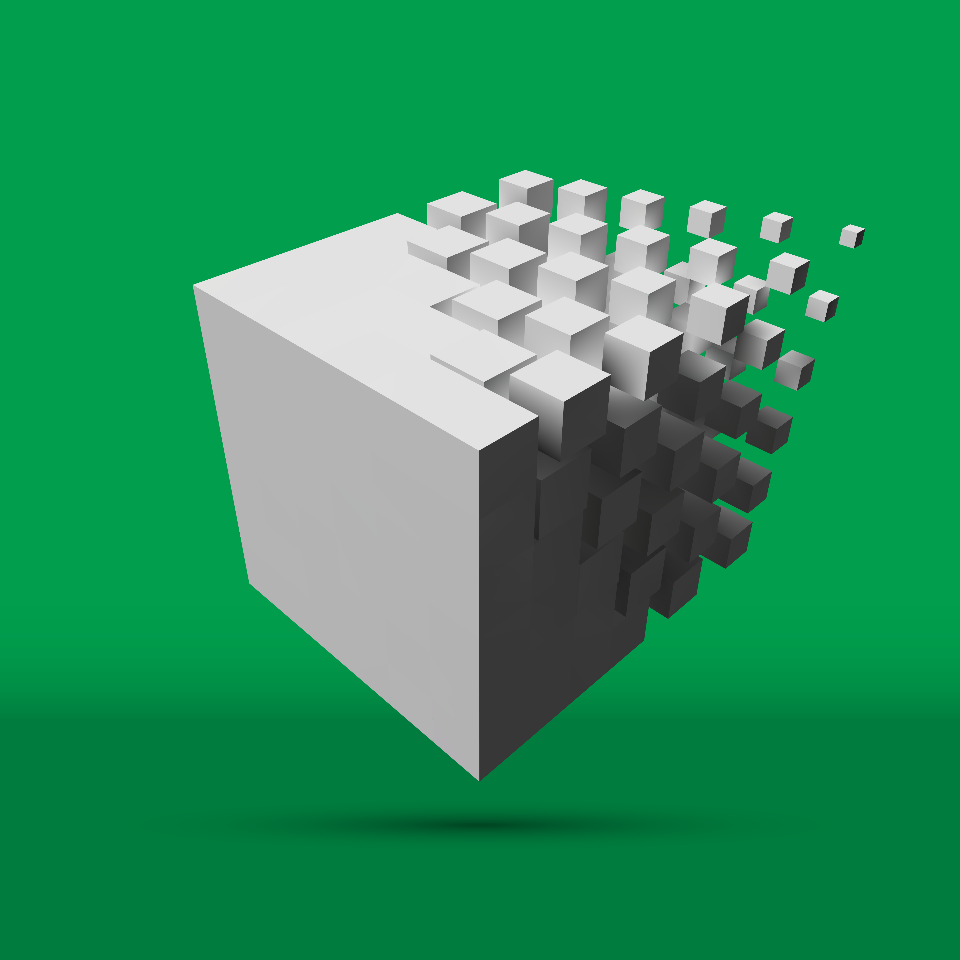
Is Bigger Better?
The terabyte age is quickly morphing into the petabyte age
Information utility is often being measured in hours and days instead of weeks and months
“Realized” value of information needs to be measured versus the perceived value of data
Notes:
Threats
“Data driven” organizations
Walmart only relies on the previous 4 weeks of data for its day-to-day merchandising strategies.

Slide 10

Three decades of innovation in the archiving, backup and recovery industry have made it nearly impossible to truly ‘forget’…”
Nader Henein
Gartner Analyst
Notes:
“Practical Privacy — Managing Data Retention and Backups”

Slide 11
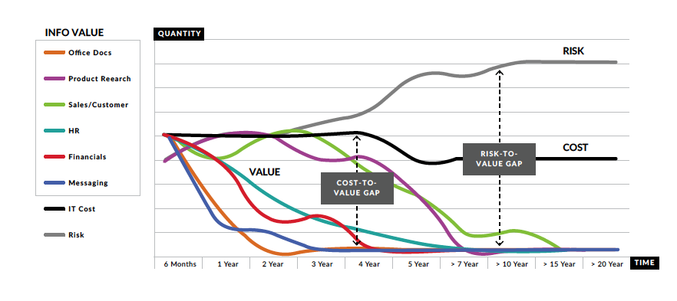
Value Decreases Over Time While Risk Increases
Source: CGOC (2018)
Notes:
https://www.prweb.com/releases/2017/01/prweb14007000.htm

Slide 12
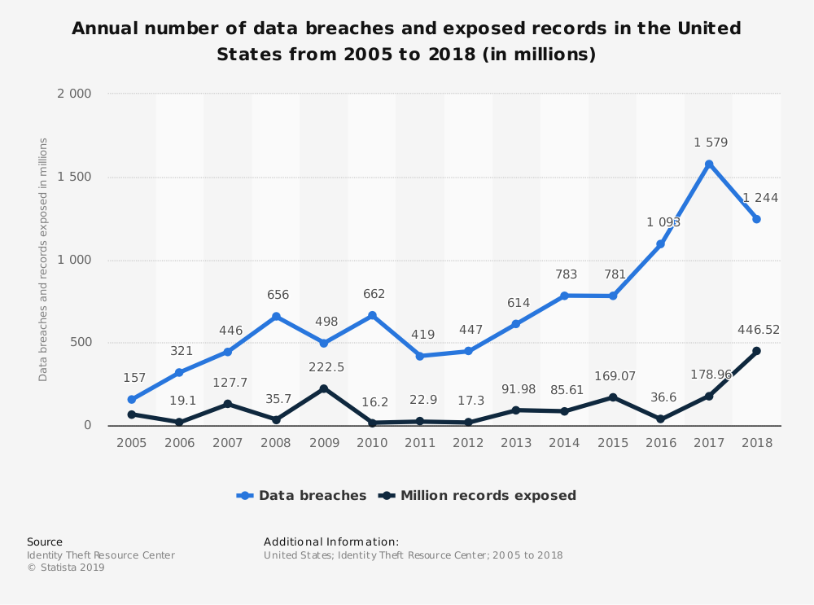
Threat of Data Breaches as a Motivator
The United States saw 1,244 data breaches in 2018 and had 446.5 million exposed records.
Source Identity Theft Resource Center

Slide 13

Breach Landscape
In 2020, it take an average of 280 days to contain a breach
The average cost for each stolen record containing sensitive and confidential information is $150
Breaches are getting more frequent and expensive
Source: Ponemon Institute – 2020 Cost of Data Breach Study
Notes:
https://www.ibm.com/security/digital-assets/cost-data-breach-report/#/

Slide 14
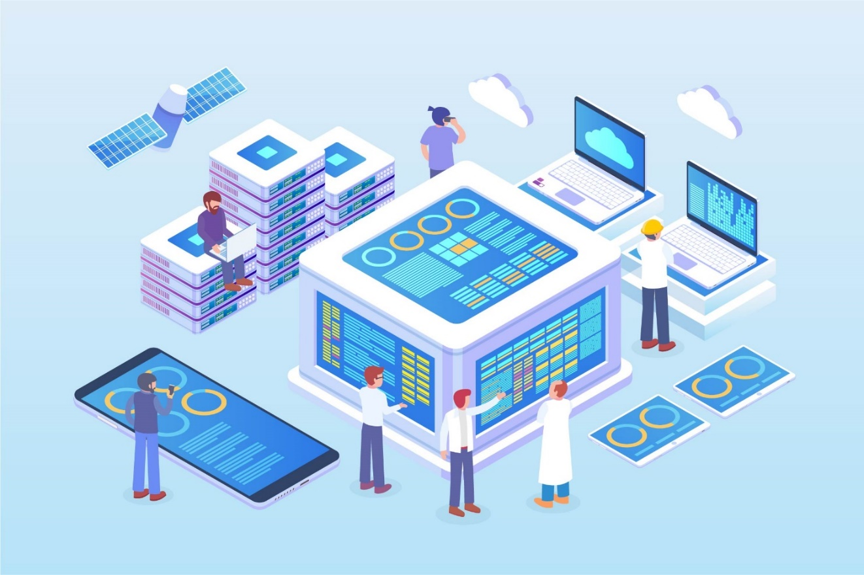
What is Data Minimization?
The concept that companies should limit the data they collect and retain to perform particular tasks and dispose of it once they no longer need it
Reducing the amount of data stored reduces the amount of data that can be misused or leaked
Source: FTC Staff Report, “Internet of things: Privacy & Security in a Connected World”

Slide 15

In 2019, it’s time to stand up for the right to privacy—yours, mine, all of ours. Consumers shouldn’t have to tolerate another year of companies irresponsibly amassing huge user profiles, data breaches that seem out of control and the vanishing ability to control our own digital lives.
That’s why I and others are calling on the U.S. Congress to pass comprehensive federal privacy legislation—… I laid out four principles that I believe should guide legislation:
First, the right to have personal data minimized…”
Tim Cook, CEO Apple
Notes:
“We must pass laws that require data minimization, ensuring companies do not keep sensitive data that they no longer need.” –Sen. Mark Warner D-Va, cofounder of the Cybersecurity Caucus (12/6/18)
A recent study by the International Association of Privacy Professionals (IAPP) found that over 75% of IT/infosecurity professionals ranked data minimization and data inventory/mapping as the most important privacy functions in mitigating the risk of a data breach.

Slide 16

California Privacy Rights Act Requirements (CPRA)
The CPRA mandates that personal information should be collected “only to the extent that it is relevant and limited to what is necessary in relation to the purposes for which it is being collected, used and shared.” CPRA §3B(3)
Source: https://www.natlawreview.com/article/businesses-should-begin-assessing-their-data-practices-order-to-meet-california
Notes:
The “collection, use, retention and sharing” of personal information shall be “reasonably necessary and proportionate” to achieve the business purpose for which the information was collected or processed, and not retained for longer than is reasonably necessary. CPRA §1798.100(c).[5]

Slide 17
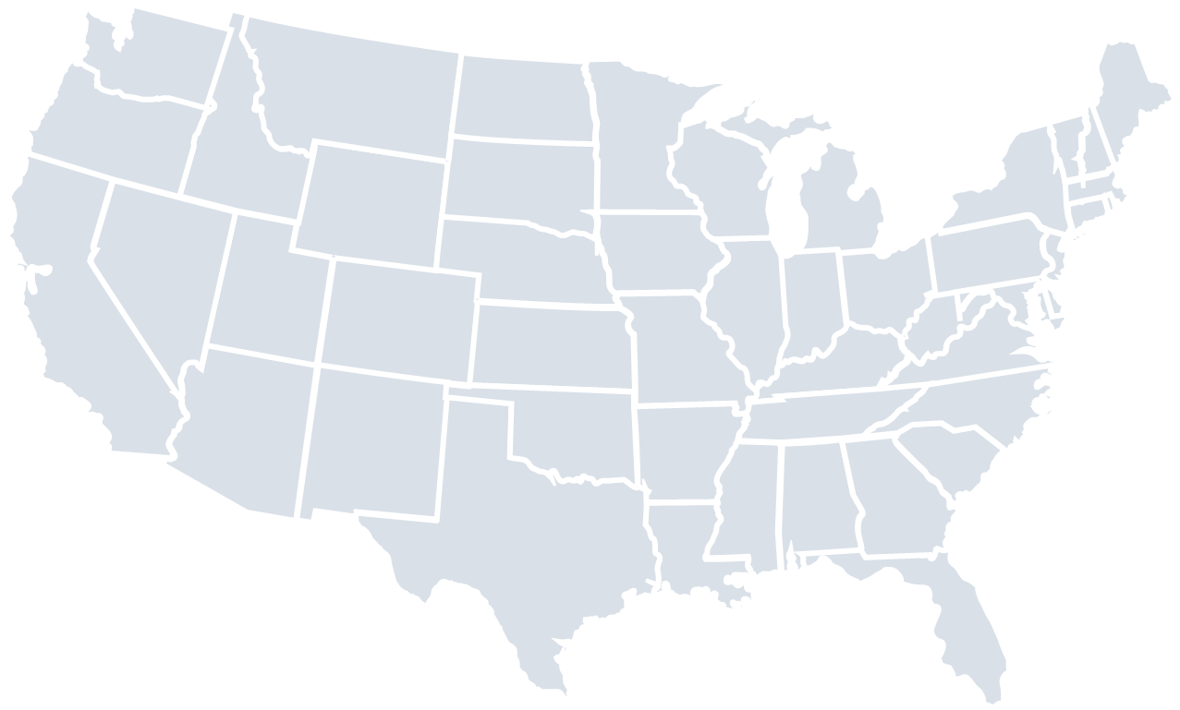
NY Cyber Regulations
Section 500.13 Limitations on Data Retention.
As part of its cybersecurity program, each Covered Entity shall include policies and procedures for the secure disposal on a periodic basis of any Nonpublic Information
. . . that is no longer necessary for business operations or for other legitimate business purposes of the Covered Entity, except where such information is otherwise required to be retained by law or regulation, or where targeted disposal is not reasonably feasible due to the manner in which the information is maintained.
New York
Source: https://www.dfs.ny.gov/docs/legal/regulations/adoptions/dfsrf500txt.pdf

Slide 18
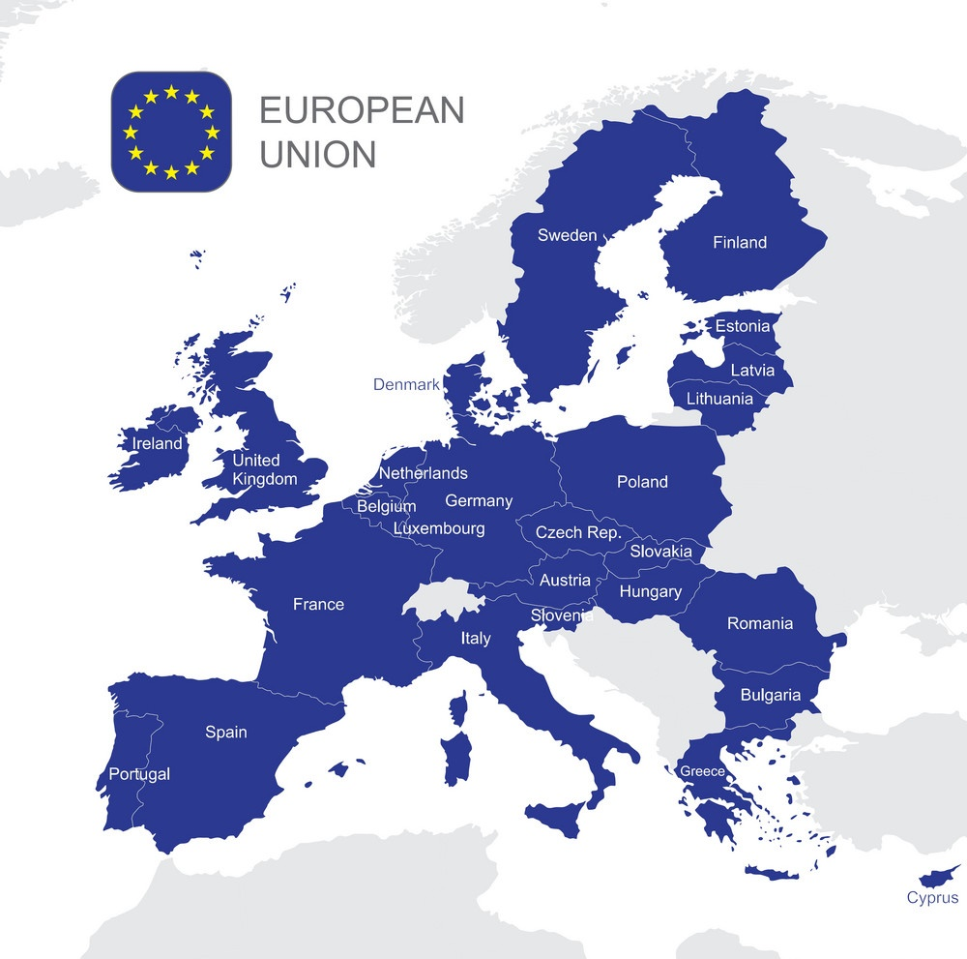
European Union’s GDPR
Article 5
1. Personal data shall be:
(c) adequate, relevant and limited to what is necessary in relation to the purposes for which they are processed (data minimisation)”
Source: https://gdpr-info.eu/art-5-gdpr/

Slide 19
A Data Estate
80%
33%
50%
33% of stale data stores haven’t been touched in three years or more
By 2022, 50% of organizations will include unstructured, semi-structured and structured data within the same governance program
Unstructured Data: 80% of the data footprint for an organization
Notes:
According to Gartner, unstructured data often accounts for nearly 80% of the data footprint for an organization
According to a recent study, 33% of stale data stores haven’t been touched in three years or more
By 2022, 50% of organizations will include unstructured, semi-structured and structured data within the same governance program, up from less than 10% today.

Slide 20

Data Risk Questions
What do we have?
Should we have it?
Who can get to it?
Should they be able to?
Should we delete it?

Slide 21

Data Minimization & Risk Management
The less personal information an organization collects and retains, the less information which is vulnerable to data security incidents
Reduced effort (and cost) required to safeguard personal information or respond to data security incidents
Dispose of or de-identify collected personal information when it is no longer required
Notes:
All organizations, private and public, need to balance the value of the data they hold, with the risks and costs involved of continuing storage.
It remains important to take a holistic (global, enterprise-wide) view towards Information Governance.

Slide 22
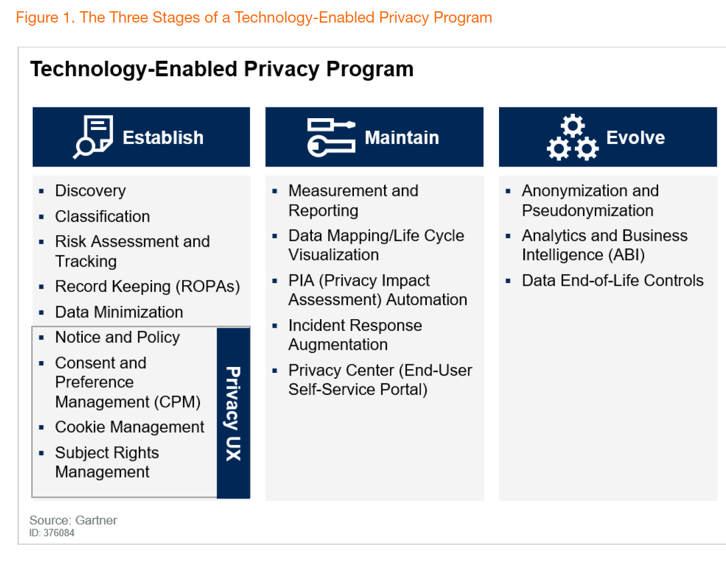
Data Minimization – Via Gartner
In the establish phase, data minimization focuses on deletion of large swathes of data that is no longer in use and that does not have any regulatory retention requirement…
--Gartner, The State of Privacy and Personal Data Protection (April, 2019)
…At later stages, this shifts to tokenization to reduce the privacy risk and maintain utility
--Gartner, The State of Privacy and Personal Data Protection (April, 2019)

Slide 23

Minimization by Design
Minimization concepts to be built in during the earliest phases of a data accumulation program
Consider why your organization might retain any category of content in the first place
The less information you collect – the less you have to store and manage

Slide 24
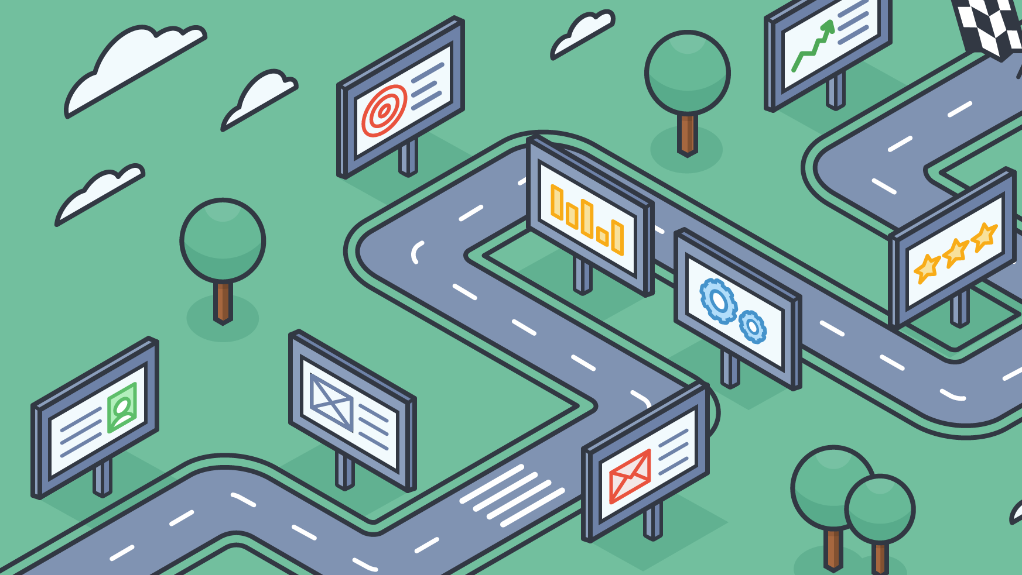
A Roadmap
Acquire data progressively, and only when genuinely needed
Clearly state your purpose
Give back
Minimum data, maximum utilization
Keep it simple

Slide 25
Why File Analysis?
Data discovery should be the first step in any data minimization project.
Data Discovery
Data Cleansing
Data Modeling
Metadata Tagging
Migration
Inventory content in target repositories:
File shares, SharePoint etc.
Identify & delete:
ROT
Duplicate
Sensitive
Develop rules for categorizing files into records schedules, knowledge sharing taxonomies, etc.
Develop metadata fields based on taxonomies and rules & auto-tag content
Migrate files with end repository metadata and structure
Notes:
Data Discovery, or content analysis as described by integro, should be the first step in any Information Governance focused project
Gives you the insight to your data so you can make policies around what you have not what you THINK you have
Gartner and other industry analysts regard this work flow as best practice for file analysis
This has long been the Active Navigation work flow
The cycle starts again with periodic monitoring of new and aged content

Slide 26
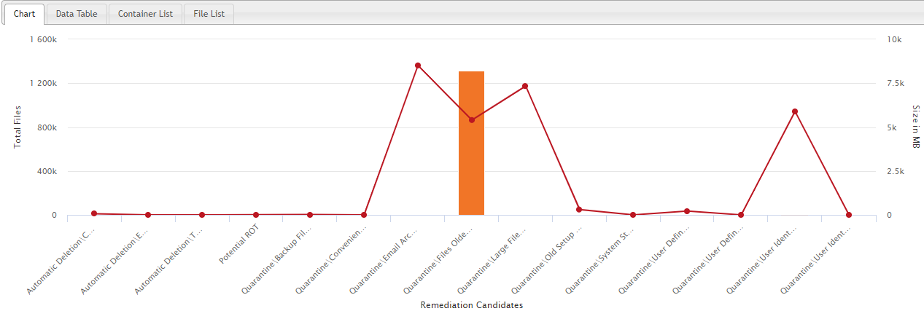
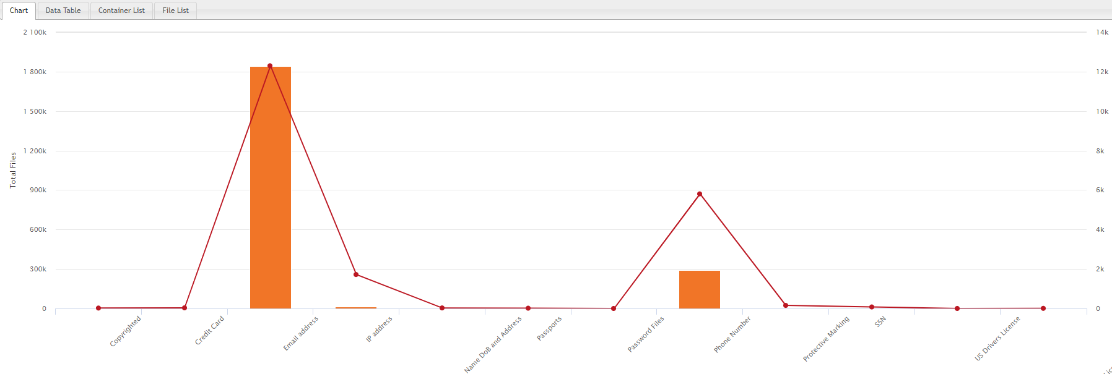
Data Inventory
  Understand what data you currently have, including Redundant, Obsolete and Trivial (ROT) data, which can be quarantined or deleted
  This mitigates the risk posed by storing unnecessary data

Slide 27
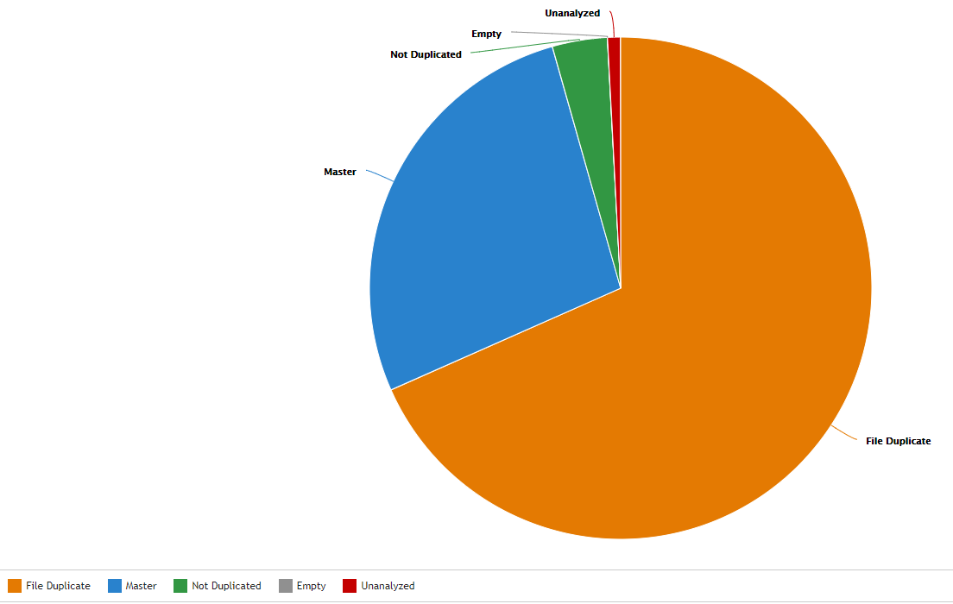
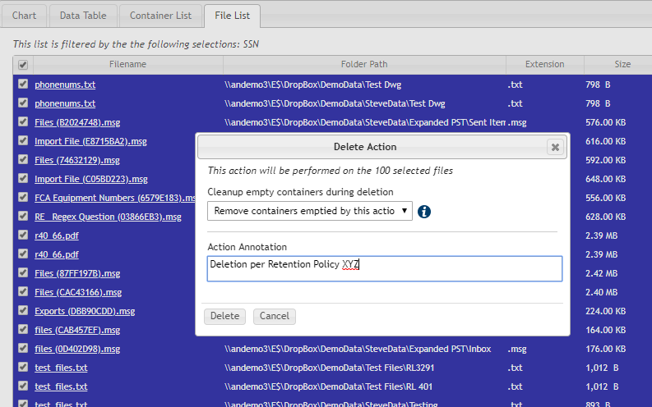
Data Cleaning
  Reduce your information estate by at least 40%, allowing for more targeted further discovery and classification thereafter.

Slide 28
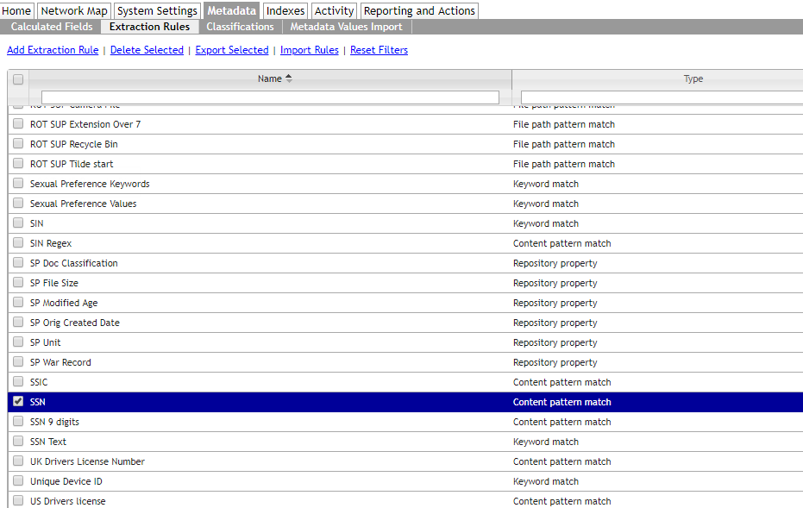
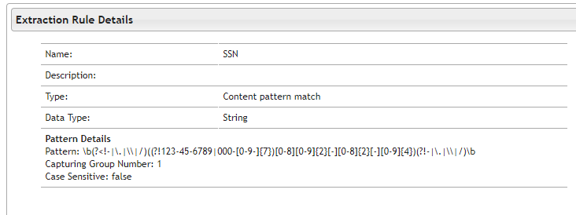
Maintain Compliance
  ActiveNav has automatic workflows which use different rules to capture personal data such as Name, Address and DoB and SSN rules to build out possible in-scope data that can be scanned for an individual’s data
  This helps to quickly fulfil consumer data access requests – reducing compliance liability

Slide 29

Conclusion: Strategies For Data Minimization
Minimization concepts to be built in during the earliest phases of a data accumulation program
Consider why your organization might retain any category of content in the first place
The less information you collect – the less you have to store and manage
Acquire data progressively, and only when genuinely needed
Minimum data, maximum utilization

Slide 30
Questions?
Dean Gonsowski, Esq.
Dean.Gonsowski@activenav.com
Matthew Krengel, Esq.
mkrengel@cooley.com

Slide 31


Enter Title of the Presentation Here
Enter subhead here
Thank you!
PRESENTER
Enter presenter’s name here
DATE
Enter date here
Notes:
Thank you!

Slide 32
Closing
Dan Beard, Chapter President
Reminder - materials will be shared on the chapter website
Coming Up!
June 16th – “3 Apples – The History and Future of Privacy”
Speaker: Trevor Hughes, President & CEO, IAPP
  Check out our website for upcoming events:
  ARMA NOVA - Programs (arma-nova.org)

