Slide 1
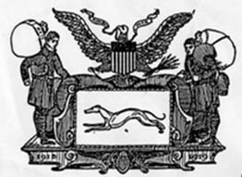

The Diplomatic Courier Service:
1918-2018
100 Years of Securely Transporting Vital Information

Slide 2
"Neither snow nor rain nor heat nor gloom of night stays these couriers from the swift completion of their appointed rounds“
Greek historian Herodotus describing the Persian mounted couriers
in the 5th century BC

Slide 3
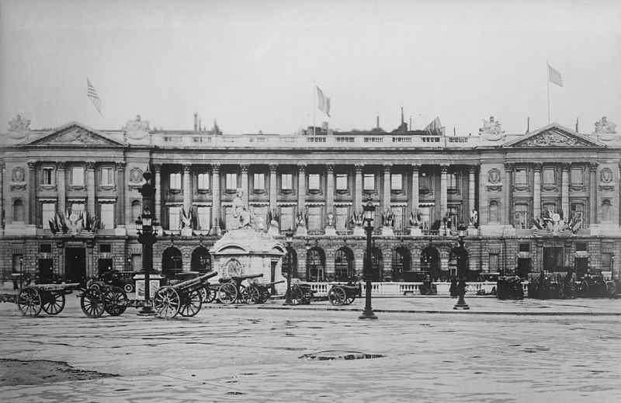
Hôtel de Crillon on the Place de la Concorde (Paris) during or just after World War I
Date: circa 1918-1919 Photo from US Library of Congress Prints & Photographs Division

Slide 4
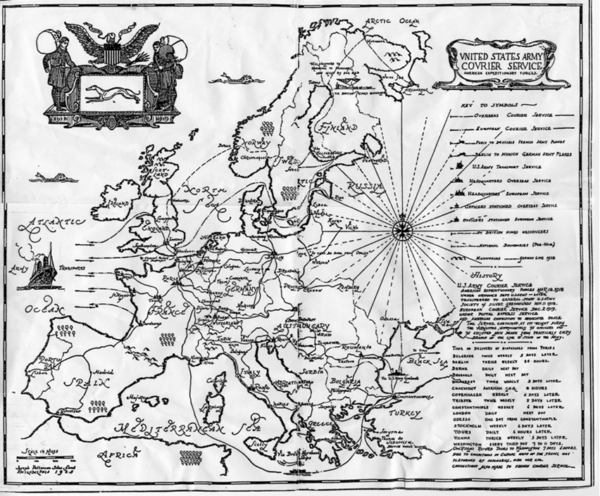

Slide 5
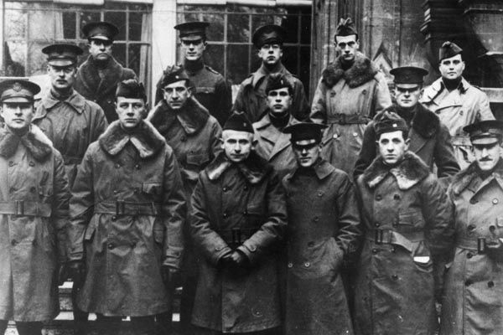
1918: Fifteen U.S. Army Officers assigned to the U.S. Embassy in Paris served as message couriers for U.S. Expeditionary Forces in France during the First World War, and afterwards for President Wilson and the U.S. delegation at the Versailles peace negotiations in 1919. As such, they were among the early forerunners of today's diplomatic couriers. (Source: Diplomatic Security Records)

Slide 6
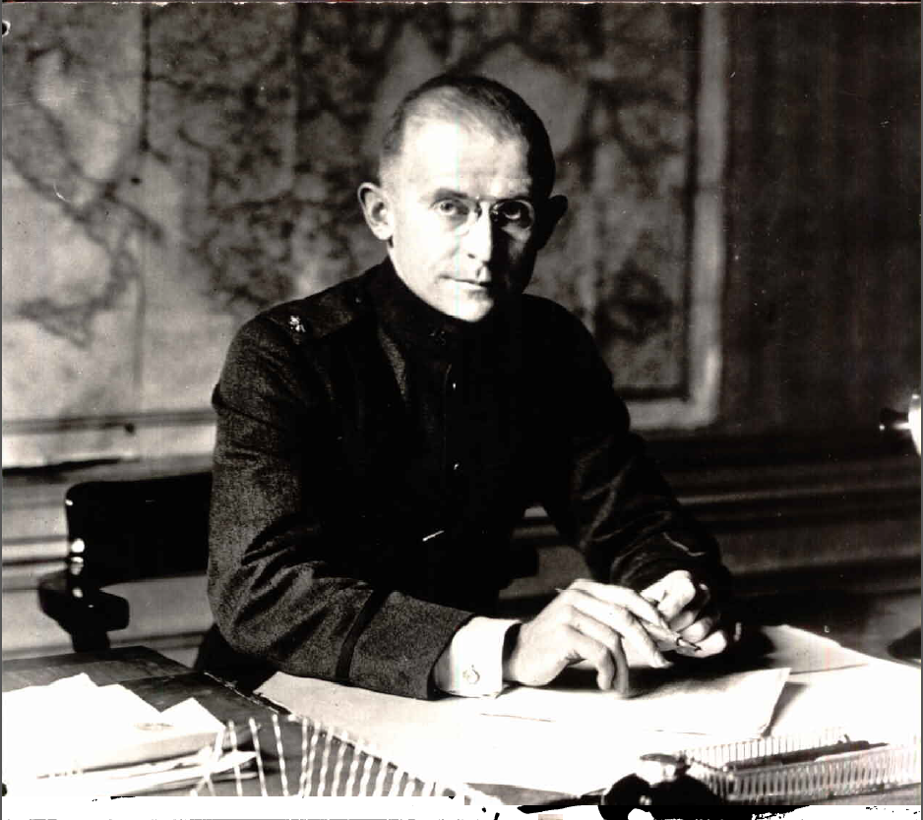
First Director of the Diplomatic Courier Service – Amos J. Peaslee
Firz

Slide 7
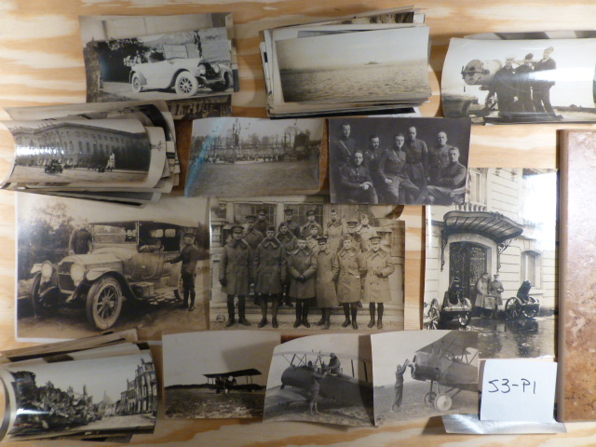
Courier Photos from 1918-1919

Slide 8
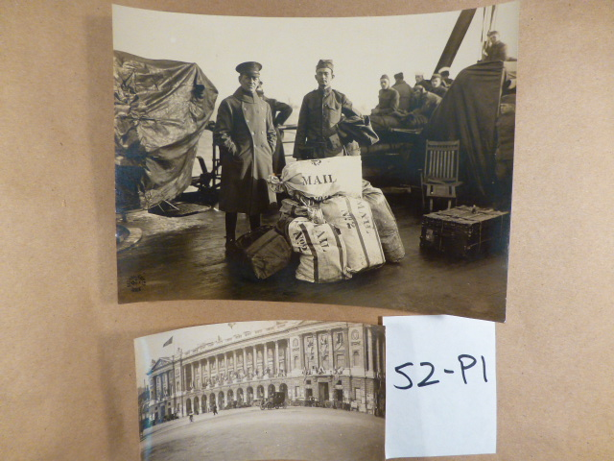
Silver Greyhound Couriers with Mail Bags
Silver Greyhound Headquarters in Paris

Slide 9
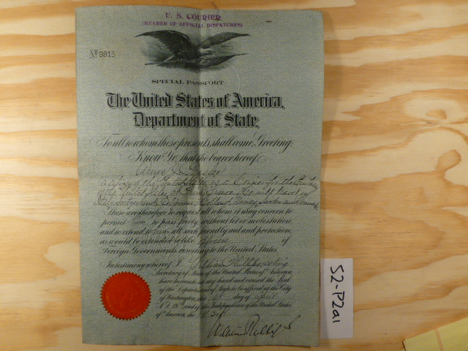
Bearer of Official Dispatches
Diplomatic Courier Passport of Amos J. Peaslee

Slide 10
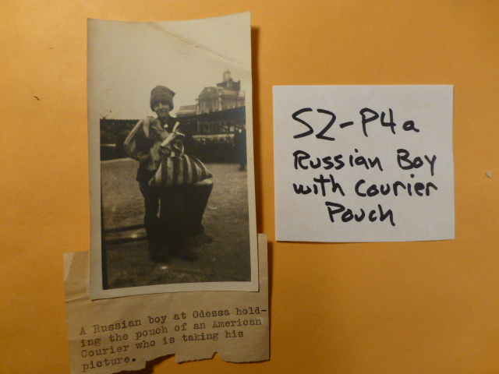

Slide 11
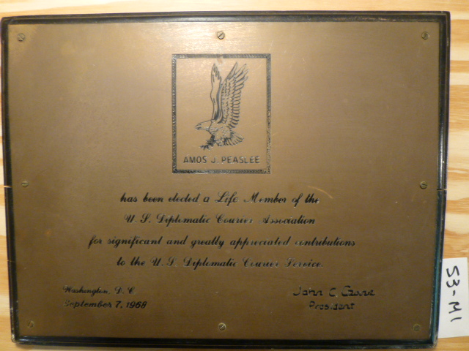

Slide 12
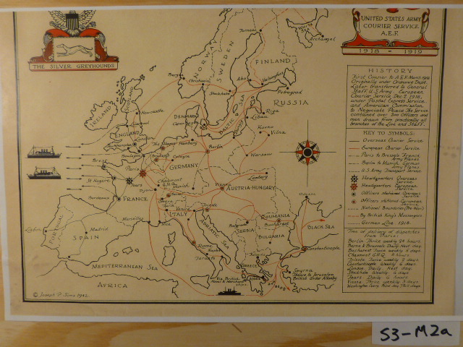

Slide 13
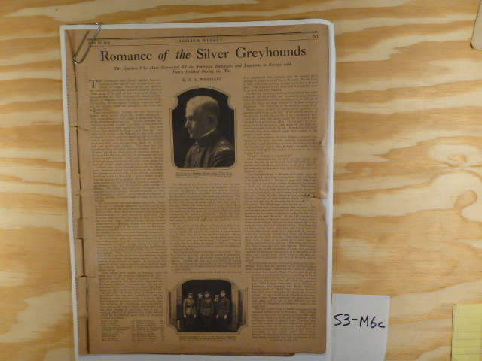
Newspaper article from April 1919, “Romance of the Silver Greyhounds”

Slide 14
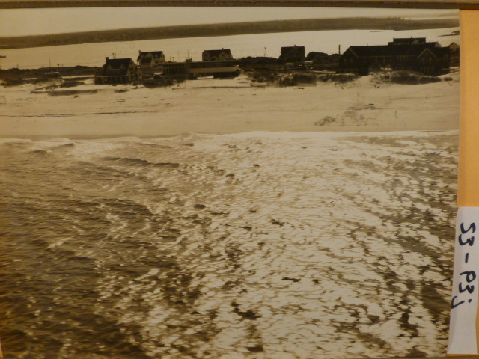
Photo of Peaslee Home on the Jersey Shore

Slide 15
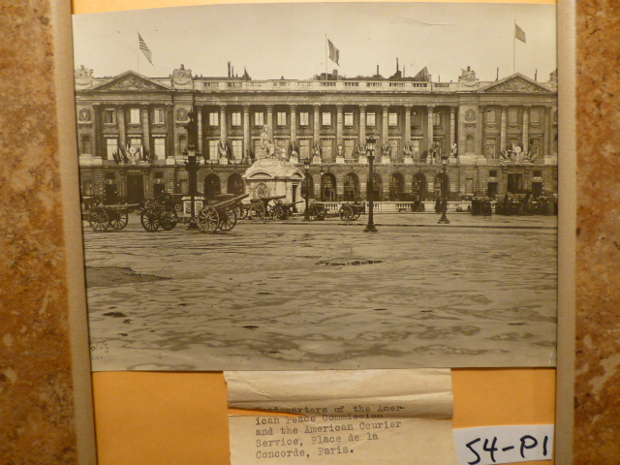
Headquarters of the American Peace Commission and the American Courier Service, Place de la Concorde, Paris

Slide 16
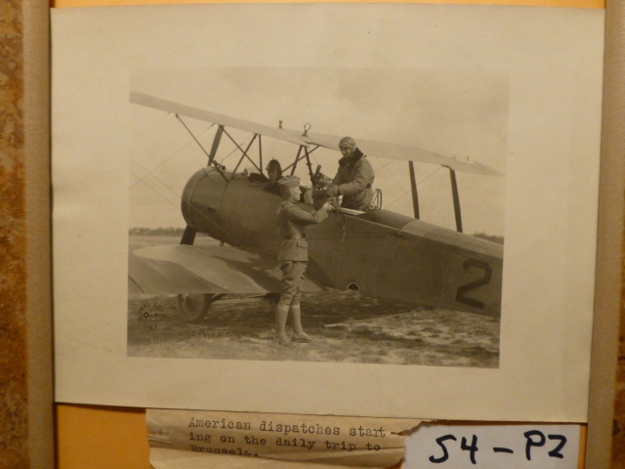

Slide 17
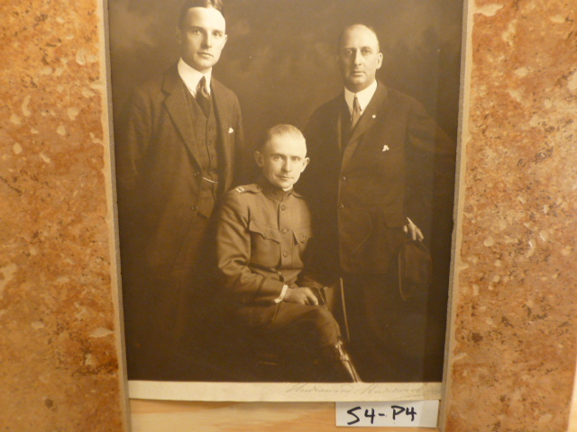
New York Election Commission in 1917 with Amos J Peaslee (center)

Slide 18
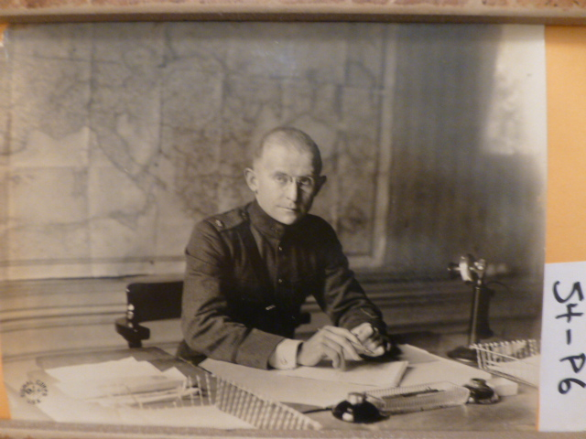

Slide 19
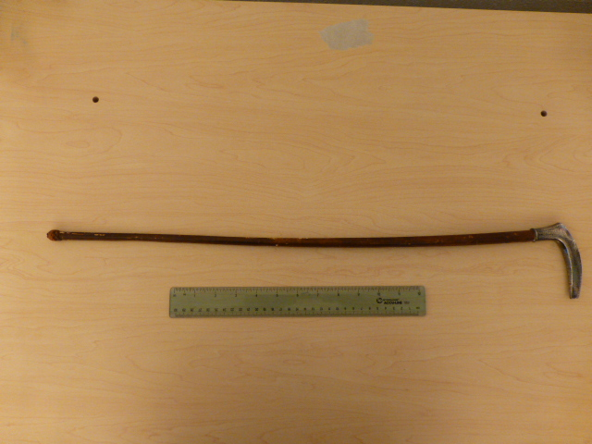

Slide 20
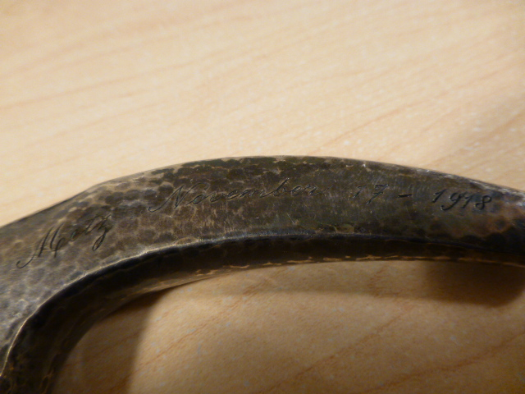

Slide 21
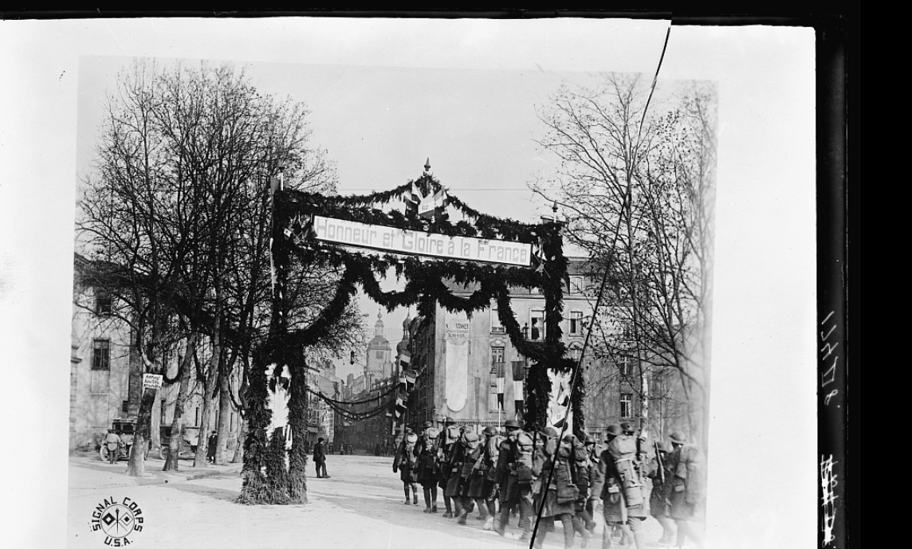
U.S. troops enter the City of Metz on Friday, November 23, 1918. This was six days after Peaslee entered the city
with the Silver Greyhounds. Photo: US Army Signal Corps

Slide 22
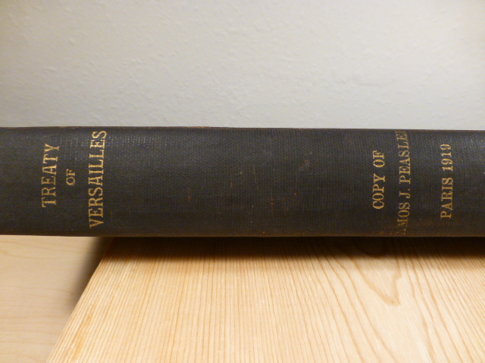

Slide 23
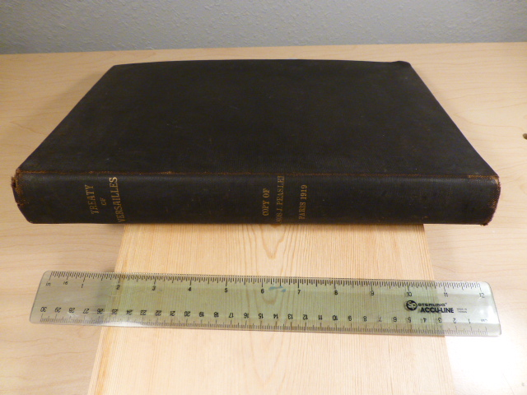

Slide 24
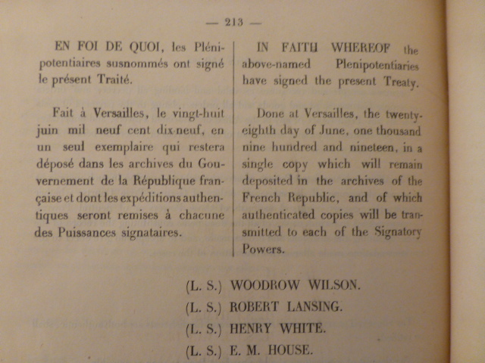

Slide 25
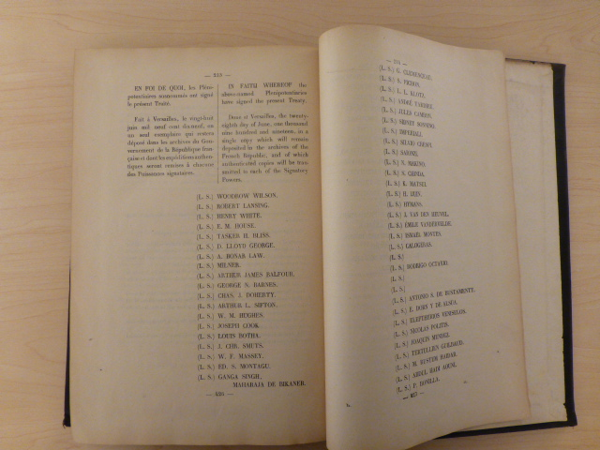

Slide 26
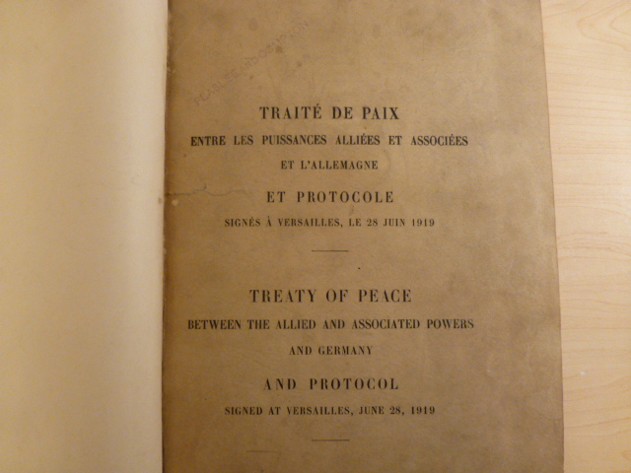

Slide 27
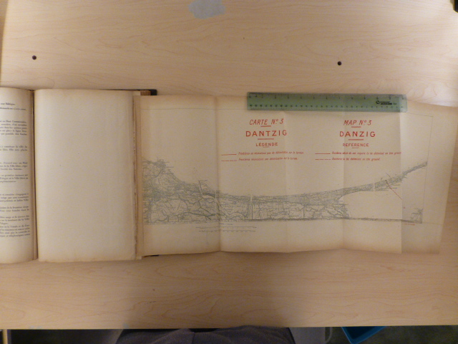

Slide 28
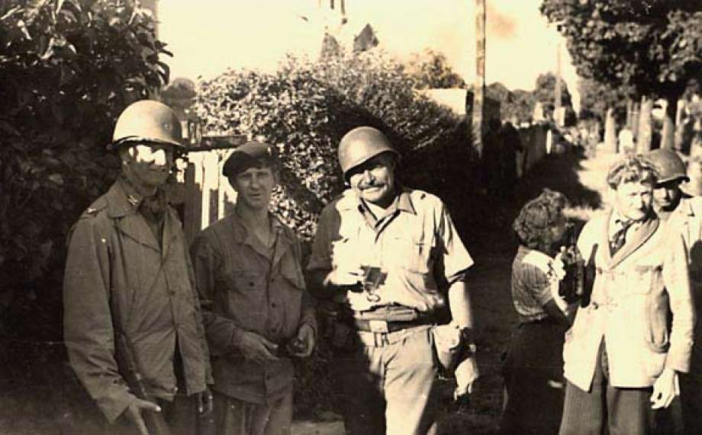
Rambouillet, France – August 1944
Former Diplomatic Courier and Commander of the Office of Strategic Services (OSS) in Europe Colonel David Bruce (far left), with War Correspondent Ernest Hemingway
(Photo: John F. Kennedy Presidential Library)

Slide 29
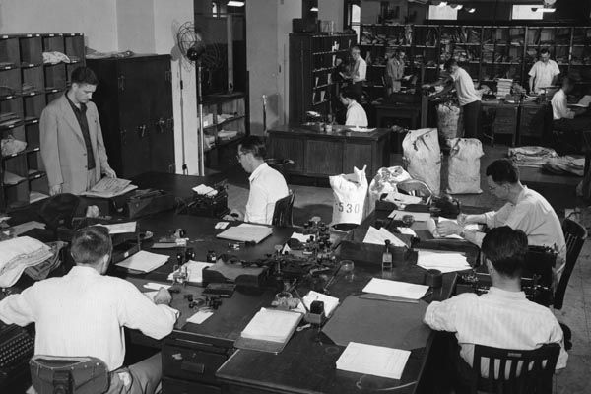
A Diplomatic Courier (left) waits in U.S. State Department mail room in 1948 as diplomatic pouch contents are sorted and logged. (U.S. Department of State photo)
U.S. Department of State / 1948

Slide 30
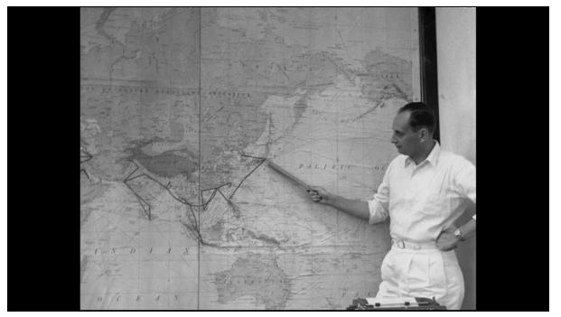
Map scene circa 1955 from documentary U.S. Diplomatic Couriers: Through the Khyber Pass.
https://history.state.gov/departmenthistory/diplomatic-couriers

Slide 31
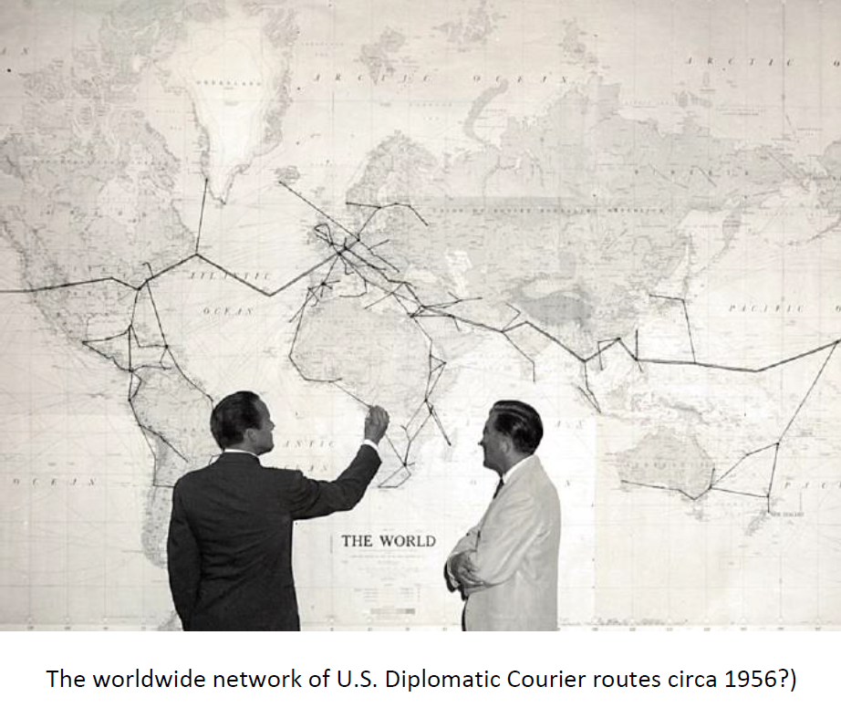

Slide 32
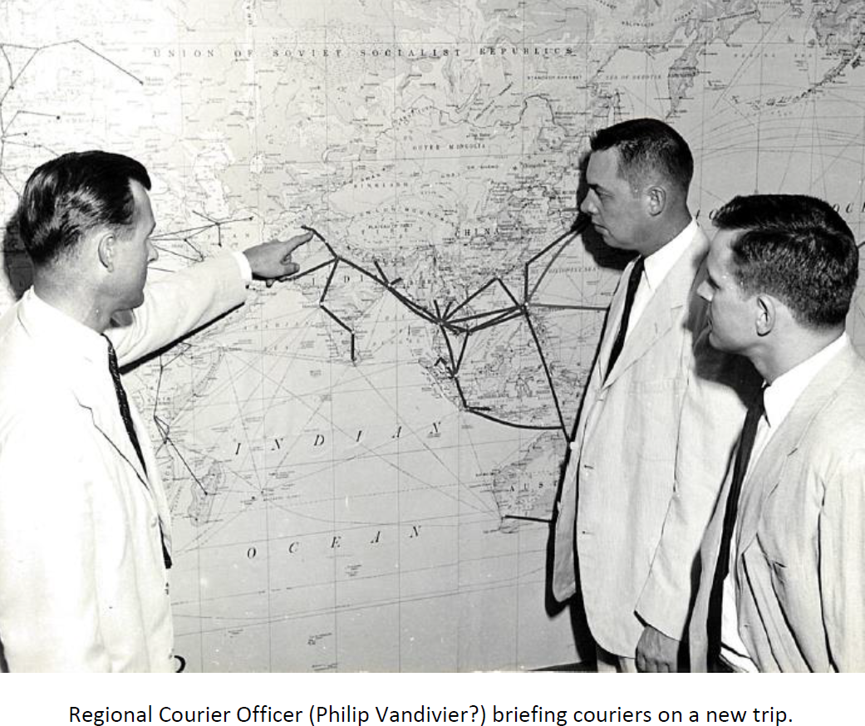

Slide 33
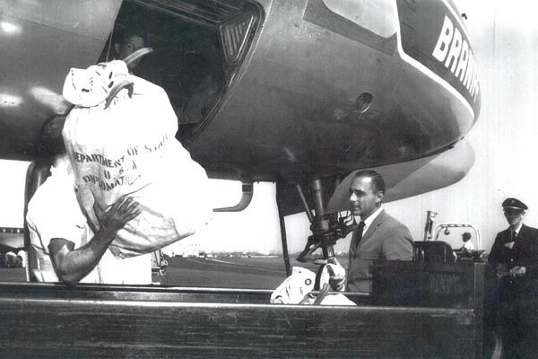
Circa 1950: Diplomatic Courier Vincent Cella carefully oversees the loading of diplomatic pouches aboard an international Braniff Airlines flight. (U.S. Department of State photo)
U.S. Department of State / 1950

Slide 34
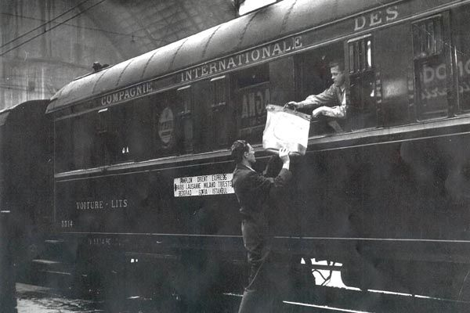
1957: Diplomatic Courier Bill Croasdale hands a diplomatic pouch through a window of the Orient Express to the U.S. Vice Consul Raymond Baine in Milan, Italy. (Source: U.S. Department of State)
U.S. Department of State / 1957

Slide 35
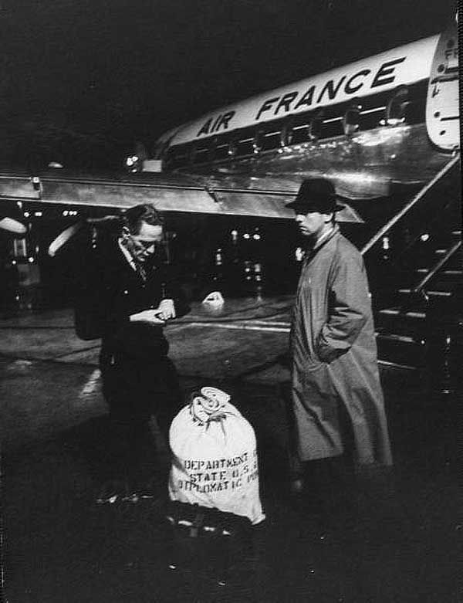
1957: A State Department diplomatic courier (right) delivers pouched items to a U.S. Embassy Paris officer on the airport tarmac in Paris. (Source: DS Records)
DS Records / 1957

Slide 36
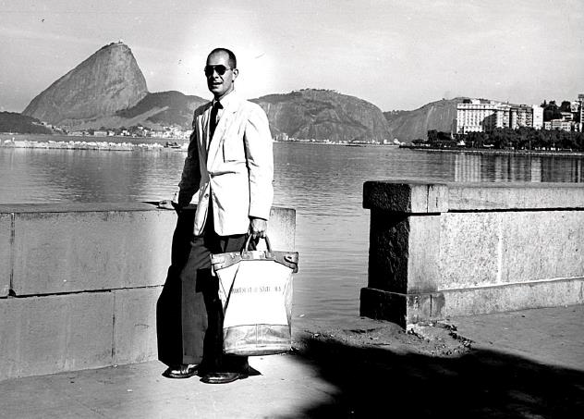
Diplomatic Courier John Silva in Rio

Slide 37
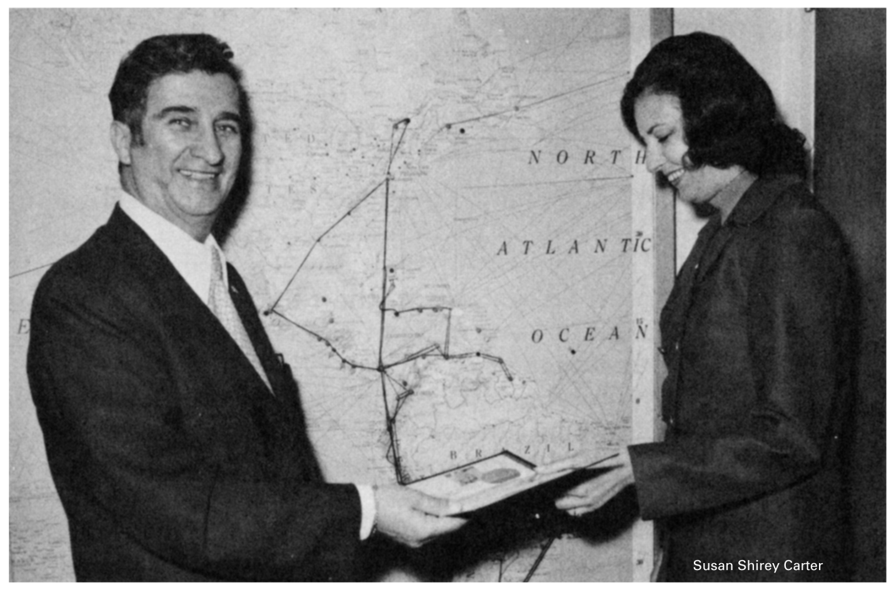
Susan Shirley Carter,
receiving her credentials
as the first female
Professional US Diplomatic Courier in April 1967 from
Joseph Sagona, Chief of the - Courier and Pouch Division.

Slide 38
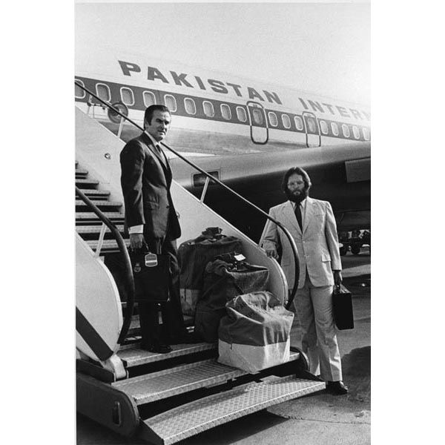
April 26, 1973: The first diplomatic couriers return to Beijing following a 23-year hiatus in U.S. diplomatic presence in China. They flew pouches in through Islamabad for the newly opened U.S. Interest Section in Beijing. (Source: DS Records)
DS Records / Apr 26, 1973

Slide 39
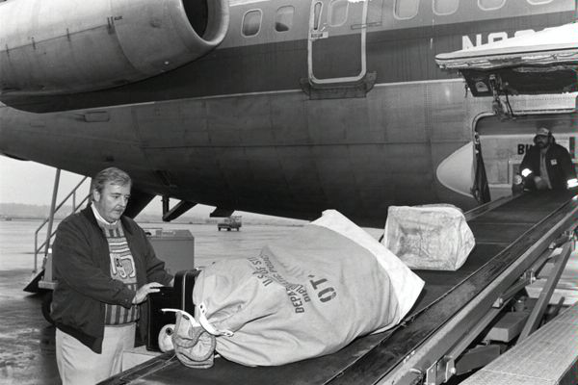
Circa 1985: A DS diplomatic courier loads pouches at a Washington, D.C. airport. Diplomatic couriers spend tens of thousands of hours annually delivering tens of millions of pounds of classified diplomatic pouch material by air, sea, and over land, including palletized equipment for new embassy construction. (Source: DS Records)
State Department Image / 1985 / Washington, D.C.

Slide 40
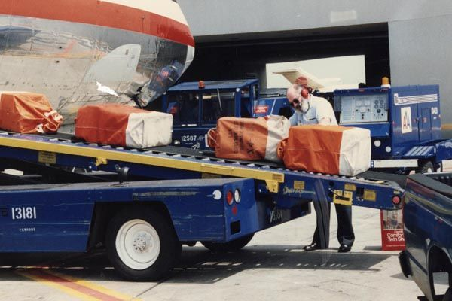
April 1991: A DS diplomatic courier loads pouches at Miami Airport. (Source: DS Records)
DS Records / Jan 01, 1910

Slide 41
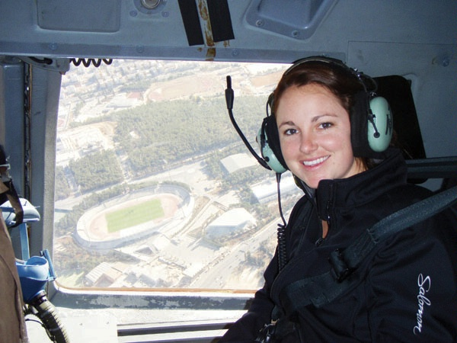
Diplomatic Courier of the Year for 2011 Shane Morris, the first woman to receive such recognition, aboard a U.S. Air Force plane over Cairo, Egypt, November 30, 2011. She was cited by the Bureau of Diplomatic Security for having "pioneered classified deliveries throughout the Middle East and Persian Gulf from Frankfurt during a period of historic unrest." (U.S. Department of State photo)
State Department Image / Nov 30, 2011 / Cairo, Egypt

Slide 42
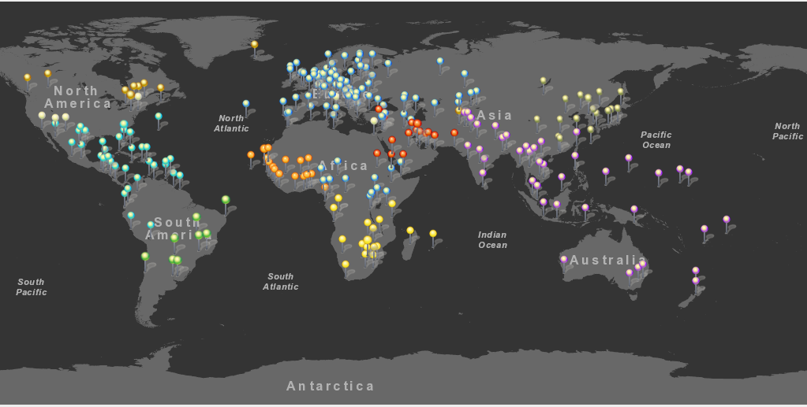
Today, the Diplomatic Courier Service provides service to over 250 embassies
and consulates around the world.

Slide 43
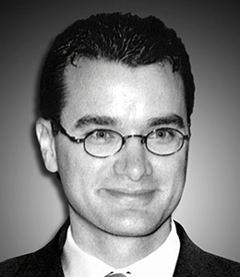
In Memoriam
Seth Foti
1969 – 2000
The last Diplomatic Courier killed in the line of duty.
Seth J. Foti, Diplomatic Courier, died on August 23, 2000, in Manama, Bahrain, in the line of duty. He was aboard Gulf Air Flight 72, which crashed during landing.

Slide 44
