Slide 1
Meeting the NARA Digital Mandate
Panel Discussion
April 18, 2018
Lisa Haralampus
Director, Records Management Policy and Outreach
Don Rosen
Director, Records Management Reporting and Oversight
Matthew Hebert
Senior Records and Information Management Specialist, DOJ

Slide 2
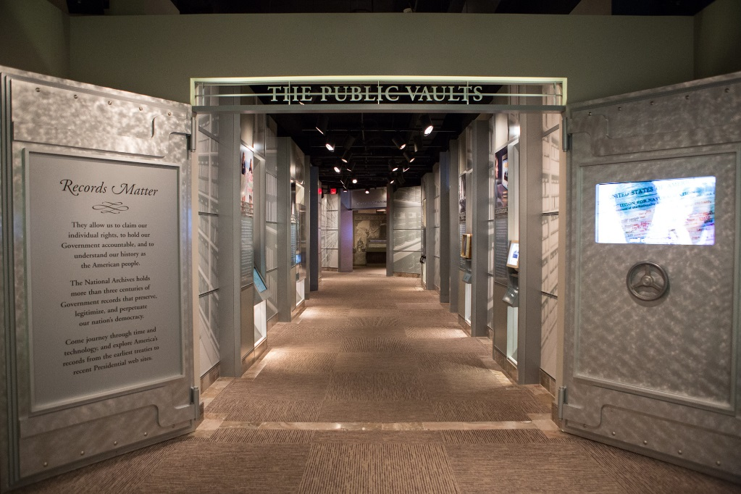
NARA’s Vision (or Challenge) Statement
Our Vision is to transform the American public's relationship with their government, with archives as a relevant and vital resource. This vision harnesses the opportunities to collaborate with other Federal agencies, the private sector, and the public to offer information—including records, data, and context—when, where, and how it is needed. We will lead the archival and information professions to ensure archives thrive in a digital world.
Office of Chief Records Officer
More Specific, More Tech Focused
Records Integral to Agency Mission
Effective Governance of Assets
Manage Electronically
Transparent to User
Notes:
At the agency level, the vision is about engagement and discovery – but also about living in a digital world.
The vision of my Office is also connected to the digital world, but is even more specific
We are technology focused
We see records as integral to each agency's mission
We promote the effective governance of information assets
We think records and information should be managed electronically with minimal end-user intervention,
where even 1 click is the kiss of death

Slide 3
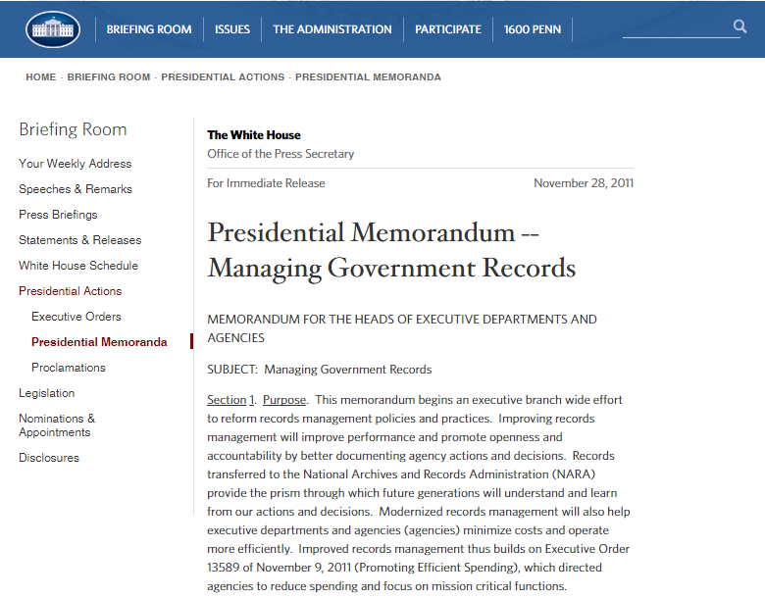
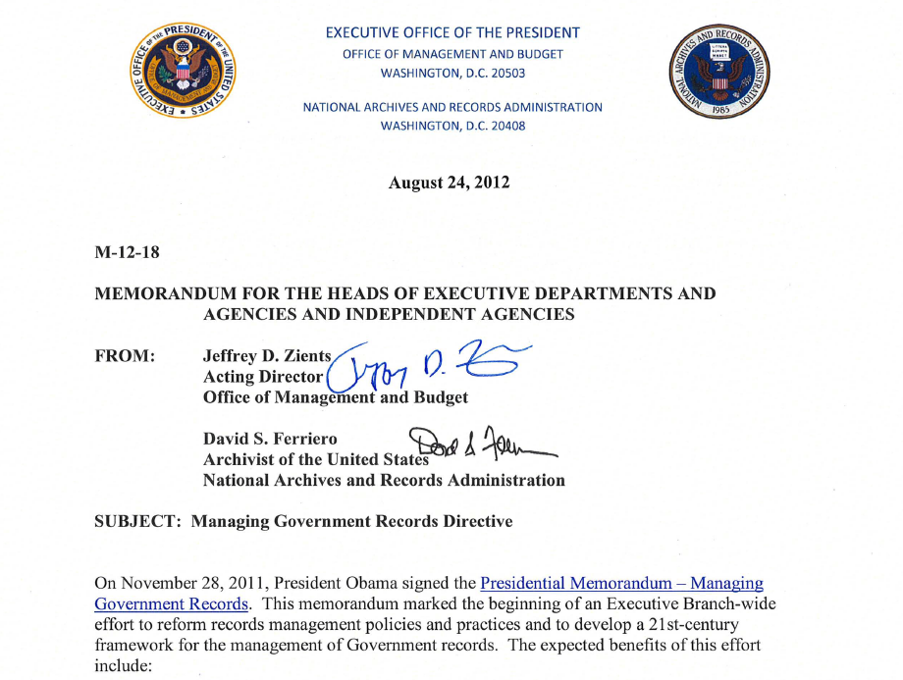
The Road Starts Here…
Presidential Memorandum
Managing Government Records Directive
NARA Strategic Plan 2018 - 2022
Notes:
Clear GOALS --- Focus on Email
The Presidential Memorandum – Managing Government Records was issued November 28, 2011. This was a once in a generation emphasis from the President of the United States in modernizing records management. The Memorandum acknowledged that “records management is the backbone of open government.” Part of the administrations focus on creating a more open government – and technology provides opportunities to do better than ever before
NARA, along with the Office of Management and Budget (part of the Executive Office of the President) issued the Managing Government Records Directive on August 24, 2012. The Directive describes a mix of strategic and technical tasks. Two primary targets are:
By 2016, agencies manage permanent and temporary email in accessible, electronic format
By 2019, agencies manage all permanent electronic records in electronic formats
One of the key additions of both the Memorandum and Directive was the creating the Senior Agency Official for Records Management community. The SAORM is a high-level official at each agency that has oversight of the records management budget and personnel that can advocate directly to each agency head.
Both of these documents have been major forces in driving progress in records management.

Slide 4

Transformational Targets
By 2016, agencies manage all email in an accessible, electronic format
By 2019, agencies manage all permanent electronic records in electronic formats
By 2022, NARA will no longer accept transfers of temporary or permanent records in non-electronic form.
Notes:
This is the Charles Dickens slide – if you think of these targets as ghosts of the past, present and future. In many ways they are haunting us all!
At the time these goals were communicated, they all seemed jarring in their aspirations – which is no less true than what we are hearing now about the new goal for 2022.
To my mind this new goal for 2022 is not revolutionary, but evolutionary. All three of these goals are complementary, mutually supporting, and lie on the same path that we embarked on back in 2011 when we recognized we needed to modernize recordkeeping across the Government

Slide 5
Advancing the Digital Government Agenda
Sets a clear marker for change
Expands the scope of what must be electronic
Meets customer expectations, promotes relevance of the National Archives
Begins to shift away from dual processes for analog and electronic
Forces us to explore innovative solutions and tools
Notes:
So let’s look a little closer -- Why is NARA’s new strategic plan important to reaching this goal?
Goes beyond email and born-digital permanent records
Requires us to rethink how we work and what we focus on

Slide 6
Roadblocks?
Legacy….addressing the old stuff
Cost….technology is not getting cheaper
Maturity….high demand for the right tools
Infrastructure….developing systems and processes
People….training workforce to thrive in new environment
Notes:
Challenges….generally, people process and technology – more on that later
A number of real issues here -- and this list is by no means exhaustive – to consider

Slide 7

The Road Forward
What does success look like for all of us?
Develop governance framework
Think systemically
Leverage agency leadership
Engage with private sector
Monitor environment and emerging technologies
Notes:
More broadly, here is where I would like to talk about approaches and strategies we should all be embracing if we are going to be successful transitioning to fully-electronic Government
First, from the same IMJ issue back in December, there was a short announcement that in the Australian State of Victoria, Sven Bluemmel, was appointed the first Information Commissioner. He said:
The creation of the new Commissioner is an excellent opportunity to bring together FOIA, privacy, and data protection under a single regulator.
A couple comments on this –
First, no mention of records, right? I believe this is more reflective of viewing records and information management at a higher level, where RM is a component of the larger information ecosystem. That said, I do not want to minimize the importance of records – they still have an important role for accountability and evidence.
Second, what I believe is relevant is that we work in organizations where there are interrelated and connected information disciplines that must be coordinated, whether centralized or not. This is where IG, and having a governance framework is critical.
Q – How many of you have read Peter Senge, Fifth Discipline?
The message is relevant – we live in a connected world and cannot work in isolation if we are going to succeed. We have to change our mental models, recognize that we work within a system, and focus on partnering and coalition building
Engagement is critical – senior leadership, other offices, private sector, and of course NARA, should all be on our radar
An effective IG framework views drivers and impacts from a people process and technology perspective – I talked about the people side of things, however, we need to also incorporate technology trends and process, how we work.

Slide 8
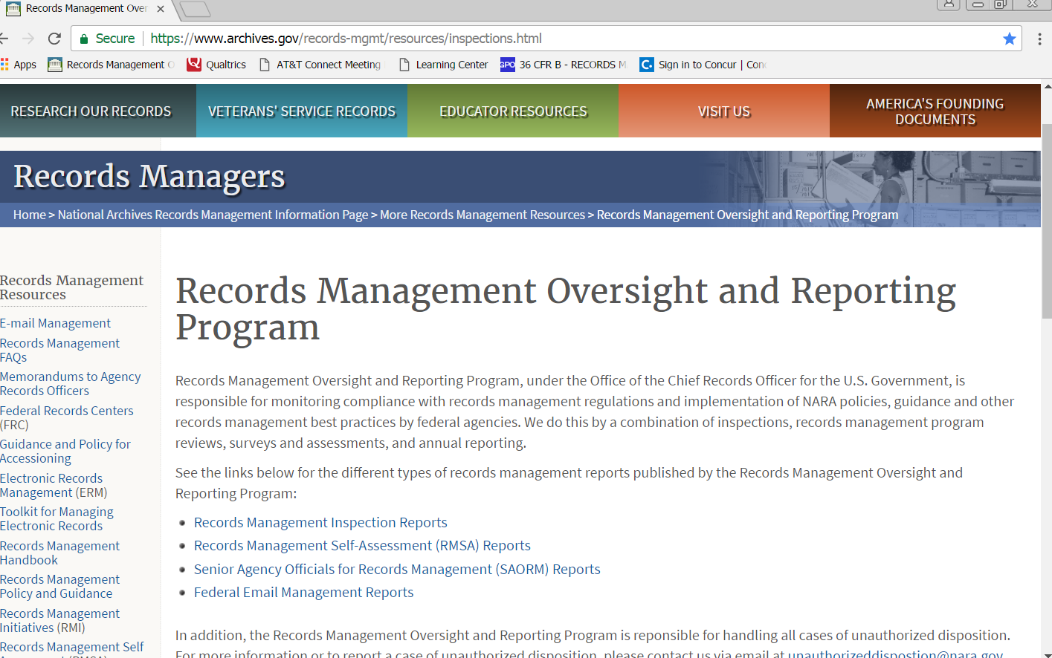
Records Management Oversight
http://www.archives.gov/records-mgmt/resources/inspections.html

Slide 9
Inspection Process
Inspection planning
Communication with Target Agency
Review background documents from Target Agency
Conduct site visits and telcons
Report
Plan of Corrective Action created, monitored, and completed

Slide 10
Unauthorized Disposition
What is unauthorized disposition?
  Unlawful or accidental removal, defacing, alteration, or destruction of records
Why are we required to report this to NARA
  CFR: Title 36, Chapter XII, Subchapter B, Part 1230
How to Notify NARA of Allegations
  Verbally and in writing
Where should correspondence be sent?
Office of the Chief Records Officer
National Archives and Records Administration
8601 Adelphi Road, Suite 2100
College Park, Maryland 20740

Slide 11
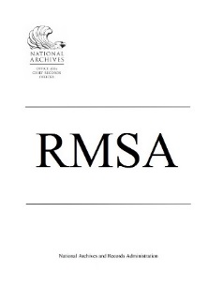


Agency Reporting
Agency records officers provide an evaluation of their individual agency’s compliance with Federal records management statutes, regulations and program functions.
Agency records officers assessed their individual agency’s email management using a maturity model template.
Responses from high-level officials about progress towards MGRD targets and requirements and other strategic topics.

Slide 12


Federal Electronic Records Modernization Initiative (FERMI)
To help agencies obtain electronic records management (ERM) solutions and services fitting their needs through an improved procurement process
To proactively address changing trends in ERM by setting policy for new solutions and services.
HELP FEDERAL AGENCIES WITH THE HOW!

Slide 13
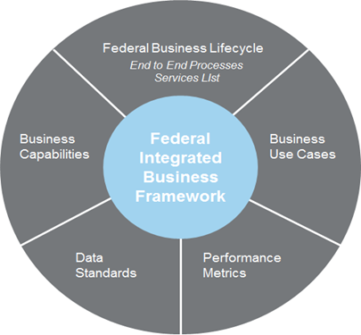

Federal Integrated Business Framework (FIBF)
Notes:
The Federal Integrated Business Framework is a model that enables the Federal government to better coordinate and document common business needs across agencies and focus on outcomes, data, processes and performance. It is the essential first step towards standards that will drive economies of scale and leverage the government’s buying power. The FIBF includes five components:
Federal Business Lifecycles, service areas, functions, and activities serve as the basis for a common understanding of what services agencies need and providers should offer.
2. Business Capabilities are the outcome-based business needs mapped to Federal government authoritative references, forms, and data standards.
3. Business Use Cases are a set of agency “stories” that document the key activities, inputs, outputs, and other LOB intersections to describe how the Federal government operates.
4. Standard Data Elements identify the minimum data fields required to support the inputs and outputs noted in the use cases and capabilities
5. Performance Metrics define how the government measures successful delivery of outcomes based on timeliness, efficiency, and accuracy targets
The FIBF is a framework that all current Shared Services Providers are working towards

Slide 14
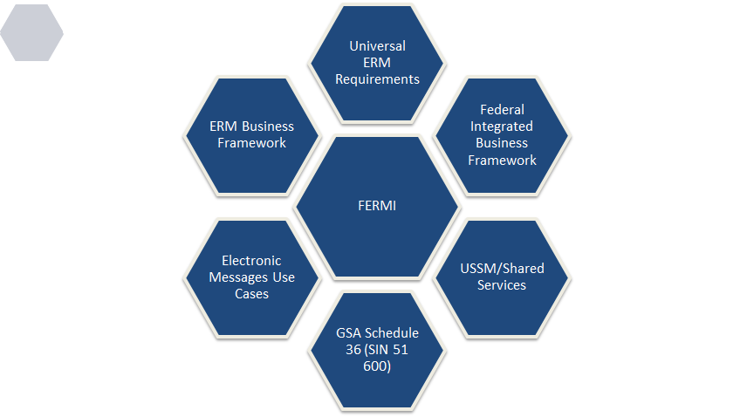
FERMI Products

Slide 15
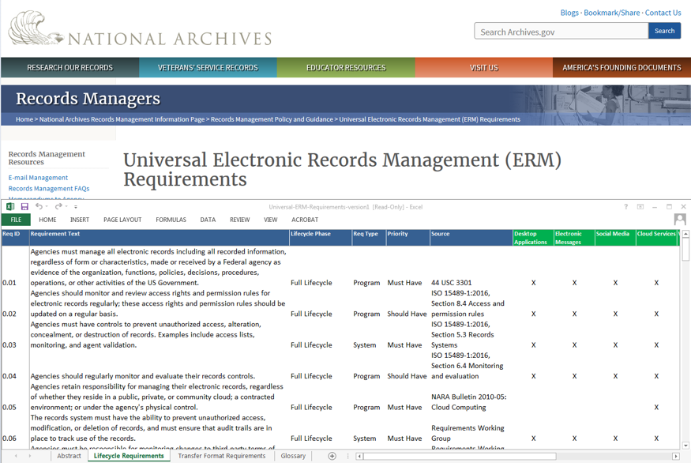
Universal ERM Requirements
https://www.archives.gov/records-mgmt/policy/universalermrequirements
Notes:
The Universal ERM Requirements identify high level business needs for managing electronic records.
They are baseline ERM program requirements derived from existing NARA regulations, policy, and guidance.
They are a starting point for agencies to use when developing system requirements. Records management staff should work with acquisitions and IT personnel to tailor any final system requirements.
The document contains an abstract, list of lifecycle requirements, list of transfer format requirements, and a glossary.

Slide 16
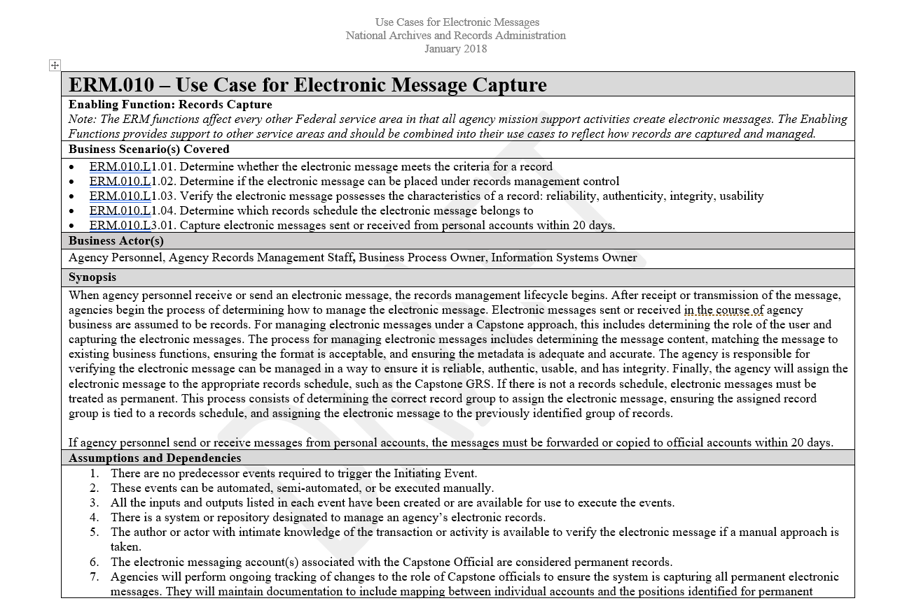
Electronic Messages Use Cases

Slide 17
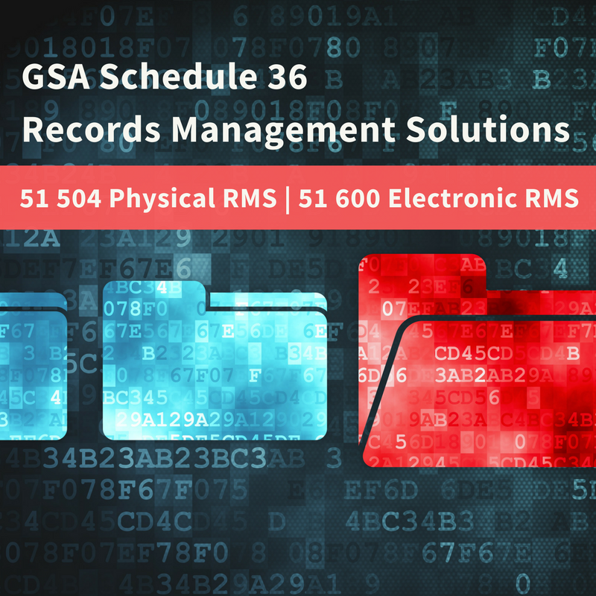
GSA Schedule 36 Updates

Slide 18
More Information
Lisa Haralampus
lisa.haralampus@nara.gov
Don Rosen
donald.rosen@nara.gov
Matthew Hebert
Matthew.Hebert@usdoj.gov
Records Express blog
http://blogs.archives.gov/records-express/
Notes:
Before I stop for questions, just wanted to close with my take on where this road is leading us
Yes, it is leading us to digital government, but in order for us to stay on that road, we need to shift our thinking to an IG approach where RM is a critical component to its success.
Here is my information and some resources for you.
--QUESTIONS --

Slide 19

POC: Wendy Couch, president 202-482-4559 Wcouc@doc.gov

Slide 20
Council of Inspectors General on Integrity and Efficiency (CIGIE)
Records Administrators group
POC: Matt Hebert, Co-Chair 202-305-1921
Matthew.Hebert@usdoj.gov

Slide 21

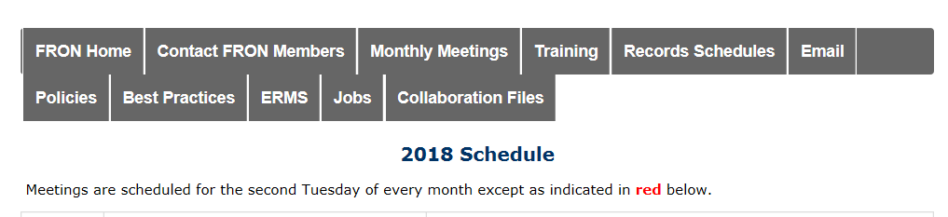

Joint FRON/CRAG Meeting April 17, 2018

Slide 22
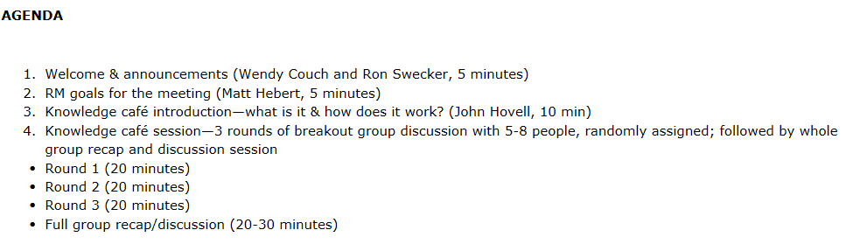
Knowledge Café – Format

Slide 23
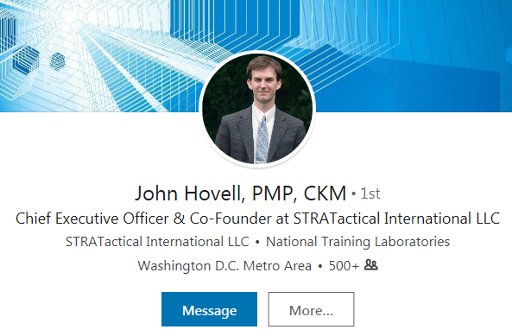
Knowledge Café – Speaker/Facilitator
Host: Monthly DC Area Meetups
https://www.meetup.com/Knowledge-Cafe/

Slide 24
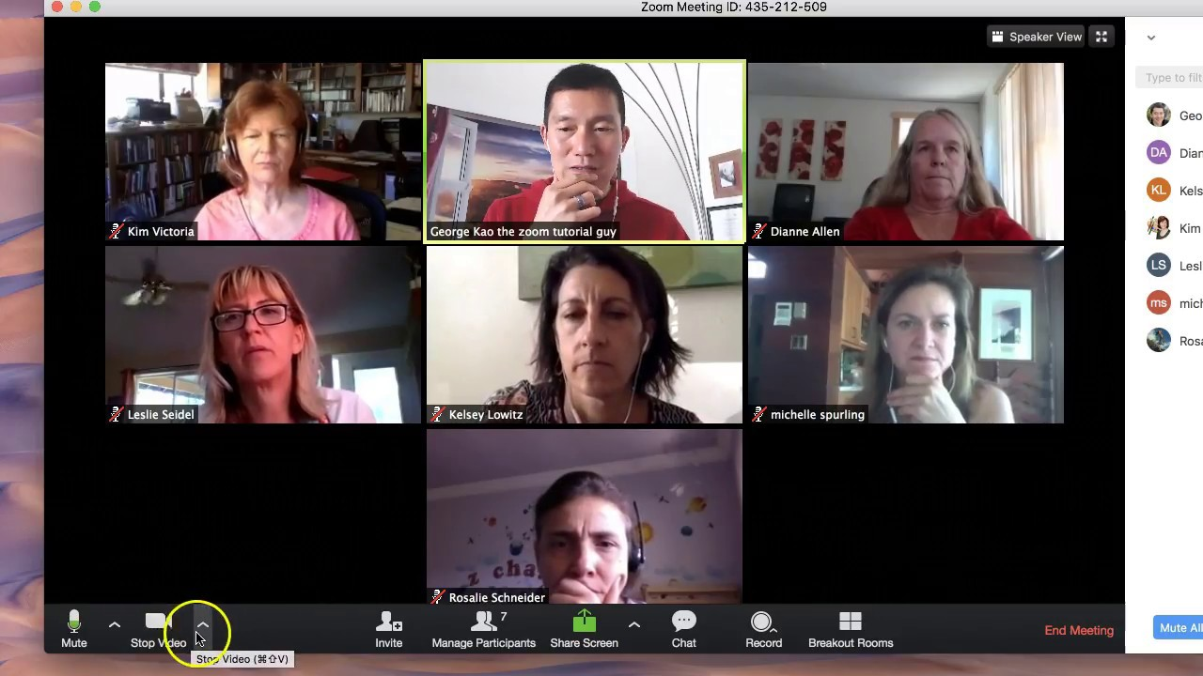
Knowledge Café – Zoom Virtual Meeting

Slide 25
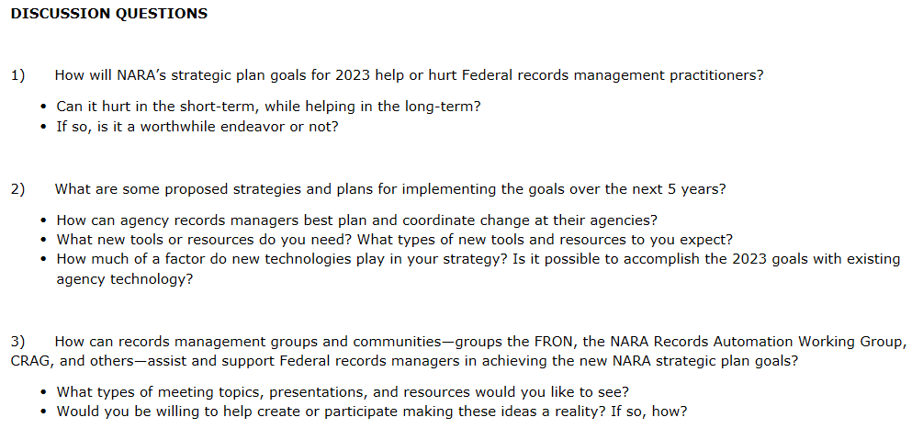
Knowledge Café – Topic

