Slide 1
The NARA Mandate: How Did We Get Here and Where Do We Go From Here?
ARMA Northern Virginia/ARMA Metropolitan Maryland Chapters Symposium
Washington, D.C.
April 16, 2018
Jason R. Baron
Information Governance and eDiscovery Group
Drinker Biddle & Reath LLP
Washington, D.C.
© Jason R. Baron 2018

Slide 2
Outline of Talk
A Timeline
The Mandate: Capture & Filter
The Capstone Email Policy
Dimensionality Reduction & Autocategorization
The “Sensitive” Archivist: The #1 Issue He Now Needs to Confront to Ensure Timely Future Access by Members of Civil Society to Digital Public Archives

Slide 3

The US National Archives: the repository for US government records appraised as “permanent”

Slide 4

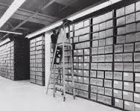
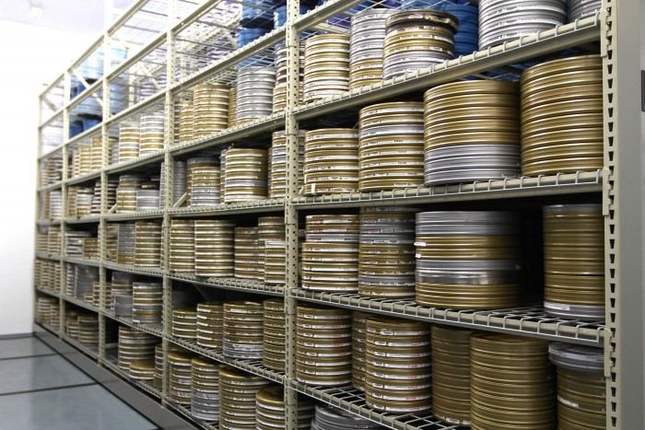
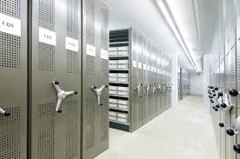
Yesterday’s Archival Collections

Slide 5

Tomorrow: Exponentially Growing Amounts of Digital Information (On Premises and in the Cloud)

Slide 6


Post-2019 Tsunami

Slide 7
Timeline
1971: invention of email as we know it (with @ sign)
  (see Wikipedia article referencing Ray Tomlinson)
1982: first use of email in Reagan era White House
1989: first US lawsuit claiming White House emails are records
1993: US courts say email can be government records
1994: Clinton Administration begins archiving White House email
1995: US National Archives issues email regulations
2008: Lawsuit claiming there are 20 million missing White House emails under George W. Bush

Slide 8
Timeline (continued)
2011 President Obama issued recordkeeping memorandum to entire Executive branch of government
2012 Archivist’s Managing Government Records Directive
2016: Dec 31 deadine for managing email records in electronic form
2019: Dec 31 effective date for beginning of era of NARA accessioning permanent records only in electronic form
2022: NARA stops accepting temporary records in hard copy form to store at FRCs
Post-2022: End of FRCs?
Post-2022: End of new private/public Presidential libraries?

Slide 9
Growth in Presidential and Federal Records in Electronic Form
William Clinton White House 32 million email records
George W. Bush White House 200+ million emails
Barack Obama White House ~ 300+ million emails transferred in Jan. 2017 + records on social media
And after 2019: billions of emails and all forms of electronic records from hundreds of Executive Branch agencies being accessioned into the National Archives
HOW MANY OF THESE RECORDS WILL BE ACCESSIBLE TO THE PUBLIC AND HOW SOON?

Slide 10

Somewhere in a vast collection of digital objects stored in archives are important records relevant to Freedom of Information Act requests, e-discovery demands, investigations, audits, as well as to historians and civil society at large. How can we efficiently access them?

Slide 11
Trust in Government
Transparency & Accountability
Completeness in recordkeeping
  Individual records preserved with their metadata in a stable digital repository (to ensure authenticity & admissibility as evidence)
  Government officials using official, not private, networks to transact business
  Preservation of records for appropriate retention periods
Demand for reasonable access to public records
Government will not release private, proprietary information
Archival Tension: Access vs. Privacy

Slide 12
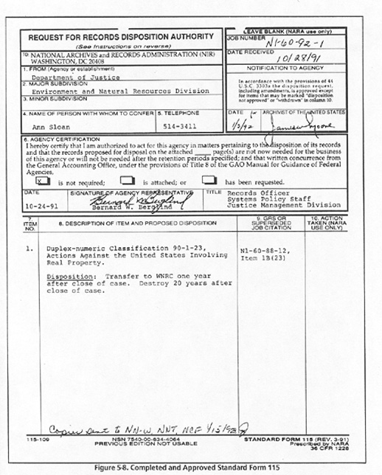
20th Century
Records
Schedules

Slide 13
Problems with the paradigm
Traditional record schedules work when….
  Hard copies are managed by assistants & secretaries
  There are a well-known, semi-structured set of categories based on either format or content of the document
  Staff can manageably handle conditional trigger dates
  Everyone assumes that retention periods represent minimum legal requirements for preservation, not a maximum (but cf. General Data Protection Regulation or GDPR)

Slide 14
Problems with the paradigm
Records schedules don’t work
  When everything is born digital, and end-users are expected to perform their own “recordkeeping” functions
  When end users must print out or drag and drop objects based on pre-populated (and often highly granular) rule-sets
  When digital objects come in all varieties
  WHEN THERE ARE TOO MANY RECORDS CATEGORIES TO CHOOSE FROM!

Slide 15
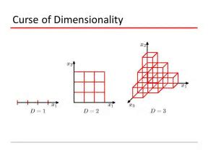
Does records management have to be so complex?

Slide 16
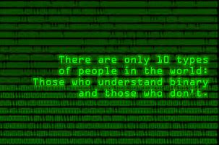
Can records management be reduced to a binary categorization issue? (or at least dimensionally reduced?)

Slide 17
Capstone Approach
Addresses challenges in managing email
Preserve permanently valuable email and dispose of temporary email
Capstone Approach
Categorize and schedule email based on the position and/or work of the email account owner
Schedule all of the email belonging to selected officials as permanent
Schedule all other email accounts as temporary to be preserved for a set period of time based on agency needs

Slide 18
Capstone Officials
Capstone accounts
Other accounts
Key staff accounts
Other accounts
Capstone officials may include:
  Officials at or near the top of an agency or an organizational subcomponent
  Key staff members that may be in positions that create or receive presumptively permanent email records

Slide 19
Compliance with Directive 1.2 (as of March 2018)

Slide 20
One example of % Capstone Accounts at an Agency

Slide 21
Leveraging the Archivist’s Directive to obtain more meaningful access to public records
The 2016 and 2019 directives mean electronic mail and permament electronic records of all forms will be preserved in searchable formats
Adoption of Capstone policies mean that a repository of emails and attachments from senior officials can easily made subject to a “reasonable search”
  With all other substantive emails preserved for at least 7 years
A more complete historical record of government will be available to future generations, if we can overcome barriers to access.

Slide 22
NARA’s Capstone Success Criteria: Access
Access: Email records must remain usable and retrievable throughout their lifecycle. Access supports an agency’s ability to carry out its business functions. Access should address internal agency needs and accommodate responses to requests for information.
What Success Looks Like: Your agency’s email records are maintained in a system that preserves their content, context and structure, protects against their unauthorized loss or destruction, and ensures that they remain discoverable, retrievable, and usable for the period specified in their retention schedule.
Source: https://www.archives.gov/files/records-mgmt/email-management/2016-email-mgmt-success-criteria.pdf

Slide 23
(My Own) Alternative Success Criteria
Did agencies really adopt Capstone or just implement forms of “save everything” policies?
Will transfer guidance for 2019 compel agencies to provide public-use versions of records without personally identifiable information (PII) content?
Will NARA recommend seamless integration of permanent emails with other related permanent records after 2019?
How do agencies cope with exponentially growing amounts of email records in email archives? Are they employing more robust search technologies?
How are agencies dealing with FOIA now for email?

Slide 24
Research agenda
Signal to noise ratio: analyzing Capstone’s success in capturing (and only capturing) e-mail records from senior officials that are of permanent value;
Appraising existing archival strategies for filtering sensitive content in large e-mail repositories; and
Evaluating how well total capture of email has increased the right of citizen access to these records, through informal and formal means.

Slide 25
Difference in Information Retrieval Task: Dimensionality
E-discovery context: binary classifications for relevance and privilege (R, NR) (P, NP)
Records management: legacy schedules with 500 record series and 25 record retention periods
RM Task: Collapsing record series into big buckets
Focus on records retention period as driver for big bucket, not records category per se

Slide 26


Bigger Buckets / Fewer Categories (Dimensions)

Slide 27
Key Concepts in Autocategorization
Coverage: ensuring that every record or digital object that the system interacts with is in fact categorized
Detail: ensuring that the system captures or extracts every meaningful piece of information from a record or digital object.

Slide 28
Auto-categorization techniques can be used to classify content “output” into…..
  topic maps
  subject-based classification
  faceted classification
  metadata (Dublin core or otherwise)
  controlled vocabularies
Source: http://www.ontopia.net/page.jsp?id=classify

Slide 29

Beyond Capstone: Automated Categorization of Records into Records Schedule Categories

Slide 30
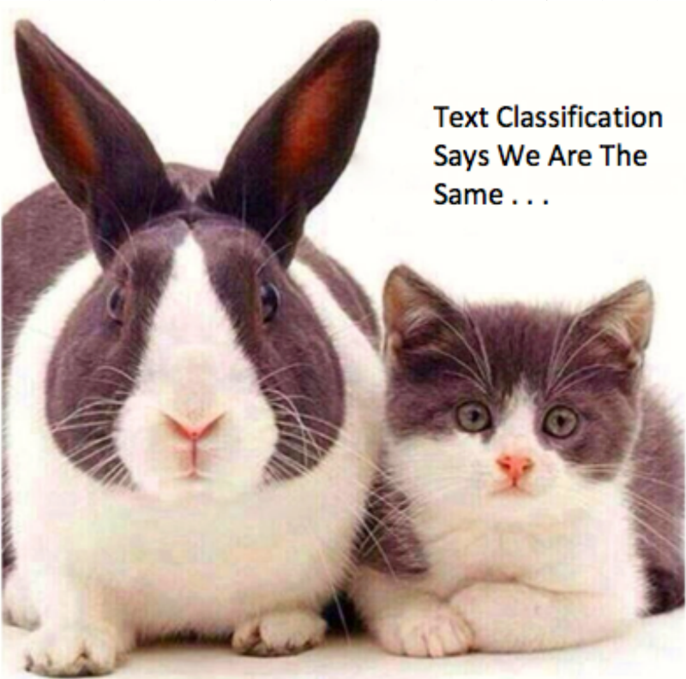
Problems with current auto categorization

Slide 31
Steps For Designing An Auto-Classification System
Critical Steps
  Understand the training requirements and needed training data
  Understand how input features will be represented within the learned function
  Determine the structure of the learned function and corresponding learning algorithm
Once these three items have been considered, normal testing and implementation can occur
  Splitting the data into a test, training, and validation step
  Completing the tactical design
  Running the learning algorithm on a sample of training data with various parameters tuned in a logical manner
  Completing the parameter optimization against a subset of the training data, or validation set, along with cross-validation

Slide 32

Providing access…..

Slide 33

….to the digital archive……

Slide 34



How can citizen access to future digital archives be accomplished in a timely way by means other than litigation and FOIA?

Slide 35
NARA 1601 on Screening Records (2002)
Screen records if there is a reasonable chance that they may contain information about a living individual that reveals details of a highly personal nature, which if released would constitute a clearly unwarranted invasion of privacy. Withhold such information from files before disclosure if it has not been officially released previously or if it relates to individuals less than 75 years old or events that occurred less than 75 years before the date of screening.
Source: https://www.archives.gov/foia/directives/nara1601.pdf

Slide 36

Anticipating the need to filter sensitive content of all types

Slide 37
Categories of Sensitive Info in Records (non-exhaustive)
Personally identifiable information (PII)
  Names as metadata fields; social security numbers; telephone numbers; driver’s license information; taxpayer information; bank or financial account information’; credit card numbers; vehicle registrations; dates of birth, height and weight characteristics; asset information
Personal health information (PHI)
Arrest records
National security & law enforcement investigations
Intellectual property
Material covered by a legal privilege
FOIA exempt material (nine categories)

Slide 38
Types of sensitive content
Content susceptible to deletion through the use of “regular expressions”
Textual content
Nontextual content (images, fingerprints, biometric data, geospatial imaging)

Slide 39

I

Slide 40



Faith in Analytics

Slide 41


Black boxes: algorithms separating wheat and chaff

Slide 42
Ensuring a complete record of governmental activities
Proposition 1: encouraging the use of capture and filter technologies to ensure that there will be a complete historical record, and access to it
Proposition 2: encouraging auto-categorization of records content to assist in search and review
Proposition 3: e-government actors should be promoting the use of advanced search and filtering techniques to find and open public records as soon as possible, taking into account sensitive content.

Slide 43
Information Governance Strategies

Slide 44


Slide 45

Sunsetting of older employees in the current workforce…

Slide 46

… means a green field for younger records managers to take up this Call to Arms & insist on using more technologically sophisticated strategies to provide access to record repositories & e-archives

Slide 47

To Advance the Cause, Records Managers, Archivists, IT staff, and (yes) Lawyers All Need To Cross Intellectual Boundaries

Slide 48

Culture change is possible (even for government)

Slide 49
Jason R. Baron
Drinker Biddle LLP
jason.baron@dbr.com
202.230.5196
Twitter: @jasonrbaron1
© 2018 The views expressed are the author’s alone and not any firm or institution with which he is affiliated.

Slide 50
Appendix: Specific Advanced Search Methods For Use in Filtering Sensitive Content
REFERENCES:
Nathaniel Payne & Jason R. Baron, “Auto-Categorization Methods for Digital Archives,” IEEE Big Data Conference (Dec. 2017), Workshop on Computational Archival Science, Boston, MA , https://ieeexplore.ieee.org/document/8258182/
Jason R. Baron & Nathaniel Payne, “Dark Archives and eDemocracy: Strategies for Overcoming Access Barriers To the Public Record Archives of the Future,” Proceedings of the 7th International Conference for E-Democracy and Open Government” (CeDEM 17), Danube University, Krems, Austria (2017) (available from author)
Jason R. Baron, “Records Hiding in Broad Daylight: Problems of Accountability and Access Posed by the Digital Archives of the Future, KVAN 150th Jubilee Conference of Netherlands Archivists, Haarlem, The Netherlands (2016), published in Hildo Van Egan, ed., VALUES IN TRANSITION: PERSPECTIVES ON THE PAST, PRESENT AND FUTURE OF THE ARCHIVAL PROFESSION (2017) (available from author)
Jason R. Baron & Bennett B. Borden, “Opening Up Dark Digital Archives Through the Use of Analytics To Identify Sensitive Content,” IEEE Big Data Conference (Dec. 2016), Workshop on Computational Archival Science: digital records in the age of big data,” Washington, D.C., http://ieeexplore.ieee.org/document/7840978/

Slide 51
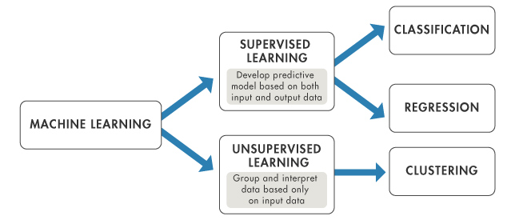
Supervised Learning
Supervised learning is the machine learning task of inferring a function from labeled training data.
In supervised learning, each example is a pair consisting of an input object (typically a vector) and a desired output value (also called the supervisory signal).
A supervised learning algorithm analyzes the training data and produces an inferred function, which can be used for mapping new examples.
See Grossman, M.R., Cormack, V., “A Tour of TAR,” chap. 3 in J.R. Baron et al., eds., PERSPECTIVES ON PREDICTING CODING And Other Advanced Search Methods for the Legal Practitioner (ABA 2016).
Hastie, T., Tibshirani, R., Friedman, J. THE ELEMENTS OF STATISTICAL LEARNING: DATA MINING, INFERENCE AND PREDICTION. Springer 2017)
Acknowledgement: Slides from Nathaniel Payne, Ph.D. candidate, Univ. of Br. Columbia, joint presentation at 2017 IEEE Big Data Conference, Computational Archives Workshop, Boston, MA (Dec. 2017).

Slide 52
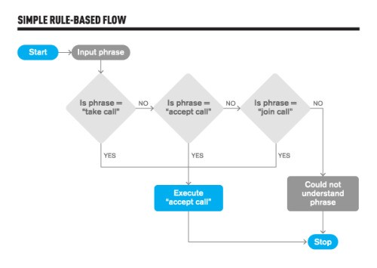
Rule Based Classification – Decision Rules
Advantages
  Easy to initially implement
Disadvantages
  At high dimensions with large numbers of categories, implementation can be a challenge
  Significant time can be spent updating decision rule methods and creating and maintaining rule sets
Specific rules are then constructed in the format of “IF condition THEN conclusion”, where the condition portion is filled by features of the category, and the conclusion portion is represented with the category’s name or another rule to be tested.

Slide 53
Fuzzy Correlation
A technique that can be used to allow a system to either precisely or fuzzily match single words or multi-word phrases together.
Advantage
  can often deal with fuzzy information or incomplete data, allowing for document classification
Disadvantages
  It is primarily effective at augmenting approaches
  At high dimensions with large numbers of categories, implementation is still a challenge

Slide 54
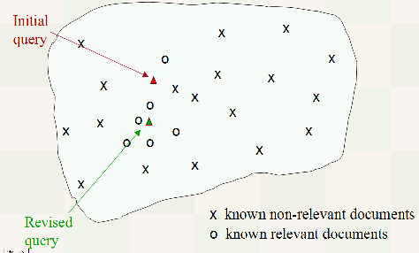
Vector Space Methods
Methods for document routing or filtering in informational retrieval, where the algorithm builds a prototype vector for each class using a training set of documents (Eg. Rocchio’s Algorithm)
Advantages
  Easy to implement, efficient in computation, is a fast learner and employs relevance feedback
Disadvantages
  Algorithms have low classification accuracy and are low in detail
  Methods have difficulty dealing with lexical ambiguity and variability
  Methods do not deal well with feature sparseness

Slide 55
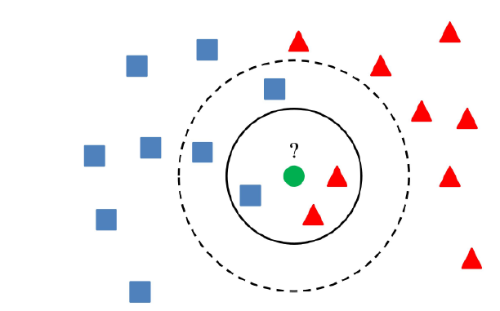
Prototype Methods & Nearest Neighbor
Used to test the degree of similarity between documents and k training data and determining the category of test documents
Categorizes objects based on closest feature space in the training set
Advantages
  Easy to understand with a training process that is fast
  Robust to noisy data, particularly well suited for multimodal classes
Disadvantages
  Very sensitive to the local structure of the data
  Can have significant memory limitations as implemented in its most basic form
  Runs slowly which can be a significant problem as the number of documents grows, and is sensitive to initialization
  We need to specify the number of clusters in advance which may not be knowable

Slide 56
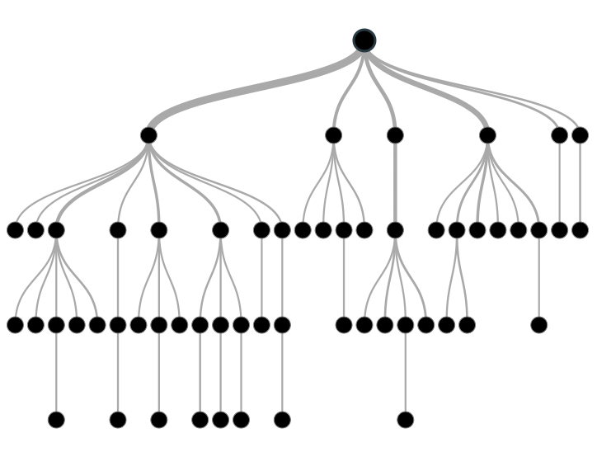
Tree Based Methods
Decision tree rebuilds the manual categorization of training documents by constructing well-defined true/false-queries in the form of a tree structure
Advantages
  Simplicity in understanding and interpretation, as well as execution
Disadvantages
  A selected model may overfit the training data (can be addressed using ensembles or random forests)
  Can have significant error when dealing with heterogeneous data
  Adding more categories can create problems at high dimensions

Slide 57
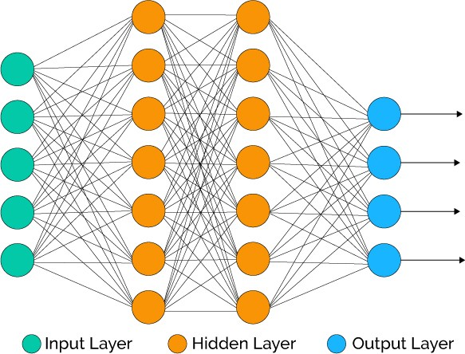
Neural Networks & Content Based Matching
Artificial neural networks (ANNs) are computing systems inspired by the biological neural networks that constitute animal brains.
ANN’s learn (progressively improve performance on) tasks by considering examples, generally without task-specific programming.
Advantages
  Ability to handle documents with high-dimensional features and/or noisy and contradictory elements.
  Linear acceleration in the matching process with respect of the large number of computational elements is provided by a computing architecture which is inherently parallel
Disadvantages
  High computing cost, which consumes high CPU and physical memory usage
  Artificial neural networks are extremely difficult to tune. Challenging to understand.

