Slide 1
Transitioning from Paper to Electronic Information:
Cost Control, Risk Mitigation, & Managing the Process
April 2018

Slide 2
Topics
Proliferation of Information
Impact of Technology Changes on Corporations
Challenges in Implementing Information Governance
Challenges of Managing Data in the Legal Discovery Process
Benefits of Electronic Data in Measuring and Adding Meaning to Data
What’s Next? The Dawn of Predictive Analytics and Artificial Intelligence

Slide 3
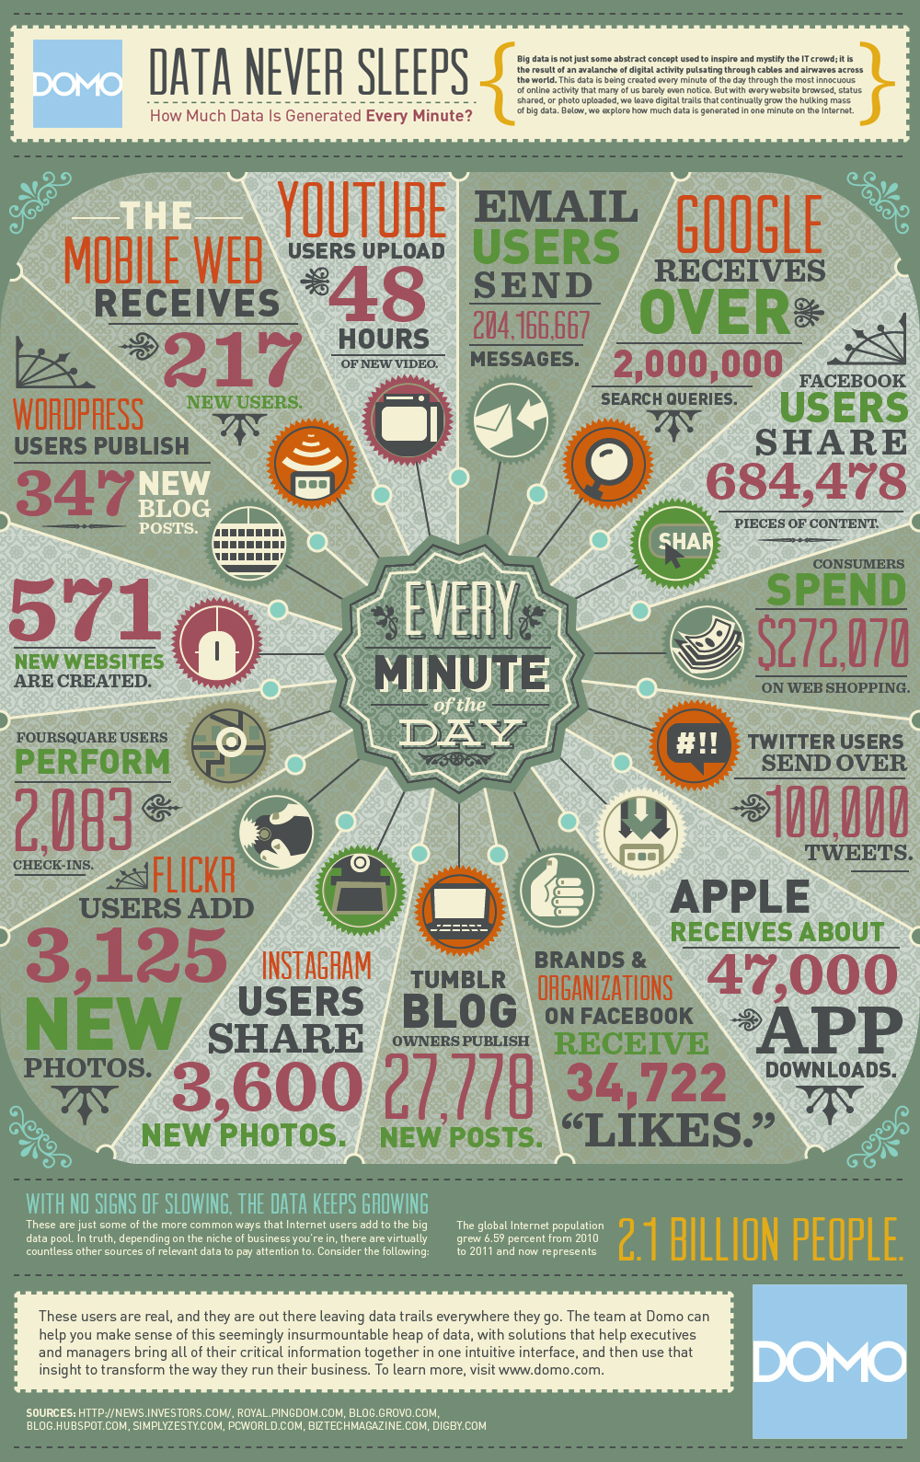
Data Creation
Every minute of the day,
47,000 app downloads happen on iTunes.
100,000 tweets are sent. Facebook users share nearly 685,000 PIECES OF CONTENT.
Every minute.
How can a human possibly absorb all available information?
The key is learning to leverage technology to manage technology.
Reduce the noise and find what is relevant.
Notes:
Every minute of the day, 47 THOUSAND app downloads happen on iTunes. 100,000 tweets are sent. Facebook users share nearly 685 THOUSAND PIECES OF CONTENT. Every minute. How can a human possibly absorb all available information? The key is learning to leverage technology to manage technology. Reduce the noise and find what is relevant.

Slide 4

The “Big Data” era
ExxonMobil’s Employees create 5.2 million new email messages every single day.
By 2020, web-based business transactions will reach 450 billion deals per day.
Walmart processes 1 million customer transactions every hour, which are stored in databases of 2.5 petabytes of data.
The volume of business data worldwide, across all companies, doubles every 1.2 years.
Notes:
MOST RECOGNIZE “BIG DATA ERA,” BUT FEW REALIZE THE MAGNITUDE
PULLED SOME OF MY FAVORITE STATS TO DRIVE POINT HOME
EXXON PARTICULARLY COMPELLING – BIG, GLOBALCOMPANY, BUT JUST ONE COMPANY
- AND THIS IS AN OLD STAT; BY NOW PROBABLY TALKING ABOUT OVR 10MM EMAILS/DAY + IMS, TEXTS, ETC…
CAUSE OF EXPLOSION IS PARTLY HOW EASY IT IS FOR EMPLOYEES TO CONDUCT BUSINESS FROM ANYWHERE (PLANES, SUBWAYS, ETC)
BIG DATA = GREAT FOR OPERATIONS AND BUSINESS INTELLIGENCE
BUT TERRIBLE FOR EFFICIENT LITIGATION
- MAKES LITIGATION INCREDIBLY EXPENSIVE (EVEN COST PROHIBITIVE IN MANY CASES)
- ALSO MAKES IT REALLY, REALLY HARD FOR LITIGATORS TO ASSESS THEIR CLIENTS EXPOSURE AND GIVE ACCURATE, RELIABLE ADVICE EARLY IN THE CASE BECAUSE IT TAKES FOREVER TO FIND THE RELEVANT DOCUMENTS UPON WHICH LEGAL ADVICE IS BASED.

Slide 5
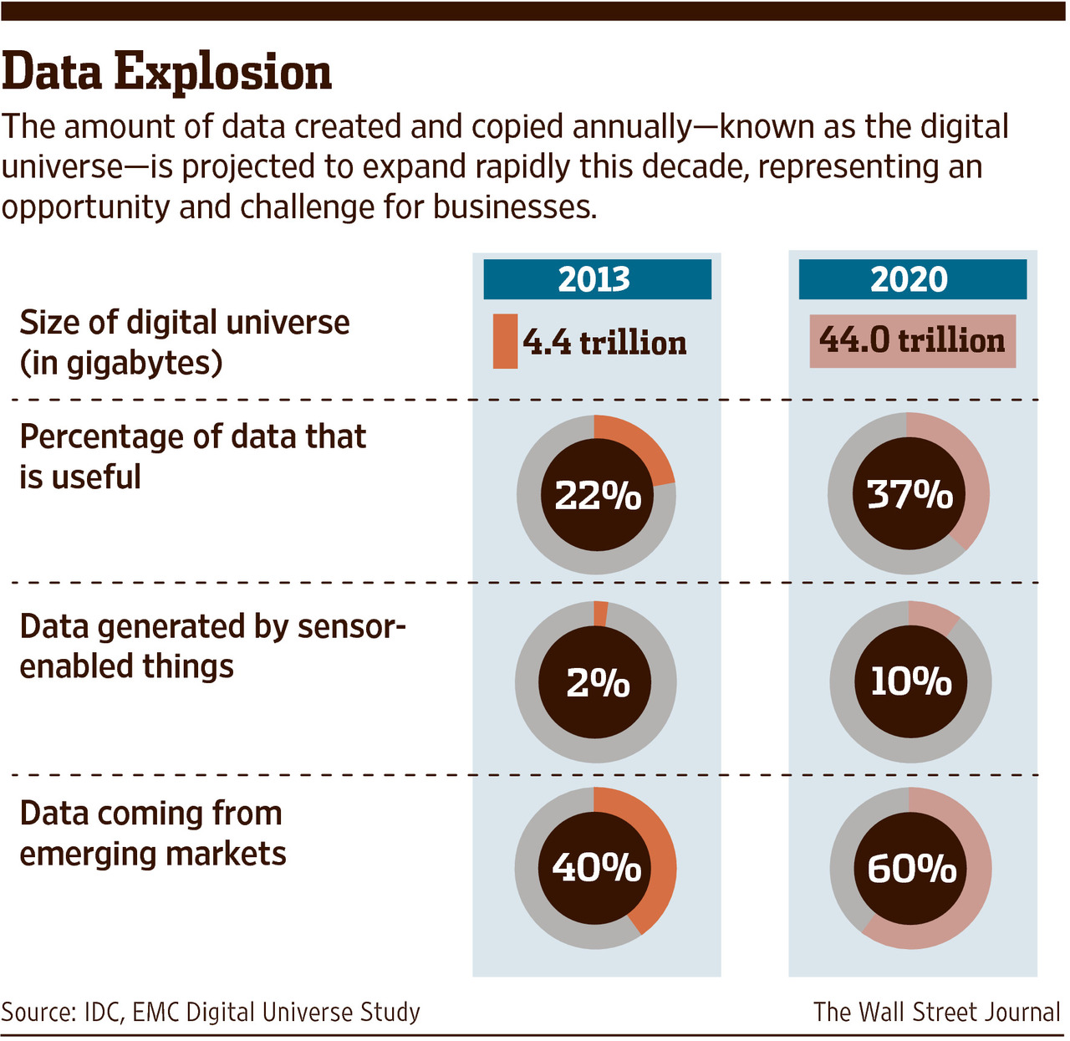
Explosion of Data Volumes
Notes:
Add an explosion sound byte?

Slide 6
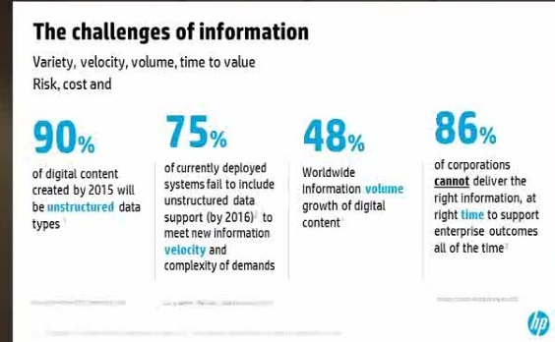
Unstructured Data and the Business Process

Slide 7
  Business Users, Cyber, & Risk
Business users are always looking for the newest, most effective technologies to get their work done
    Over the past 15 years, cyclical downturns in the economy have resulted in downsizing of workforces, so effectively fewer people are doing more work
    Older systems typically create redundancies, duplication of work, and generally result in inefficient use of time
Newer systems offer great benefits:
    reduce time spent on any given task
    Improve collaboration
    Users no longer need to be connected to a single location to accomplish work
These same systems also dramatically increase general corporate risk and cybersecurity exposure

Slide 8
Benefits vs Risks of New Data Sources
Benefits
Centralization of data
Mobility (work from anywhere)
Efficiency (templates, etc…)
Collaboration/Teamwork
Scalability
Real-time communication
Reduced infrastructure costs
Improved cloud security & CASB controls
Reduces need to continually buy new storage
Risks
Data exfiltration
Control in hands of cloud brokers
Massive data mapping efforts
Expensive up front migration costs
Massive change management and ongoing training costs
Centralized data means one security breach exposes large volumes of data (i.e. Target breached via HVAC vendor)

Slide 9
Information Governance
Understanding Information Governance and Developing Effective IG Programs
    Key IG Building Blocks
    Hurdles to Implementation

Slide 10
Defining Information Governance
Information governance is
A set of multi-disciplinary structures, policies, procedures, processes and controls
    Information governance addresses the full data lifecycle
      Creation
      Communication
      Collaboration
      Storage & Retrieval
      Destruction
Implemented to manage information on all media in such a way that it supports an organization's regulatory, legal, and operational requirements.
An effective information governance program
should balance risk, value, and efficiency.

Slide 11
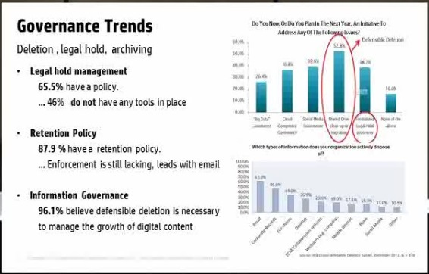
How Are Corporations Faring with IG?

Slide 12
Hurdles to Implementing Information Governance
Resistance to Change
    People like to stick with what they know, even when they are aware their current methodologies are less efficient
    “I have a system”, “I know where everything is” “This is going to be extra work”
Requires top down commitment but effort from the bottom up
    Recognize this process doesn’t take place overnight and requires involvement from EVERY sector of an organization
Context and Programs are Critical
    It’s easy to tell workers to discard data, it’s rare that senior management deploys the necessary support staff and change management process to explain WHY this is important and HOW to execute
    Without both initial and ongoing training, IG initiatives will not success
Budget Constraints
    Many organizations struggle to reconcile the long term benefits of moving to an all-digital enterprise against the up front costs to invest in infrastructure, digital asset management, change management, and additional training to execute

Slide 13
Change Management – The Big Headaches
Without certain key building blocks, no organization can transform from a paper-based process to a digital enterprise. Several key, significant processes, must be undertaken to lay the foundation for an effective digital transformation.
          Data Mapping
          Records Retention Policy & Schedules
          Data Classification Matrix
Data Mapping
    Understanding what systems and applications an organization utilizes and what types of data outputs are created is THE foundation for any digital transformation.
    If you don’t know what you have, you cannot organize or categorize it, let alone find it when needed for litigation, regulatory, or compliance matters

Slide 14
Change Management –
Records Retention Policy & Schedules
    In addition to knowing WHAT data sources you have, an organization must implement an effective records retention schedule to ensure the regular and timely destruction of records that have exceeded their useful life (*Except those records subject to legal holds).
    In order to be effective, Records retention schedules must consider not just the legal/regulatory aspects of data asset life, but also the useful business life of information to avoid forcing employees to continuously recreate basic forms and templates.
Implementing Records Retention Schedules
    Many structured data systems support records retention schedules and allow system administrators to program in the lifecycle of documents.
    Many newer technologies also offer automated classification to recognize certain document types (e.g. contracts) and establish a retention date that is X number of years from the termination date of the agreement.

Slide 15
Change Management – Data Classification
Data Classification
    Data classification is often misunderstood and presumed to relate only to the security clearance of a file (i.e. public use vs confidential).
    In fact, when data classification is properly implemented, it provides a wealth of information about any given business record/document that provides instruction on handling, protection, communication, storage, and destruction of data
    Many organizations are shifting to a more detailed and user friendly matrix style classification process
  SAMPLE DATA CLASSIFICATION MATRIX
Document/Record | Data Category | Data Owner | Security Classification | Sensitivity/Privacy | Record Format/Location | Retention Period
2017 Budget for Law Dept | Organizational Data | Legal | Confidential | Financial Data | Electronic - file share | 3 years
5 Year Financial Plan | Organizational Data | Finance | Restricted | Financial Data | Electronic - Oracle Financials | Retain previous version for 3 years
Customer Credit Application | Customer Data | ESS Credit | Confidential | PCI, PII Data | Electronic - ERM | 5 years
Personnel File for Employee X | Employee Data | Human Resources | Confidential | EPHI Data (HIPAA) | Paper - HR Files | Employment term + 7 years
Development of new patent | Organizational Data | Legal | Restricted | Legal - Trade Secret | Electronic - file share | Permanent
Customer Gaming Profile | Customer Data | VIP Marketing | Confidential | PII | Electronic - SMART/CMS | 10 years

Slide 16
Laying the Groundwork
POLICY & PROCESS
Document retention policy
Document retention schedule
Data map
Data archiving & backup policies
Litigation Readiness Plan
LEVERAGING TECHNOLOGY
Archiving & ECM solutions
E-Discovery solutions
Data classification – end user-applied and automated

Slide 17
Data Mapping – Information to Include
Information Architecture
  How data is created, communicated, stored, server structure
  Number of users & total data volume
  Onsite, offsite, cloud-based data management
  Email environment + backup methodology/frequency
  Archiving method and location
Data Classification
  Types of business records
  Information security - Personally Identifiable Information (PII) & other data types that require special treatment (PCI)
Applications and Programs
  List of primary and secondary applications + systems impacted
  User access profiles
Retention Policy
  Business Records vs. General Data vs. Email
  Paper vs. Electronic records
  Regulatory components of retention (i.e. Financial, HR)
  Data destruction policies
Organizational Charts
  Business unit leaders, key custodians, IT administrators
Legal
  Legal hold procedures to ensure data preservation obligations can be met
  Tools and methodologies for collection, preservation, culling data for legal matters

Slide 18
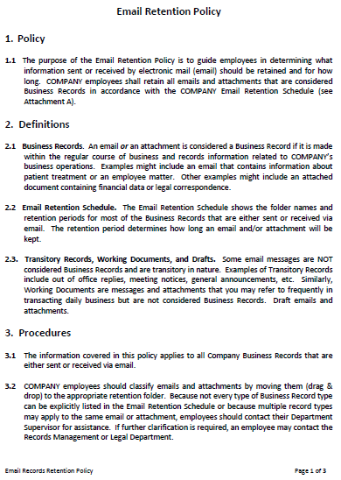

Developing Retention Policies & Schedules
Develop and document consistent policies
Provide employees with initial and follow up training
Do not keep data past documented retention period
Develop audit mechanism to determine retention success rate

Slide 19
Paper Data and the Legal Process
Challenges around the ongoing use of Paper in organizations and the impact on legal obligations

Slide 20

Dangers of Paper Within E-Discovery
Paper is not an “original form” of a record – Fed Rules
      PRINTING Causes Loss of Metadata (creation date, last modified data, etc.)
      Security
      Inefficient process – electronic to paper to electronic
      Faulty OCR
      Cannot effectively create and test search terms for efficacy
      Cannot De-duplicate
      Cannot Near-dup
      Cannot test and sample custodial data
      Cannot use email threading
      Cannot use conversation threading for conversational context
      Cannot prioritize documents for review
      Increased Costs
        Inefficient process
        Printing, supplies, maintenance
        Storage Costs
    Some regulatory requirements continue to support creation of paper files – i.e. gaming data
Notes:
90% of all information in the world is now created electronically

Slide 21
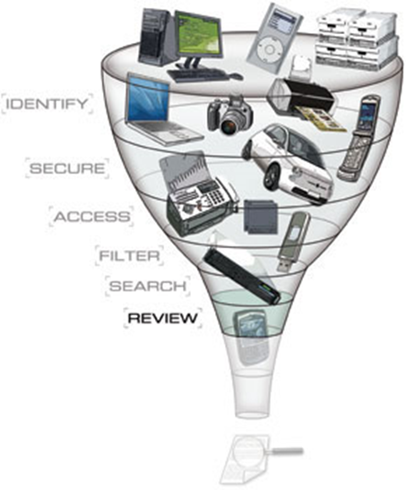
Managing E-Discovery Costs
Understanding The Role of Digitization on E-Discovery Costs:
    Collection costs
      8% of total discovery costs
    Processing costs
      19% of total discovery costs
    Document review
      73% of total discovery costs
Use of technology is paramount to impact the hours required to perform document review.
Where the Money Goes: Understanding Litigant Expenditures for Producing Electronic Discovery”, Rand Corporation (April 2012)
Notes:
To achieve significant cost reductions, focus on document review segment of process
Legal departments are taking more control over the review process, with more of the “first pass” review function being outsourced to document review vendors, with outside counsel providing second level review oversight function.
Technology is the key, but standing alone, it is not a silver bullet
Early Case Assessment
Email Thread Consolidation
Predictive Coding
Concept Clustering & Searching
Outside Vendor Review Technology: Providing Counsel Daily Detailed Metrics
Review Strategy –sampling v linear review; privilege strategy

Slide 22
Comparison of Methods
Assume 20GB Case
Assume 1GB of data = 6,000 Documents
 | Paper Discovery | Using E-Discovery
Initial number of documents in 20GB Case | 120,000 | 120,000
Documents excluded through E-Discovery (tools providing filtering, key word search and analytics capabilities) (assumes standard filter hit rate of 20%) | 0 | 90,000
Documents Left to Review | 120,000 | 30,000
Assumed Review Rate (Doc/Hr) | 30 | 55
Total review hours | 4,000 | 545
Timeline for a review team of 20 reviewers (8 hr day, 5 day week) | 5 weeks | >1 week
Cost @ $100/hr | $400,000 | $54,500
E-Discovery costs for processing and hosting in this scenario are around $5,000 to net a savings of hundreds of thousands of dollars
Notes:
Add an explosion sound byte?
Ediscovery costs can be covered by review savings (need help avoiding billable hour objection)
NEED TWILLA EXPERTISE TO PROPERLY CONVEY

Slide 23
Time & Cost of Identifying Paper Records
Needle in a Haystack
Without metadata, headers, footers, or other searchable information, the only way to find paper files is to either keep massive collections of filing cabinets or to have boxes that are labeled with inordinate detail
    Example:
      Recently found box of IT Contracts with date ranges from 2008 to 2015
      Some contracts were still in force, others had expired as far back as 2010
      How to search through these contracts efficiently to find a single contract from 2011 that may have expired in 2016?
Volume & Cost
    Enter Iron Mountain & other paper storage facilities (Recall, Pullitz, Private Warehouses)
    Aside from the potential security risks of transporting boxes of data, the cost of storing physical assets is significantly higher than electronic data due to inability to compress paper data
    2016 estimate showed our organization was storing 135,000 boxes at various private warehouse storage facilities at a cost of $1.4M per YEAR.
    This does NOT include captive fees or the costs of retrieving or destroying boxes (anywhere from $10-25/box)

Slide 24
Digitization and the Emerging Role of Data Analytics
The Role of Data Analytics in Enterprise Transformation
What Can/Should You Measure?
Reducing Arguments to Costs
Predictability Breeds Efficiency

Slide 25
Overview: Why we need metrics & analytics
Metrics: Measuring past or ongoing activity
    Measuring some aspect of legal process or matter management
    If you cannot measure something, you cannot improve it
Analytics: Deriving meaning from metrics and projecting future trends to enable smarter, more objective decision making
    Analytics can range from simple trend analysis to combination of multiple indices to form a more holistic 3-dimensional picture
    Analytics need not be complex to be meaningful

Slide 26
Using Data to Influence Business Leaders
Removing the guesswork
    Hard data and metrics show historical trends
ROI
    Invest in technology today to generate cost savings and risk reduction for the next decade
Benefits of using technology/business intelligence
    Reduce risk
    Lower costs
    Increase predictability
    Create efficient, repeatable processes

Slide 27
The Emerging Role of Analytics
New Analytics Tools Have Emerged That Capitalize on Electronic Data to Generate Meaningful, Actionable Insights
    Useful for managing the business of law and trends across matters
    Trends over time
    Understanding past experience to better predict future cost, behaviors, and likely outcomes
    Better alignment of budgets with actual spend
    Identifying gaps in resources to target problem areas
Notes:
Need more on this slide?

Slide 28
Visualization as a time saver
Evaluating Resource Allocation by Stage of Litigation
  Matter management provides designations for stage of litigation
  Adding percentage complete to each stage allows for visual presentation
Print/List Format Visualization Format
Matter 1 – Pre-Trial Motions
Matter 2 – Discovery
Matter 3 – Depositions
Matter 4 – Trial
Which format gives you a faster read and easier way to allocate resources?

Slide 29
Using Business Intelligence: Through the Legal Lens
Law Department/Law Firm is a business unit not a unique business entity
    Applying the same principles as any other business:
    Metrics
    Statistical Analysis
    Past behavior as a predictor of future outcomes
    Decisions based on “hard data”
Combining data from multiple systems
    All relevant information is stored in a single database and sortable, searchable across wide range of fields/categories
    Matter Management, E-Billing, Docketing, Legal Hold, E-Discovery tools integrated in a central dashboard

Slide 30
Using Business Intelligence III: Benefits Achieved Through Business Intelligence
Selecting outside counsel
    Outside counsel should matches up well against plaintiff’s counsel in the particular jurisdiction for the specific matter type
Understanding historical costs and trends
    What have similar matters cost?
    How long have similar matters lasted?
Litigate vs Settlement decisions
    Strategy development from day 1
Effective budget planning based on past trends

Slide 31
Outside counsel selection based on success vs plaintiff counsel
Outside counsel selection based on law firm scorecard ratings and historical performance against plaintiff’s counsel across other matters

Slide 32
Litigation Volume:
Number# of Employment Suits Annually by Region

Slide 33
Analyzing the data: What Do trends tell us?
Flat line tells us litigation is static year over year
    Not much to do here
Generally level trend with a spike in a particular year
    Review personnel moves and new hires in that year to identify potential cause
    i.e. Several line employees were elevated to first time managers in the Midwest region in 2013, resulting in an increase in age, race, and gender discrimination charges
    Remedial action can be established
    New managers/first time managers should receive extra sensitivity training
Steady increasing volume of litigation year-over-year
    Regions with heaviest concentration of employees would be expected to have highest volume of employment claims
    However, year-over-year increase means that either more training is needed or existing training is no longer adequate.
    Budget for next year should included enhanced training methods and development of new training materials that align with contemporary work environment
Data shows us the numbers, analytics shows us the trends and helps identify root causes and solutions

Slide 34
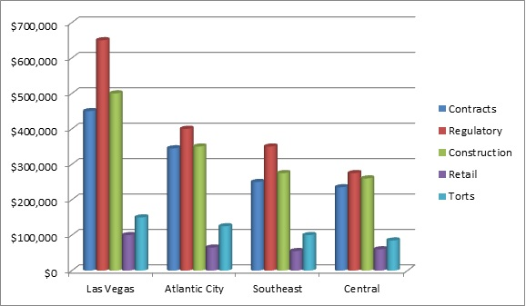
Litigation cost profiles by region
Average Judgment Amount, by matter type & region 2012-2015

Slide 35
Analyzing Historical Trends Manage Future Budgets
Linking matter management and online billing platforms allows you to combine multiple metrics and create a broader picture
Combining multiple metrics:
    Matter Type
    Region/Office
    Judgment Amount
Regulatory matters result in highest judgments, more resources and attention should be spent on compliance than tort actions
Las Vegas region shows highest average judgment amount, more time and planning should be focused on the region that presents the greatest organizational risk

Slide 36
So How do we measure cost savings??
Time Savings
Example: Sane Box Email Organizer
    Email tool is used to prioritize emails from key personnel and move junk to an alternate mailbox
    Cutting down non-important or mass email notices saves users approx 10 minutes per day
    10min per day X 5 days/week = 50min/week (aka .83 hours)
    .83 hours/week saved X 50 weeks/year = 41.5 hours/year per employee
    Total of 20,000 employees at an average wage of $25/hour results in total annual savings of $20,750,000 ($1,037 per employee)
  10 minute savings generates $20M annual ROI

Slide 37
More ways to measure cost savings
Controlling Discovery Costs
Example: Outsourcing 1st pass review to an e-discovery vendor
    Average attorney rate is $250 or higher (sometimes $850+/hour)
    1st pass review eliminates up to 80% of initial document collection, thus most of the material in 1st pass review is largely irrelevant
    1st pass review only requires a YES or NO decision about relevance, high priced outside counsel are not needed for this decision
    Many discovery vendors offer managed review services under $50/hour or at a per document rate
    For every hour that a managed review solution is used, a savings of approximately $200/hr is realized ($250/hr less $50/hr = $200/hr saved)
    Average review might contain 150,000 documents that can be reviewed at a rate of 60 docs/hour, requiring a total of 2,500 hours to complete
Managed review results in cost savings of $500,000 (2,500 x $200/hr)

Slide 38
Practical Example of Metrics/Analytics in Action
Key Procedural Background Info
    Lawsuit is filed in Clark County (Las Vegas) Nevada claiming breach of contract and seeking $650,000 in damages
    Plaintiff is represented by Jones Day
    Judge assigned to the matter is Judge Smith

Slide 39
Practical examples of combined metrics & analytics II
Enter Analytics & Reporting (**combination of matter management/docket tools/e-billing)
  Docket information tells us that Judge Smith is very pro plaintiff, in the last 40 matters in front of Judge Smith, she has ruled for plaintiff in 32 of them (80% pro plaintiff)
  Judge Smith rarely grants defendant motions, having only ruled in favor of defendant motion 2 times out of the last 20 preliminary case motions (10% of defense motions)
  Jones Day has brought 11 lawsuits against our organization the past 5 years, prevailing on 7 of them (64% success rate)
  Average duration of business litigation matters in Clark County is 35 months
  Last 15 breach of contract matters in Clark County, NV have resulted in judgments against our company in 12 of 15 total matters (80% loss rate), with average judgment against our company of $500,000
  Cost of outside counsel over duration of breach of contract matters in Clark County, NV has averaged $1.1 million (based on 35 month duration noted above)
  Discovery costs for breach of contract matters have averaged $550,000, with 85% of those costs coming from the review stage and use of contract attorneys

Slide 40
Practical examples of combined metrics & analytics III
Strategic Decision
  Based on past matters in this jurisdiction, with this plaintiff’s counsel, and this judge, outcome is not likely to be favorable to our company
  Offer plaintiff settlement of $475,000 within first 60-90 days of matter
Time Savings
  Result achieved in 3 months instead of 35 months
  Internal legal team is freed up to work on other matters
Cost Savings
  Avoid majority of outside counsel fees ($1.1million)
  Avoid majority of discovery costs ($550K)
  Avoid Court judgment (delta of $25K based on average $500K judgment)
  Total cost savings = $1,675,000
Before Analytics:
  No one in the law department would have ever entertained the notion of offering a settlement that was nearly 75% of the amount in the complaint
After Analytics:
  Not only does historical data support this decision, but this strategy avoided nearly 3 YEARS of outside counsel and e-discovery costs, resulting in an estimated net savings of over $1.6M

Slide 41
What’s Next?
The Emergence of Artificial Intelligence and Internet of Things (IoT)

Slide 42
What Makes IoT Data so Different?
Traditional Data
Email
Chat-Text
Internet Activity
Transactional Data
IoT Data
Home Systems/Devices
Wearables
Ingestibles
Implantables
Granularity and Accuracy

Slide 43
Tracking and Monitoring Uses
Product placement
Advertising and offer pushes
Customer reaction (sentiment recognition)
Resource allocation (especially hospitality and retail)
Manufacturing process improvement
Employee movement tracking
Identifying and predicting misconduct
….virtually endless applications

Slide 44
Using Technology & Digital Data to Improve Business Processes
With new technologies comes unprecedented ability to gain insight into customers BEFORE they actually purchase your good or service
Social Media and Machine Learning tools are emerging that allow incredible insights into a variety of areas
    Affinity groups
    Behavior involving competitors
    What’s new and NEXT?
    Compliance Background Checks (Bank Secrecy Act – KYC)
    Human Trafficking
Artificial Intelligence Being Deployed as a Business Tool
    Identifying embarrassing content
    Spotting malfeasance patterns imperceptible to the human eye
    Catching network intrusions before employees even know (irregularities)
    Reducing volume of humans in legal review process

Slide 45
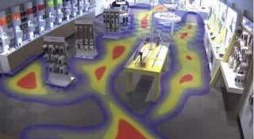
Tracking and Monitoring the Public

Slide 46

Tracking and Monitoring the Public

Slide 47
The Corporate View: In-House Perspective on IT Infrastructure
  Moving from On-Premise to the Cloud
    Reduced infrastructure
    Greater scalability
    Dramatically improved security from 3-5 years ago
  With the move to the cloud, comes a massive proliferation in systems and applications

Slide 48
Summary
The last 25 years have seen a profound evolution in the creation and use of information.
    Technology has developed at a rapid pace and re-defined what is possible and how data is used by organizations and consumers
    Businesss that cannot properly harness digital data cannot survive
New leadership and new skillsets are needed
    Chief Technology Officer
    Chief Information Governance Officer
    Chief Privacy Officer
    Chief Information Security Officer
Understanding the risks that come with digital data
    Security
    Privacy
    Legal challenges
    Training & Oversight
    Managing excess volumes

Slide 49
Questions
QUESTIONS?

