Slide 2


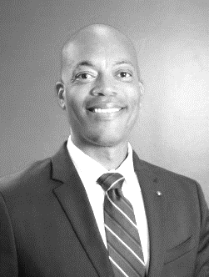
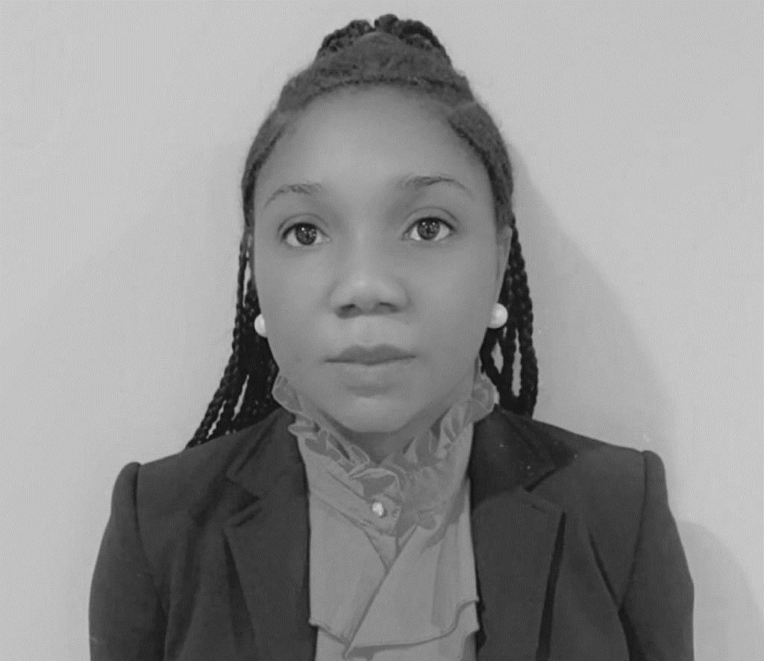
Is It Too Cold For Phishing?
James Bailey
President & CEO
Millicent Kesewaa
Senior Information Security,
Privacy and Risk Management

Slide 3


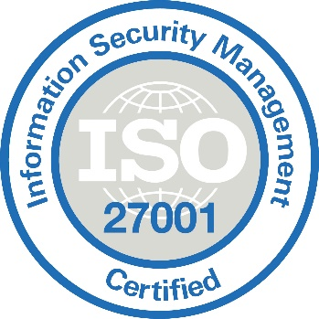






RE-THINK
TECH
Recipient of numerous awards:
  Correspondence Mgmt. Inclusion in Innovation Microquadrant by MarketsANDMarkets
  Hyland Alfresco Federal Partner of the Year (for 3 years)
  Winner of the OpenText Documentum DEV Challenge
  OpenText Documentum Platform Product of the Year
  Stevie Award (The Well Project)
  InfoWorld 100 Best Website of the Year
  Inc. 5000 (4 years)
Technology & Systems Integrator
Founded in 2002
  135 employees
  Main offices in Atlanta, GA; Vienna, VA (DC Metro); Florida; and Europe
Veteran Owned Small Business (VOSB)
Certified MBE
ISO 9001 / ISO 27001 Certified
CMMI Level 3 Appraisal
FedRAMP Moderate (in process)
Strong partnerships with leading providers:
  ActiveNav, Alfresco/Hyland, ASG, AWS, Box, Ephesoft, Fujitsu, Hitachi, Microsoft, OpenText, RICOH, Splunk, UiPath, Veritone, IPRO/ZyLab
Top Secret facility with 30+ Top Secret Employees

Slide 4

Patterns in Digital Transformation
Case & Content
Management
Records Management
IT Modernization & Cloud Migration
ArkCase, an open-source case management platform to automate processes
“ArkCase is the primary interface … resulting in over 40% efficiency...”
---Mr. Davis, COO and co-founder, FederalConference.com
Years of experience supporting City of Atlanta, IRS, FBI, Delta Air Lines, NSF, WHS, etc.
Partnered with DoD Joint Chiefs of Staff to rollout Alfresco RMS as the enterprise document and records management platform.
The Armedia Content Cloud is a FedRAMP Moderate offering with ArkCase, Alfresco, Documentum and Ephesoft.
Migrated over 600 million objects from Oracle UCM to Alfresco and consolidated 4 business applications
Cloud – Open Source – Mobility

Slide 5








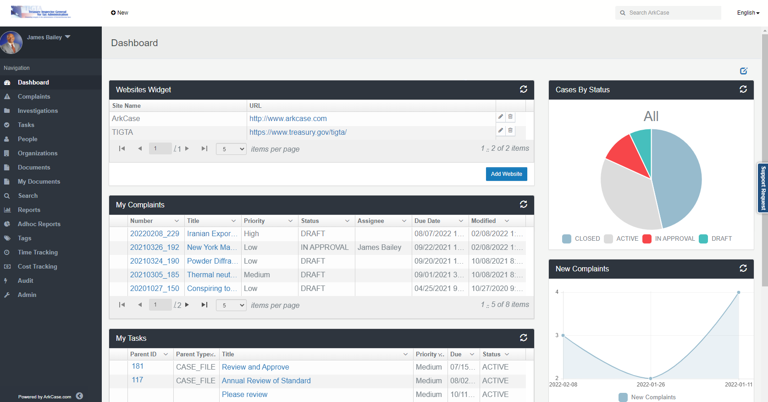



ArkCase
Extends
Alfresco for Case Management System
“ArkCase is the primary interface for federalconference.com’s employees to perform their work every day resulting in over 40% efficiency in managing events and greatly reducing manual processing errors.” — —Mr. Davis, COO and co-founder, FederalConference.com.
Personalized Dashboard
Redaction & Annotation
Reporting & Auditing
Queue, Workflow, and Rules Management
Correspondences Generation, Collaboration,
and Records Management
Subscriptions
Outlook Integration and Tasks
People, Places and Things
Notification
Search
File Management

Slide 6
Phishing By the Number
Different Types of Phishing
Phishing Cases
How to Detect Phishing
How to Protect Yourself From Phishing

Slide 7
IS IT TOO COLD FOR PHISHING

Slide 8
PHISHING BY THE NUMBERS
~1.5 M new phishing sites are created each month
25% of all data breaches involve phishing and 85% of data breaches involve a human element
81% of organizations around the world have experienced an increase in email phishing attacks since March 2020
60% of small businesses shut down within 6 months of an attack
77% of millennials are more susceptible to lose money through email scams
Source: Manage Solution, LLC
Source : 50 Phishing Stats You Should Know In 2022 | Expert Insights
Source: Cost of a Data Breach Report 2021 (ibm.com)

Slide 9
WHAT IS PHISHING
Phishing is a cybercrime in which a target or targets are contacted by email, telephone or text message by someone posing as a legitimate institution to lure individuals into providing sensitive data.
Common Phishing Scams
Credit Card Phishing Scam
Bank Phishing Scam
Email Phishing Scam
Website Phishing Scam

Slide 10
PHISHING ATTACK
Spear Phishing
Spear phishing is a targeted attack at a specific individual in a organization
Whaling
Phisher targets high profile executive from the company
Email/Spam
The same email is sent to millions of users requesting for personal details

Slide 11
PHISHING ATTACK
Vishing (Voice Phishing)
Phisher makes phone calls to the user and asks the user to dial a number
Smishing (SMS Phishing)
Phishing conducted via Short Message Service (SMS), a telephone-based text messaging service
Malware
A phishing scam which requires malware to be run on the user’s computer

Slide 12
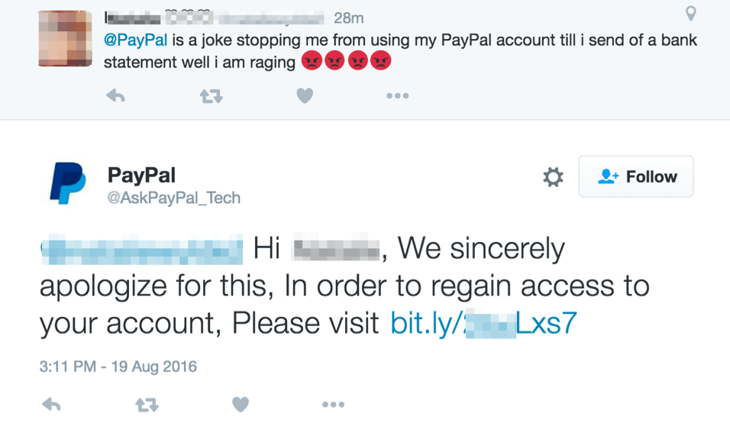
SOCIAL MEDIA PHISHING
With over 1.3 billion users every month, social media phishing represents a rich source of income for hackers.

Slide 13
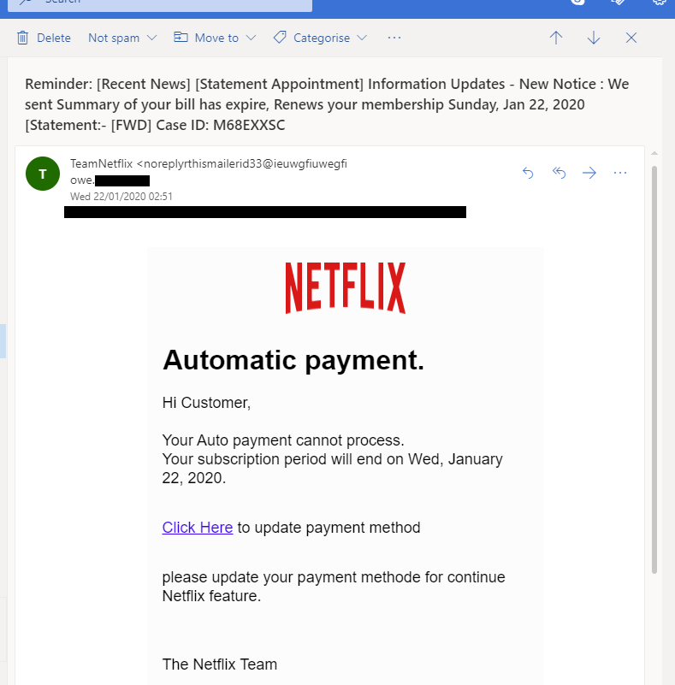
PHISHING EMAIL

Slide 14
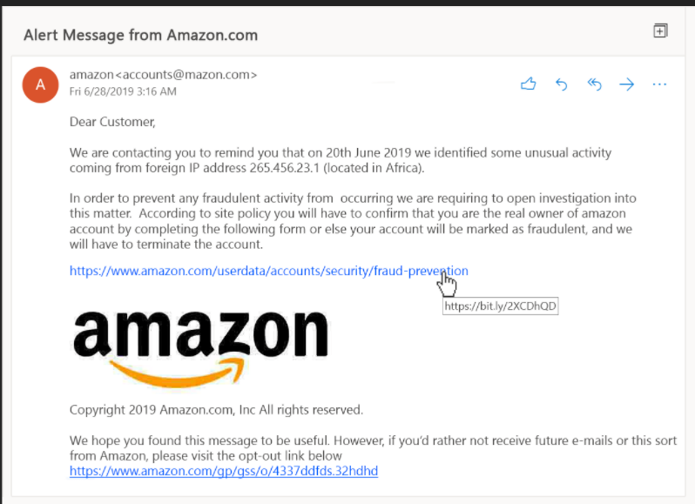
PHISHING EMAIL

Slide 15
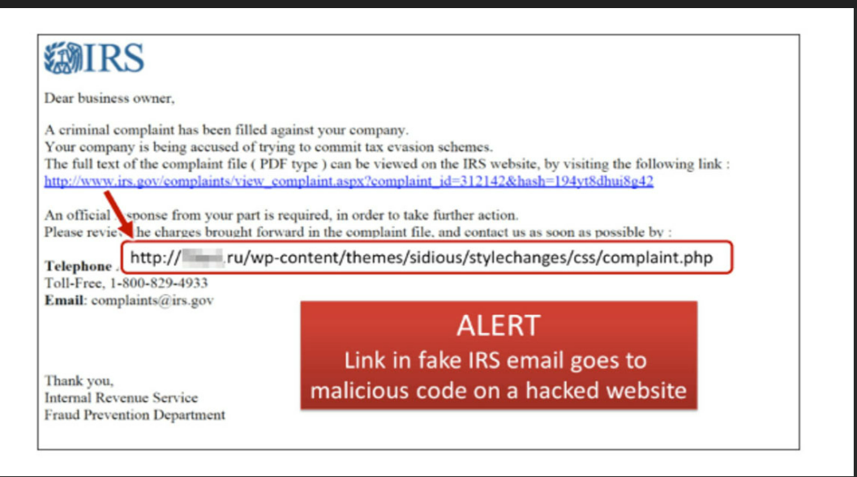
PHISHING EMAIL

Slide 16
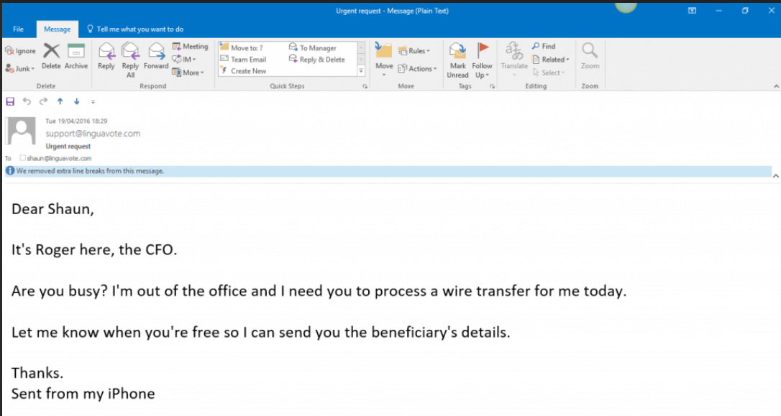
PHISHING EMAIL

Slide 17
IDENTIFYING PHISHING EMAILS
There is usually an attachment, but sender never mentions content of the attachment
Uses urgency to manipulate the victim
Watch for spelling and/or grammar errors. Phishing scams will often contain one or both.
Always check the sender’s email address listed at the top of your email

Slide 18
IDENTIFYING PHISHING EMAILS
Always hover your cursor over links within an email to determine if the link URL is legitimate. If it goes to a website that you don’t recognize or doesn’t match what you are expecting to see, then it likely isn’t legitimate.
If you have any doubt about the veracity of the sender’s organization or internal department, look it up online and verify it.
Always verify physical address details from a sender you don’t recognize.
Configure your email settings to block automatic downloads.

Slide 19
PHISHING QUIZ 1
You are working as an engineer on the design of a new product your company hopes will be a big seller when you receive an email from someone you do not personally know.
The email is addressed to you and was sent by someone who identifies herself as the VP of your product division. She wants you to send her a zip file of your design documents so she can review them. While her name is that of the real VP, she explains that she is using her personal email system since her company account is having problems.
You suspect fraud. What kind of attack are you likely under?
Phishing attack
Shark attack
Spear phishing attack
A man in the middle attack

Slide 20
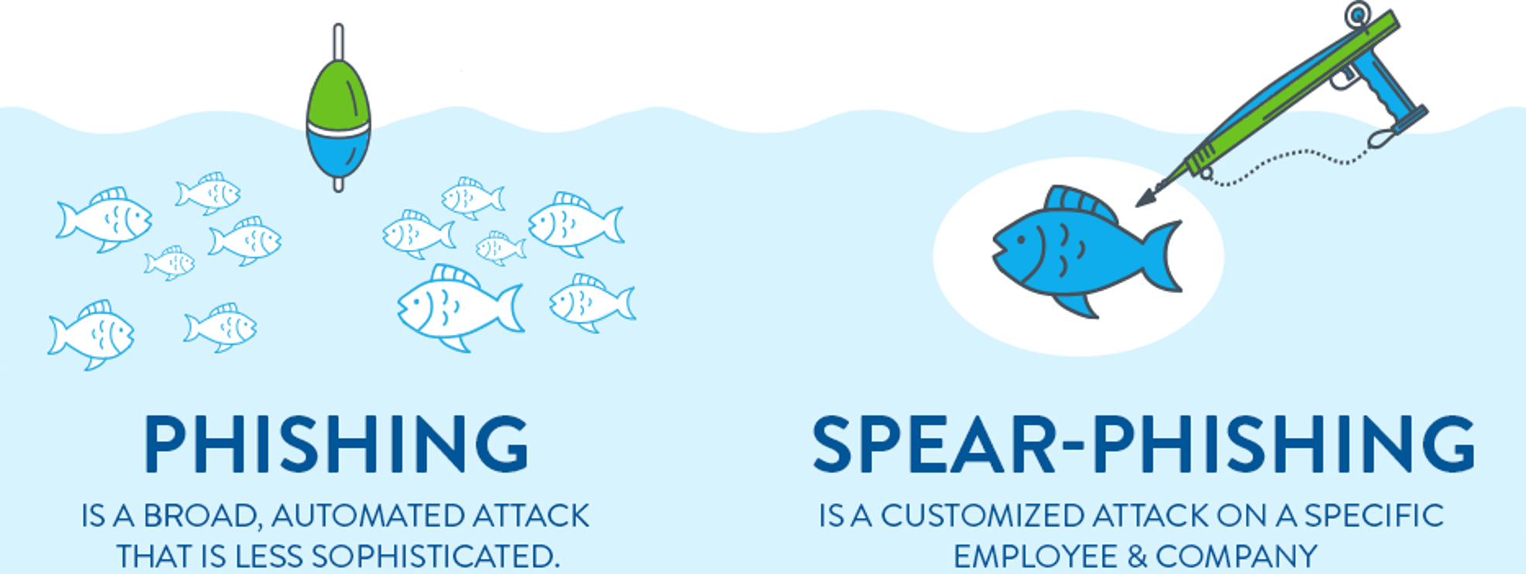
QUIZ ANSWER
c. Spear phishing attack

Slide 21
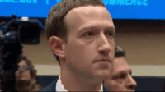
TOP CASES
Facebook & Google
Between 2013 and 2015, Facebook and Google were tricked out of $100 million due to an extended phishing campaign.

Slide 22
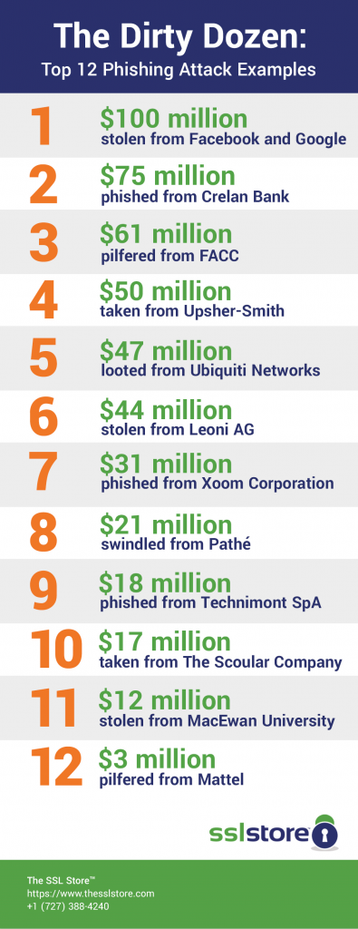
TOP CASES

Slide 23
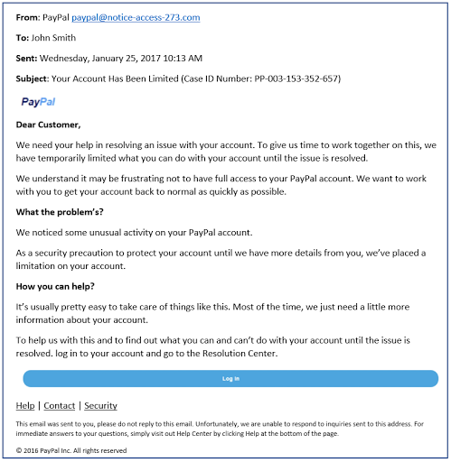
PHISHING QUIZ 2
Which feature of this email is a red flag, indicating that it may be a phishing attack and not a legitimate account warning from PayPal?

Slide 24


QUIZ ANSWER 2

Slide 25
WHY WE FALL FOR PHISHING
We underestimate the risk
Our brains are wired to make quick decisions
We see the potential for high benefits outweighing the risks

Slide 26
HOW TO PROTECT YOURSELF FROM PHISHING
Protect your network by using antivirus and anti-phishing technology
Protect your computer and mobile phone by setting software to update automatically
Protect your accounts by using multi-factor authentication
Protect your data by backing it up
Think before you click!
Never give out personal information
Avoid pop-ups

Slide 27
HOW PHISHING PRONE ARE YOU

Slide 28
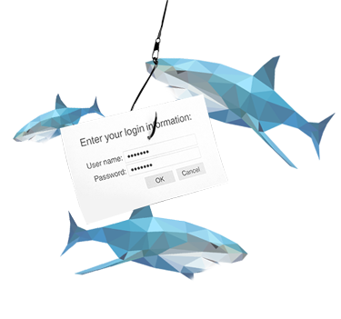
Do you use the same password for multiple accounts?
YES or NO

Slide 29
Do you overshare on social media, constantly post your location and answer personal questions?
YES or NO

Slide 30

ANSWER

Slide 31
WHAT TO DO IF YOU’RE THE VICTIM OF A PHISHING
Restart your computer
Change your password/passwords
Report incident to IT/Security department
Scan your computer for viruses and malware
Contact your financial institution
File a report with the FTC
Protect yourself against future phishing schemes

Slide 32
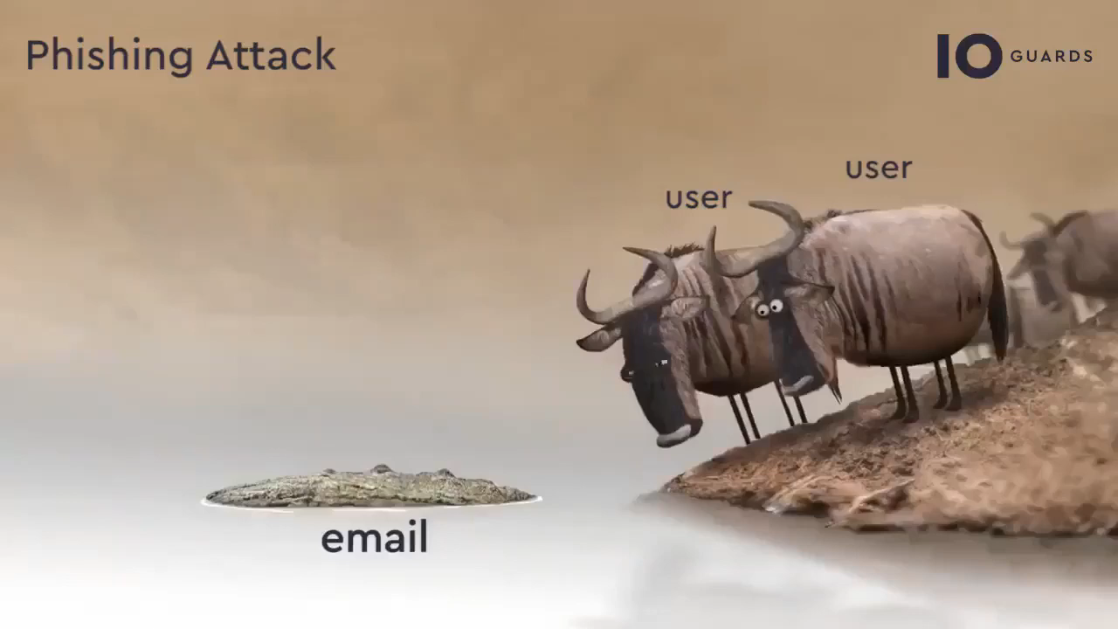
SOMETIMES YOU NEED TO USE YOUR INTUITION

Slide 33
Please contact us if you would like to discuss your cyber maturity or records management needs?
sales@armedia.com

