Slide 1

Practical Tips for Making Change Stick
Michelle Bundy
February 21, 2018

Slide 2
Overview
What Is Change Management
Why Is Change Management Important
Practical Tips For Making Change Stick
  Define Your Change Roles
  Understand Your Stakeholders
  Map Out Your Messages
  Repeat and Reinforce Your Change
  Plan To Deal With Resistance

Slide 3
What Is Change Management
change man·age·ment
noun
1. the management of change and development within a business or similar organization.
Google Dictionary

Slide 4


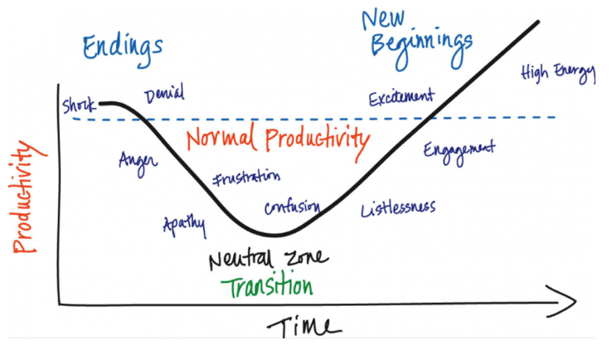
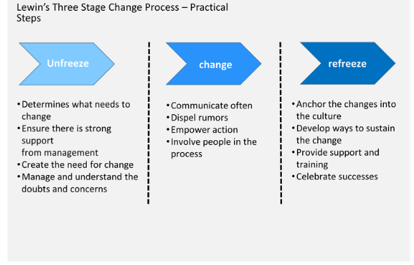
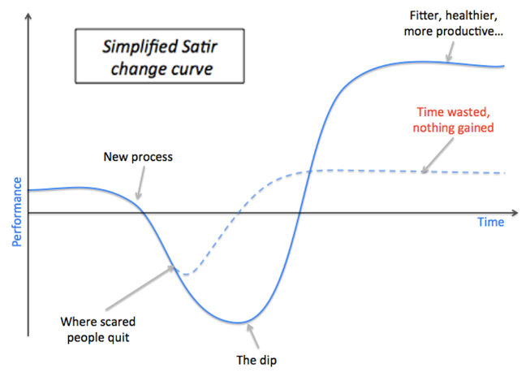
Change Management Methodologies
Bridges’ transition model
PROSCI
Kotter’s theory
Lewin’s change model
Satir change management model

Slide 5
Basic Change Management Principles
Changes is continuous
People will resist change
People have to adjust to change
Leadership buy-in is important to change success
Planning for change will provide more consistent outcomes
"Change is not only likely, it's inevitable." - Barbara Sher

Slide 6
Change Management VS Project Management
Project Management
Focus:
Technical side of moving from current state to future state
Current
state
Transition
state
Future
state
Change Management
Focus:
People side of moving from current state to future state
Prosci.com

Slide 7
Why is Change Management Important?
Current
Transition
Future
Benefits
Adoption and usage impacts
"Your success in life isn't based on your ability to simply change. It is based on your ability to change faster than your competition, customers, and business." - Mark Sanborn
Prosci.com
Notes:
Increase probability of success
Manage employee resistance
Build change competency “muscle” in your organization

Slide 8
Practical Tips For Making Change Stick
Define Your Change Roles
Understand Your Stakeholders
Map Out Your Messages
Repeat and Reinforce Your Change
Plan To Deal With Resistance
“Change is such hard work.” - Billy Crystal

Slide 9
Change Management Roles
Sponsor of Change
Project Manager
Change Management Manager
Stakeholders
Leadership / Executive Management
People Managers
Employees

Slide 10
Sponsor of Change
Be active with the project team
Build a coalition of stakeholders
Be a visible spokesperson for the change
Most common mistakes of a sponsor
  Not visibly supporting the change throughout the entire process.
  Abdicating responsibility or delegating down - “setting it up and leaving it to the project manager.”
  Not communicating the reason and need for change and the future state (the vision) to employees and managers multiple times through multiple media.
  Failing to build a coalition of business leaders and stakeholders to support the project.
Prosci.com

Slide 11
People Managers
Communicator:
  Provide employees awareness
Advocate:
  Employees follow the example set by the manager
Coach:
  Help employees through the transition
Resistance manager:
  Listen to employees so objections can surface
Liaison:
  Provide the project team an accurate view of impact on employees
Prosci.com

Slide 12
Practical Tips For Making Change Stick
Define Your Change Roles
Understand Your Stakeholders
Map Out Your Messages
Repeat and Reinforce Your Change
Plan To Deal With Resistance
“Change has its enemies.” - Robert Kennedy

Slide 13
Map Your Stakeholders
Stakeholder Assessment Diagram
Ops 1
Ops 2
IT
BU 1
BU 2
Identify the stakeholder’s capability as a change leader
  Supportive of change
  Ability to influence change
Develop a strategy to build a stronger coalition of stakeholders
Prosci.com

Slide 14
Practical Tips For Making Change Stick
Understand Your Stakeholders
Define Your Change Roles
Map Out Your Messages
Repeat and Reinforce Your Change
Plan To Deal With Resistance
“The first step toward change is awareness. The second step is acceptance.”
- Nathaniel Branden

Slide 15
Most Effective Communicators
Prosci – Best Practices in Change Management 2016 Edition

Slide 16
Messages To Share
Employees
want to hear
Business reason for change
  Why is this change happening?
  What is the risk of not changing?
What is in it for me?
Executives & People Managers
want to hear
What is my role and what are your expectations?
Business reason for change
  Why is this change happening?
  What is the risk of not changing?
Prosci.com

Slide 17
Practical Tips For Making Change Stick
Understand Your Stakeholders
Define Your Change Roles
Map Out Your Messages
Repeat and Reinforce Your Change
Plan To Deal With Resistance
“Paralyze resistance with persistence.” - Woody Hayes

Slide 18


Repeat And Reinforce Key Messages
Repeat your key messages to times
Coach your sponsors, executives, and people managers with what to say and when to say it
Be creative with how you communicate
  Meetings, 1-on-1 conversations, newsletters, presentations, focus groups, lunch and learns, Intranet Q&A forums, videos, screen saver messages, animation, etc
Monitor how well employees are engaging in change
Prosci.com

Slide 19
Practical Tips For Making Change Stick
Understand Your Stakeholders
Define Your Change Roles
Map Out Your Messages
Repeat and Reinforce Your Change
Plan To Deal With Resistance
“If you want to make enemies, try to change something.” - Woodrow Wilson

Slide 20

Focus Your Time
Early Adopters
Target
Majority
Laggards
Prosci.com

Slide 21
Managing Resistance
Expect resistance to change
Understand root causes for resistance in employees
  Lack of awareness
  Change specific resistance
  Resistance due to change saturation
  Fear
  Lack of support from management or leadership
Proactively avoid or prevent resistance from employees
Prosci – Best Practices in Change Management 2016 Edition

Slide 22

For changes to be of any true value, they've got to be lasting and consistent.
- Tony Robbins

