Slide 1
Presidential Libraries
Sam McClure
February 19, 2020

Slide 2
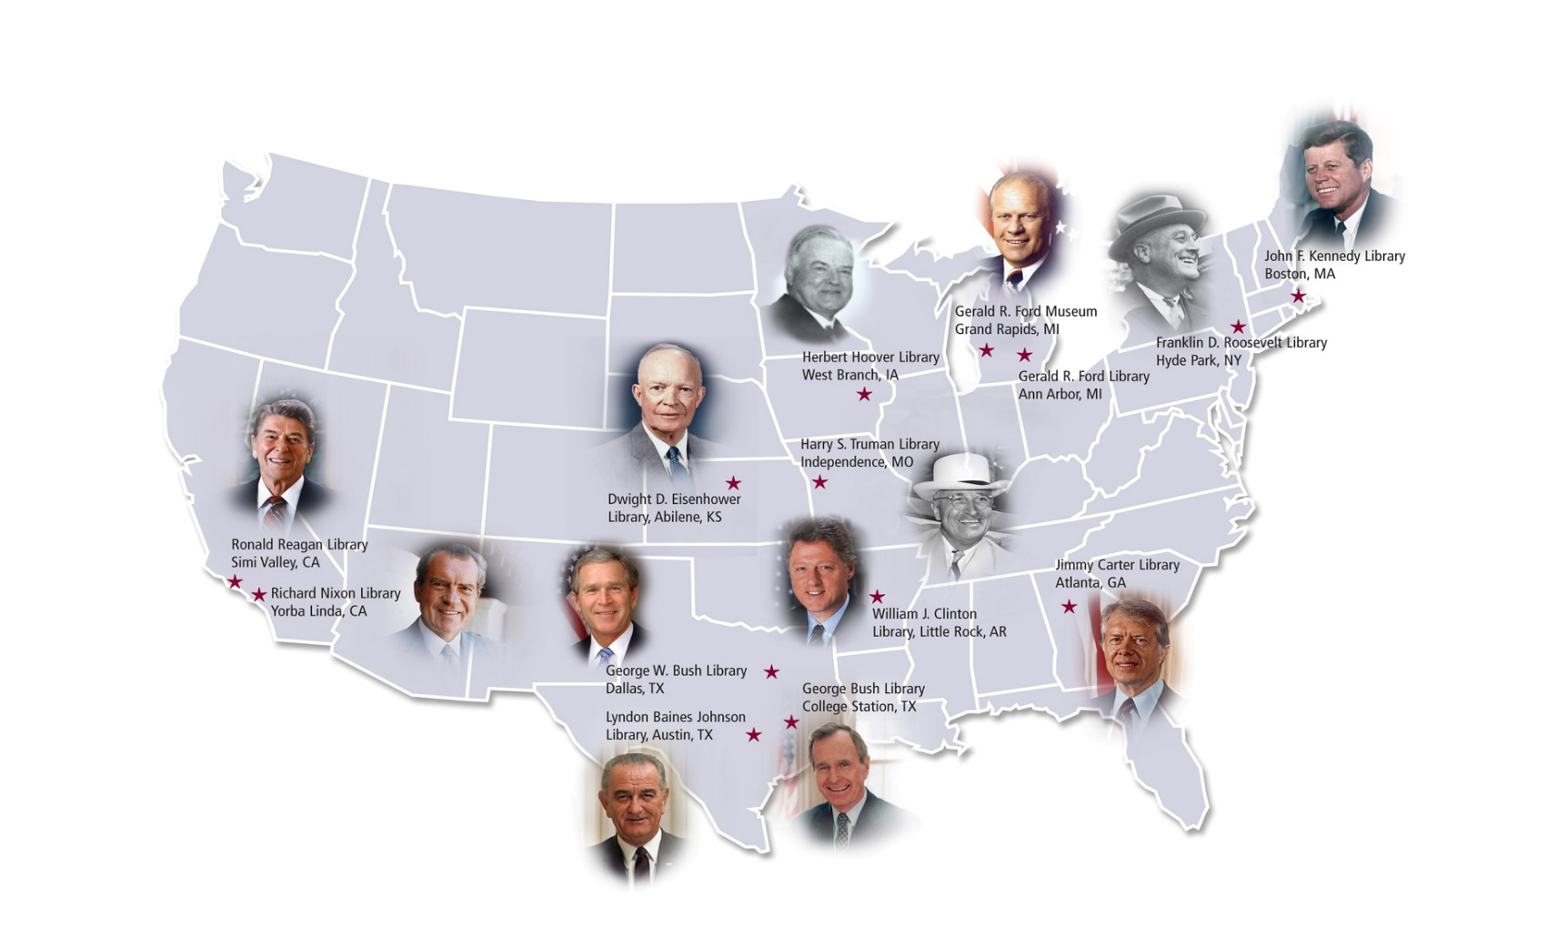
Presidential Libraries of the National Archives
650 million pages of textual records
Nearly 10 million photographs
Over 15 million feet of motion picture film
Nearly 100,000 hours of disc, audiotape, and videotape recordings
Almost 600 million emails (300TB+ of electronic records total)
More than 600,000 artifacts
Exhibits visited by more than 2 million people annually
Thousands of researcher visits
Thousands of public program attendees
Millions of visits to web sites

Slide 3
It Began with FDR
1934 - National Archives established
1938 - FDR announces creation of his Library
1939 - Legislation authorizes government acceptance of Library and holdings into custody of Archivist of the United States
1941 - National Archives special committee on finding aids proposes concept of Record Group

Slide 4
Why a Library?
Presidential files were personal property of a President, taken with him upon the end of his administration
Before FDR, no centralized means of collecting and preserving Presidential files
FDR’s materials
  Millions of pages of files
  15,000 books
  More than a million stamps, 1200 naval prints and paintings, more than 200 ship models
  Gifts from heads of state and from the American people

Slide 5
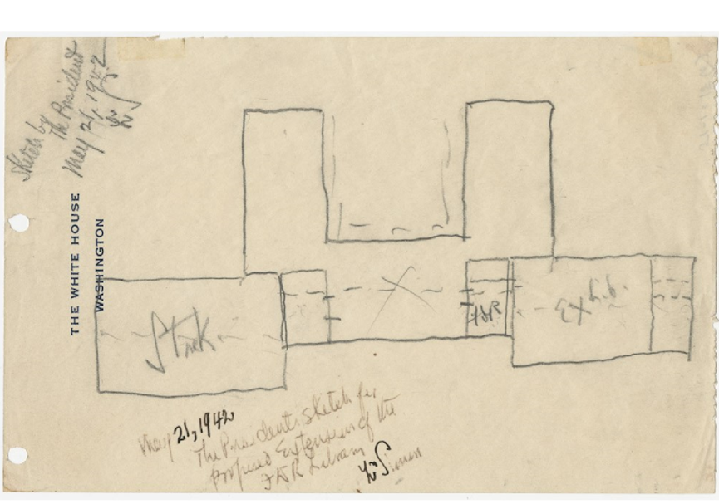
FDR’s personal interest defined the Library
Definition of the Library’s scope
Archival research
Museum
Community involvement
Subject to criticism from the outset
FDR's Sketch of Proposed Extensions to FDR Library, May 21, 1942 (from: Louis Simon Papers (Box 1))

Slide 6
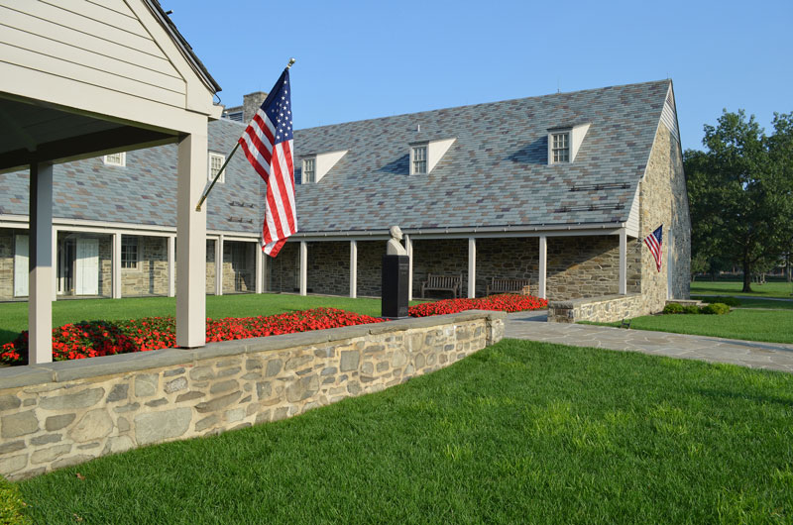
Franklin D. Roosevelt Presidential Library and Museum – Hyde Park, NY (opened 1941)

Slide 7
Congressional Oversight - Presidential Libraries Act of 1955
Required the Administrator of GSA (parent of the National Archives in 1955) to submit a report to Congress on any proposed Presidential archival depository
Authorized the Administrator of GSA, on behalf of the United States, to:
      Accept for deposit the papers and other historical materials of a President and similar materials relating to the President that are in the custody of other persons
      Accept land, buildings, and equipment offered for its establishment of a Presidential Library
      Maintain, operate, and protect the Library and its holdings
      Observe restrictions on access to the historical materials that have been set by the donors and agreed to by the Administrator
      Provide for the exhibit of museum items to the public

Slide 8
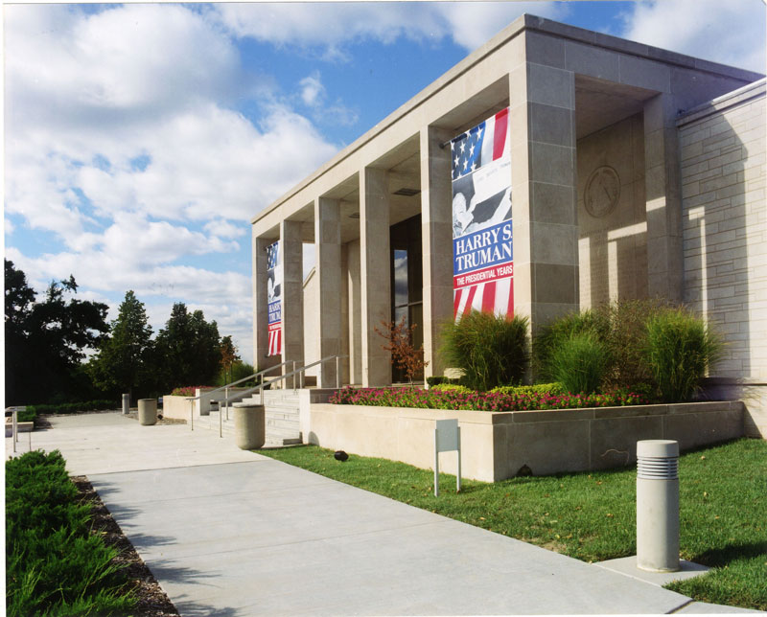
Harry S. Truman Presidential Library and Museum – Independence, MO (opened 1957)

Slide 9
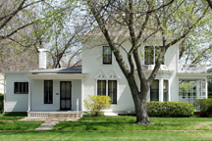
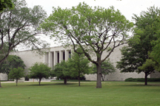
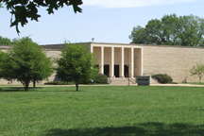

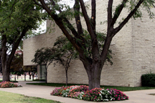
Dwight D. Eisenhower Presidential Library and Museum – Abilene, KS (Museum opened 1954, Library opened 1962)

Slide 10
Herbert Hoover Presidential Library and Museum – West Branch, IA (opened 1962)

Slide 11
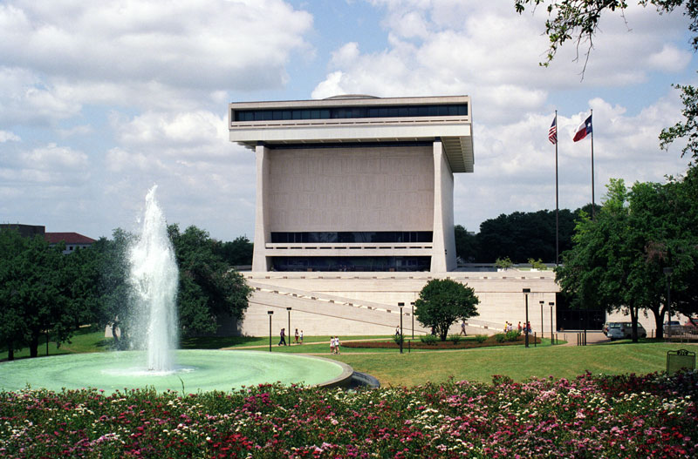
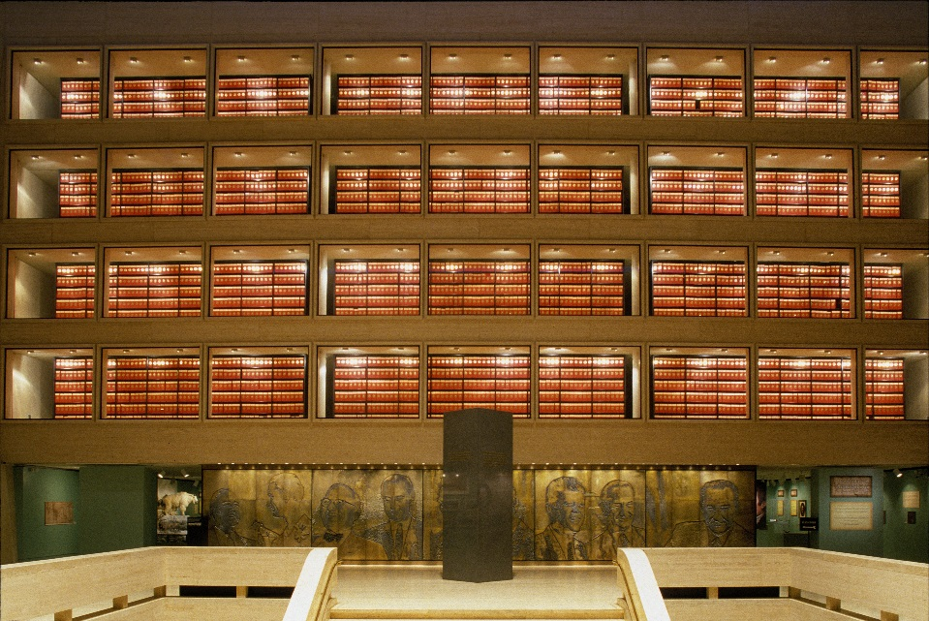
Lyndon B. Johnson Presidential Library and Museum – Austin, TX (opened 1971)

Slide 12
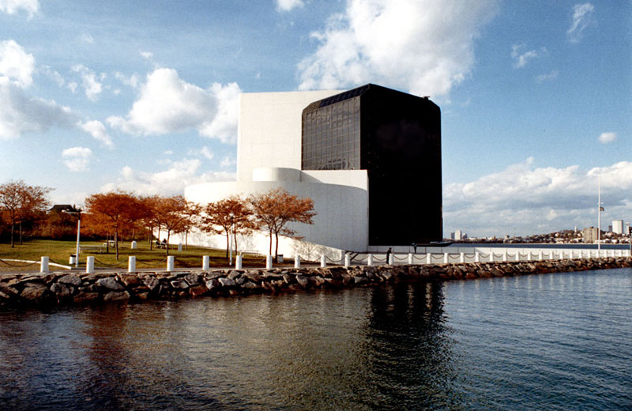
John F. Kennedy Presidential Library and Museum – Columbia Point, MA (opened 1979)

Slide 13
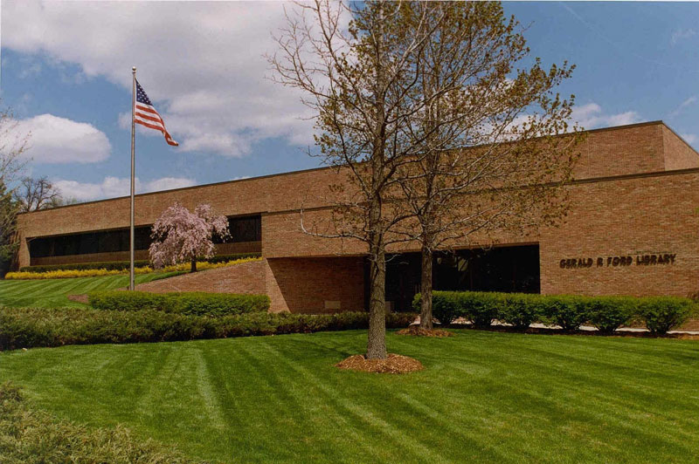
Gerald R. Ford Presidential Library – Ann Arbor, MI (opened 1981)

Slide 14

Gerald R. Ford Presidential Museum – Grand Rapids, MI (opened 1981)

Slide 15

Jimmy Carter Presidential Library and Museum – Atlanta, GA (opened 1986)

Slide 16
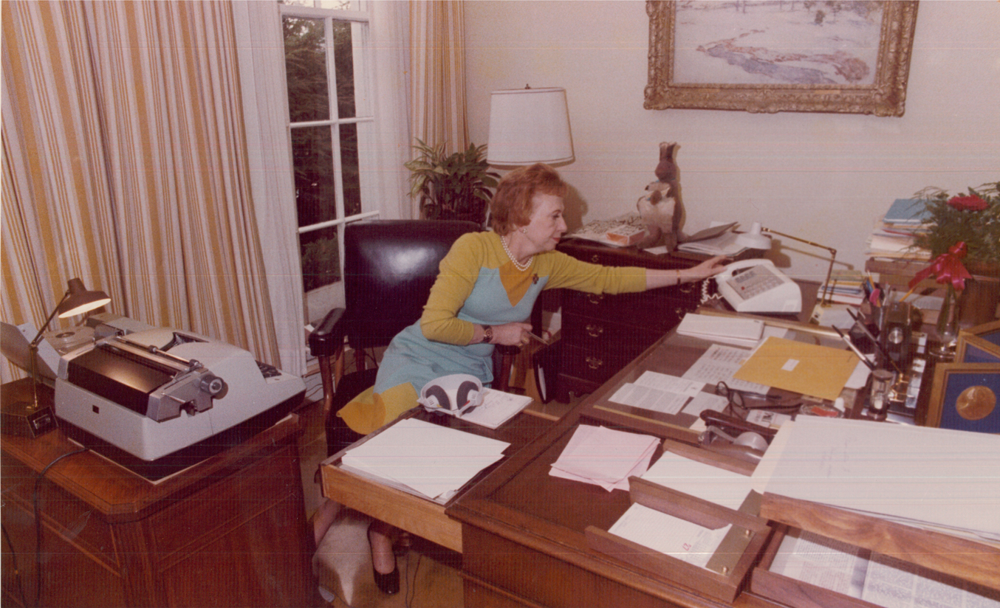
The Impact of Richard Nixon
Investigations into the actions of the Nixon administration led to a fundamental change in the ownership of Presidential materials
Exhibit 73, Picture of Rose Mary Woods in Her Office (Transcripts of In Re Grand Jury Proceedings, 5/1973 - 1/1974; RG 460: Records of the Watergate Special Prosecution Force, 1971 – 1977) National Archives Identifier 7582819

Slide 17
PRESIDENTIAL RECORDINGS AND MATERIALS PRESERVATION ACT OF 1974
Authorized the Government to take custody of Nixon Presidential materials
Under this Act, the Archivist was required to
  Store the materials within the Washington, DC, metropolitan area
  Furnish the public at the earliest reasonable date with information in the materials relating to abuses of governmental power
  Provide eventual public access to all of the materials declared to be of general historical interest
Decades of litigation ensued
Nixon Library (non-NARA) – 1990 / Nixon Library (NARA) - 2007

Slide 18
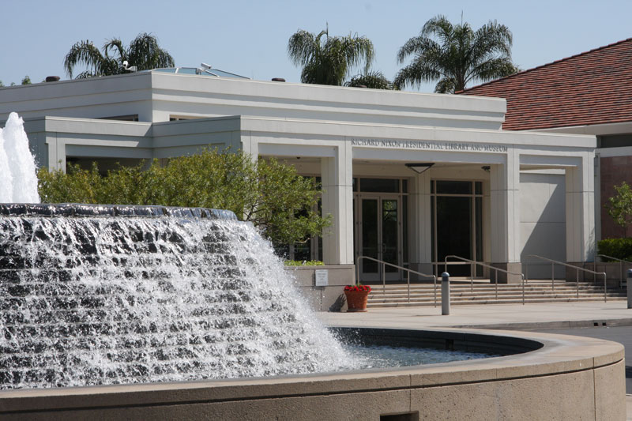
Richard Nixon Presidential Library and Museum – Yorba Linda, CA

Slide 19
Presidential Records Act of 1978
Governs the official records of Presidents and Vice Presidents that were created or received after January 20, 1981
Changed the legal ownership of the official records of the President from private to public
The Archivist is to take custody of the records when the President leaves office
The President may restrict access to specific kinds of information in the records for up to 12 years after he leaves office; but any unrestricted records will be subject to the Freedom of Information Act (FOIA) 5 years after the President leaves office; and restricted records will be the subject to FOIA after 12 years.
Vice Presidential records are also owned by the United States and are administered in the same manner as Presidential records
Current and former Presidents have right to claim executive privilege over any official records governed by the PRA

Slide 20
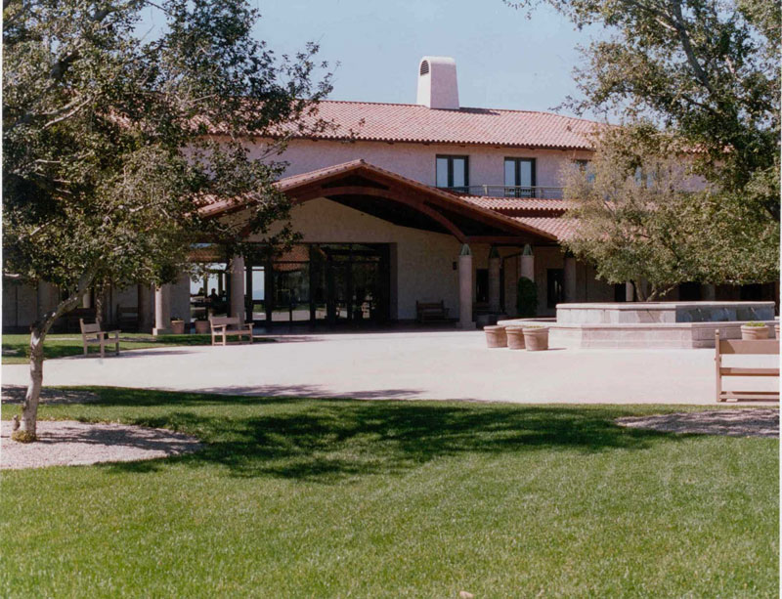
Ronald Reagan Presidential Library and Museum – Simi Valley, CA (opened 1991)

Slide 21
Presidential Libraries Act of 1986
The Archivist must issue architectural and design standards for Presidential Libraries
The Archivist must establish separate endowments for each Presidential Library
    Income shall be available to help defray the cost of facility operations
    The endowment must be equal to 20 percent of the cost of the land, building and equipment
    If the building is larger than 70,000 square feet, an additional endowment, calculated at a higher level, is required
    Applies to the Presidential Library of any President who takes office for the first time on or after January 20, 1985
Amended in 2008 to raise endowment requirement to 60 percent
    Applies to Libraries built after the George W. Bush Library

Slide 22
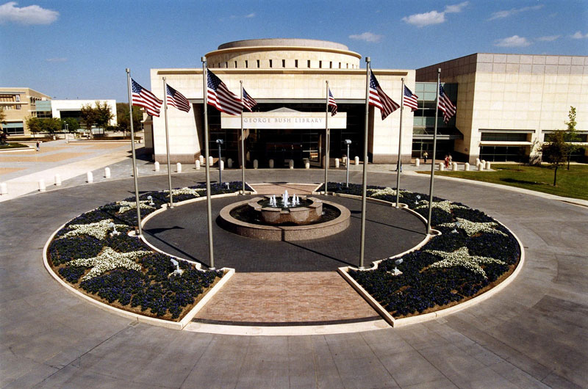
George Bush Presidential Library and Museum – College Station, TX (opened 1997)

Slide 23
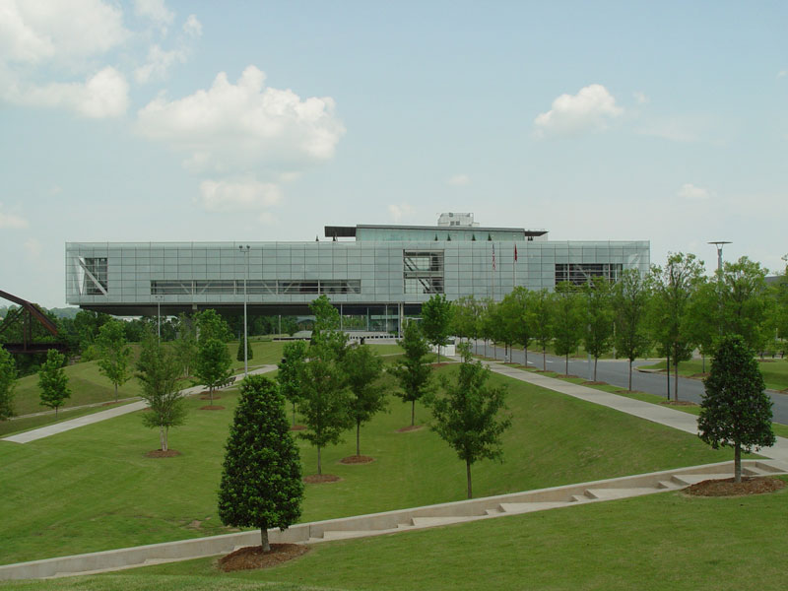
William J. Clinton Presidential Library and Museum – Little Rock, AR (opened 2004)

Slide 24
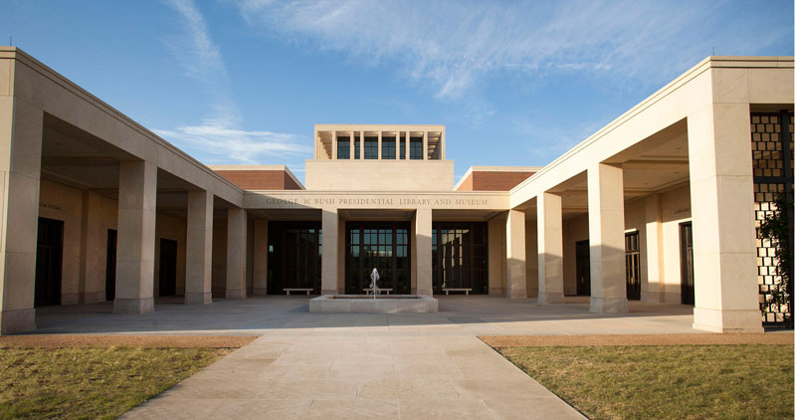
George W. Bush Presidential Library and Museum – Dallas, TX (opened 2013)

Slide 25
Evolution of Presidential Records
William J. Clinton administration
      Approximately 36,000 cubic feet of traditional records
      Approximately 20 million emails
      Less than 4 TB of unclassified electronic records
      George W. Bush administration
      Approximately 28,000 cubic feet of traditional records
      Approximately 200 million emails
      Approximately 80 TB of unclassified electronic records
      Barack Obama administration
      Approximately 16,000 cubic feet of traditional records
      Approximately 300 million emails
      Approximately 250 TB of unclassified electronic records

Slide 26
Start of a new model for Presidential Libraries
There will be no “Obama Presidential Library” building constructed and given to NARA
Digitization of analog unclassified Presidential records
      Foundation financial support, including support for shipment of original analog records to long-term NARA archival storage
      Digitization vendor to be selected by the Foundation and approved by NARA
      NARA oversight over digitization process and quality control of digital copies
      Access review (including Freedom of Information Act requests) conducted by NARA using digitized records
      NARA will loan select records and artifacts to Foundation for exhibition at the Obama Presidential Center
      Obama Presidential Library Agreements posted here - https://www.archives.gov/foia/obama
      Letter of Parties’ Intent (September 2018)
      Memorandum of Understanding Regarding the Digitization of Obama Presidential Records (February 2019)

