Slide 1

The Alphabet Soup of Regulations
Northern Virginia ARMA Chapter Feb 2023
Notes:
Thank you joining me today. This presentation will cover the alphabet soup of the ever changing regulations

Slide 2

Introduction
JENNIE GIFT, CRA,CSDS
VP of Sales at CSR Privacy Solutions
Serves as Corporate Partner Director for i-SIGMA
Past President of the Denver ARMA Chapter
The alphabet behind my Name
CRA – Certified Record Analyst
CSDS – Certified Secure Destruction Specialist
Notes:
Hello My name is Jennie Gift. I am the VP of Sales for CSR Privacy Solutions. We are offer a SASS service that provides a privacy and cyber security platform for small to medium sized business to help navigate the ever changing regulations and the current privacy environment.
I currently serve on the iSIGMA board of Directors. The Association for the Information Governance Service providers. I am the current past present of the Denver ARMA chapter and former director of the Greater Washington DC chapter.

Slide 3
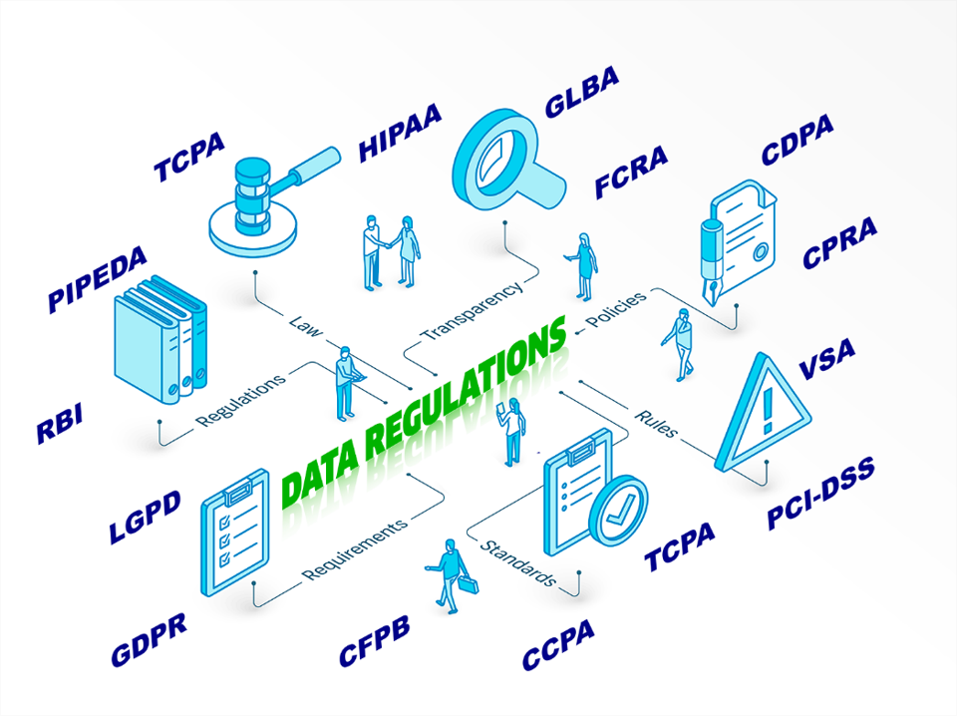
The Hodgepodge of Soup
Notes:
Hodgepodge of Acronyms
Perhaps more challenging than keeping track of the latest laws and regulations is knowing what the hodgepodge of acronyms actually mean. There is the FCRA, GLBA, GDPR, FDIC, HIPAA and PCI compliance
CCPA (now the CPRA), which is perhaps the most famous in the U.S. State Law-Calfornia’s Privacy law

Slide 4










Privacy 101
What is PII?
name, ID numbers, financial, pw
General
Name, Address, Phone Number, Email Address, DOB, Signature
Security
Passwords, PINs, Security Q&A, Access Codes
Personal ID Numbers
SSN, Tribal IDs, Driver’s License, Passport, Tax ID
Medical/Biometric
Medical info, physical description, DNA, fingerprint, voice, facial map, insurance info
Financials
Finance Records, Account Numbers, Credit Card Numbers
Other
Origin, place of birth, religion, ethnicity, orientation
Notes:
Before we take our first bite Lets discuss what information should be protected.
PII – Personally Identifiable Information
In the past we have heard a lot about PCI and HIPAA and the important of data protection. Privacy regulations take the same concept and apply it to a broader category of data.
Although there are regulated categories of data, personal information can be expanded to any information that can identify a sole person through one or multiple pieces of data.
Identity protection is about protecting your data as an element of who you are, such as your credit card number, social security number, or other personally identifiable information (PII). PII is data that can be used to distinguish or trace an individual’s identity.
Data protection establishes how a company can use and share information you give them, or they receive from a company to which you’ve given your data.

Slide 5


The Alphabet Soup
COPPA
Children’s Online Privacy Protection Act
Federal rule in the United States that regulates how online services can handle the personal information of
children under 13 years of age
HIPAA
Health Insurance Portability and Accountability Act
Federal medical privacy law in the United States governing protections for patients’ health information.
HITECH
Health Information Technology for Economic and Clinical Health (Act)
A US federal law, enacted in 2009, that seeks to close loopholes in HIPAA and promote privacy-respecting adoption of electronic health records among healthcare institutions.
AADC
Age-Appropriate Design Code
These codes place legal restrictions on how companies design online products and services for children.
There is a version of this code in the UK and in California.
BIPA
Biometric Information Privacy Act
State privacy law in Illinois governing how businesses can handle users’ biometric information,
effective since 2008.
ECPA
Electronic Communications Privacy Act of 1986
Federal law in the US, effective since 1986, that extends previous legislation against phone wiretapping to protect the contents of computer communications while they are being made, in transit, and stored on computers.
ECPA
FCRA
Fair Credit Reporting Act
Federal law in the US, effective since 1970, that regulates credit agencies’ collection of credit report information as well as individuals’ access to such information.
Notes:
COPPA - Federal rule in the United States that regulates how online services can handle the personal information of children under 13 years of age
HIPAA - Health Insurance Portability and Accountability Act
Federal medical privacy law in the United States governing protections for patients’ health information
HITECH - Health Information Technology for Economic and Clinical Health (Act)
A US federal law, enacted in 2009, that seeks to close loopholes in HIPAA and promote privacy-respecting adoption of electronic health records among healthcare institutions.
AADC - These codes place legal restrictions on how companies design online products and services for children. There is a version of this code in the UK and in California.
BIPA - State privacy law in Illinois governing how businesses can handle users’ biometric information, effective since 2008. The first jury verdict on this law happened on 10/12/2022. They concluded that a company had violated the law by collecting truck drivers fingerprints to verify indentities with out informed written consent.
ECPA - Electronic Communications Privacy Act of 1986
Federal law in the US, effective since 1986, that extends previous legislation against phone wiretapping to protect the contents of computer communications while they are being made, in transit, and stored on computers.
FCRA - Fair Credit Reporting Act
Federal law in the US, effective since 1970, that regulates credit agencies’ collection of credit report information as well as individuals’ access to such information.

Slide 6
Are you tired of Soup Yet?
FERPA
Family Educational Rights and Privacy Act
Federal law in the US, effective since 1974, that regulates access and processing of education-related data.
Foreign Intelligence Surveillance Act
Federal law in the US, effective since 1978, that establishes processes for surveillance of communications, a provision that has been an ongoing point of contention in international data-transfer negotiations, especially between the US and the EU.
.
FISA
Gramm-Leach-Bliley Act
Federal statute in the United States that, among other measures, requires financial organizations to disclose their data safeguards to their users; effective since 1999.
GLBA
Personal Information Protection and Electronic Documents Act
Federal privacy law in Canada, effective since 2000.
PIPEDA
UCPA
Notes:
FERPA - Family Educational Rights and Privacy Act
Federal law in the US, effective since 1974, that regulates access and processing of education-related data
FISA - Foreign Intelligence Surveillance Act
Federal law in the US, effective since 1978, that establishes processes for surveillance of communications, a provision that has been an ongoing point of contention in international data-transfer negotiations, especially between the US and the EU.
GLBA - Gramm-Leach-Bliley Act
Federal statute in the United States that, among other measures, requires financial organizations to disclose their data safeguards to their users; effective since 1999.
PIPEAA - Personal Information Protection and Electronic Documents Act
Federal privacy law in Canada, effective since 2000.

Slide 7
Privacy Regulations
Privacy Laws
Over 600 state and federal laws
Data Breach Laws
All 50 states
State Privacy Acts
5 states
States in Active Legislation
8 States
Sates that did not pass
Notes:
We could probably talk for hours about the alphabet and all the acronyms for Privacy. There is no federal act that covers all aspects. The states have created safeguards.
Data Breach laws/regulations – all 50 states with different requirements – consumer residence determines reportability requirements
5 States have privacy acts: California, Colorado, Connecticut, Utah, New York and Virginia
6 States in active legislation – Indiana, Iowa, Kentucky, Mississippi, New York, Oklahoma, Oregon, and Tennessee.
Three states – Indiana, Iowa, and Oklahoma –passed a bill out of one chamber but not the other

Slide 8

STATE Soup
CCPA -California
California Consumer Privacy Act
State privacy law in California, effective since 2020 and to be followed by the CPRA in 2023.
CPRA - California
California Privacy Rights Act
Upcoming state privacy law in California to replace the CCPA in 2023.
Virginia Consumer Data Protection Act
State privacy law in Virginia, going into effect in July 1, 2023.
The right to know, access and confirm personal data. The right to delete personal data.
VCDPA
Connecticut Data Privacy Act
State privacy law in Connecticut, going into effect in late 2023.
CTDPA
UCPA
Utah Consumer Privacy Act
State privacy law in Utah, going into effect in 2023.
CPA
Colorado Privacy Act
Provides Colorado residents with the right to opt out of targeted advertising, the sale of their personal data and certain types of profiling.
Notes:
CCPA applies to businesses outside California if the business meets certain thresholds. For example, a business in New York may be subject to certain CCPA obligations in relation to its website. The domestic and global data laws impacts your everyday web surfing, even if you do not realize it.
VCDPA are the right to access, right to delete, right to correct, right to data portability, right to opt out, and right to appeal. These rights are summarized as follows:
Right to Access: The right to confirm whether a business is processing the consumer’s personal data and to access that data;
Right to Delete: Allows consumers to delete the data that was provided to or otherwise obtained by a business;
Right to Correct: Allows consumers to correct any inaccuracies in their personal data;
Right to Data Portability: Allows consumers to obtain a copy of data they previously provided to a business in a portable format that allows the consumer to transmit their data to another business;
Right to Opt Out: The ability to opt out of data processing used for the purposes of targeted advertising, the sale of personal data, or profiling in furtherance of decisions that produce “legal or similarly significant effects” concerning the individual; and
Right to Appeal: A consumer can appeal a company’s refusal to provide personal data.
CPA is the Third State to sign a privacy act into law. The Colorado Privacy Act provides Colorado residents with the right to opt out of targeted advertising, the sale of their personal data and certain types of profiling.
The reason I mention these state acts because they all apply to legal entities conducting business in Colorado or delivering products or services targeted to Colorado residents.
Businesses covered by the new data privacy laws should:
Implement cybersecurity safeguards;
Create and communicate to consumers a process by which consumers may submit a request regarding their personal data and subsequently appeal a decision;
Provide a clear and conspicuous notice informing consumers that they have the right to opt out of targeted advertising and sales of their personal data;
Establish a user-selected universal opt-out mechanism by July 1, 2024;
Update their Privacy Policy to explain their collection and use of data;
Update their contracts with third parties to ensure that they comply with the laws;
Obtain consumers’ informed consent before collecting sensitive data; and
Establish a procedure to determine when to conduct a data protection assessment.

Slide 9
Enforcement of Consumer Rights
California
January 1, 2023
Virginia
January 1, 2023
Colorado
July 1, 2023
Connecticut
July 1, 2023
Utah
December 31, 2023
Notes:
These new data privacy laws have gone into effect and will be in the near future. it is never too early to start assessing your company’s data privacy obligations and begin working toward compliance.

Slide 10

How about Cookies?
Notes:
The New Cookie Monster
Cookie pop-ups are perhaps the most noticeable impact duet to the European Union’s General Data Protection Regulation (GDPR). Since the Internet has no physical borders, companies and website operators around the world had to take note of GDPR’s cookie requirements. After GDPR went into effect, you have likely noticed that every site you visit asked for your consent to enable all cookies or select just the ones to which you consent.
The intent of GDPR was to regulate personal data processing and give consumers fundamental rights to know how their personal information is processed, including ensuring the consumer is informed of how the websites they visit use their data.
It has also become to the ground work for many state privacy acts and most likely the upcoming Federal law currently in legislation
What will touch on quickly is that VCDPA says about website cookies?
The Virginia Consumer Data Protection Act (VCDPA) is clearer than most other data privacy laws when it comes to cookies: if your website uses cookies and trackers to collect and process personal data from individuals inside the state of Virginia, users must have the option to opt out of that personal data being used for so-called targeted advertising.

Slide 11

Virginia - VCDPA
Virginia became the second state in the US to pass a comprehensive data privacy law when the Virginia Consumer Data Protection Act (VCDPA) was signed into law in March 2021.
The VCDPA took effect January 1, 2023 and affects companies and organizations that do business in Virginia, or that produce products or services targeted to residents of Virginia.

Slide 12

What does the Virginia Consumer Data Protection Act protect?
The right to know, access and confirm personal data.
The right to delete personal data.
The right to correct inaccuracies in personal data.
The right to data portability (i.e., easy, portable access to all pieces of personal data held by a company).
The right to opt out of the processing of personal data for targeted advertising purposes.
The right to opt out of the sale of personal data.
The right to opt out of profiling based upon personal data.
The right to not be discriminated against for exercising any of the foregoing rights.
Notes:
What does the Virginia Consumer Data Protection Act protect?
The VCDPA also provides consumers with certain rights related to their personal data. Under the Act, these rights include:
The right to know, access and confirm personal data.
The right to delete personal data.
The right to correct inaccuracies in personal data.
The right to data portability (i.e., easy, portable access to all pieces of personal data held by a company).
The right to opt out of the processing of personal data for targeted advertising purposes.
The right to opt out of the sale of personal data.
The right to opt out of profiling based upon personal data.
The right to not be discriminated
Practically speaking, in order to comply with the VCDPA, companies need to inform consumers of their rights under the Act and create a process through which consumers can exercise those rights. The Act also implements other business obligations with regard to personal data.
VCDPA also requires that when a company uses service providers to process data on the company’s behalf, the company must enter into a special contract with that service provider which implements the requirements of the Act and makes clear the service provider’s responsibilities with respect to the personal data that they process.
As a consumer you have must go to each company website and review and request your information based on that company's process. There is not standard language on requesting. The company has 45 days to respond to a consumer's request. The consumer does not have any rights if the company does not reply. All they can do is appeal to each company indepenently.

Slide 13

WHO does the VCDPA apply to?
Companies that:
Conduct business in Virginia or market their goods and services to Virginia residents; and
  Control or process the personal data of at least 100,000 Virginia residents; or
  Control or process the personal data of at least 25,000 Virginia residents and derive more than 50% of their gross revenue from the sale of personal data.
Your business does not have to be in Virginia to be affected by the VCDPA.
Notes:
VCDPA applies to companies that:
Conduct business in Virginia or market their goods and services to Virginia residents; and
Control or process the personal data of at least 100,000 Virginia residents; or
Control or process the personal data of at least 25,000 Virginia residents and derive more than 50% of their gross revenue from the sale of personal data.
Your business does not have to be in Virginia to be affected by the VCDPA.
I know what you are thinking… My company does not fall with in the statues. We don’t collect data on Virginia Residents or process personal data. Are you a vendor that might work with a company that does met these statues? The precedent are being opposed on your business because you are a vendor of a company falls under the statues. That being said I would prepare by making sure you have policies and procedures in place – Contracts – Make sure you have created a data map of your information to understand what data you do have.

Slide 14






What you should think about…
2023 To DO List
Establish Privacy Governance
Establish and Maintain A Data Inventory
Identify and manage sensitive personal data and/or special categories of personal data (“Sensitive Personal Data”)
Conduct Privacy Impact Assessments (“PIA”) or Data Protection Impact Assessments (“DPIA”)
Obtain consent for the sale, sharing or processing of personal data of minors
Disclose if personal data is sold to or shared with third parties for targeted advertising
Update and Revise Privacy Notices
Create or revise data minimization / retention policy
Review and amend contracts with third parties/ vendors/service providers/processors
Manage Individual Rights Requests (“DSARs”)
Privacy Training and Awareness
Validate data security practices and procedures are implemented and maintained.
Sustainable Compliance
Notes:
As the emerging data privacy laws continue to bring to the forefront complex and challenging compliance requirements. Organizations should enhance privacy governance activities by implementing reasonable and appropriate processes and activities that support accountability, authority, risk Management and assurance.
Establish Privacy Governance
Establish and Maintain A Data Inventory
Identify and manage sensitive personal data and/or special categories of personal data (“Sensitive Personal Data”)
Conduct Privacy Impact Assessments (“PIA”) or Data Protection Impact Assessments (“DPIA”)
Obtain consent for the sale, sharing or processing of personal data of minors
Disclose if personal data is sold to or shared with third parties for targeted advertising
Update and Revise Privacy Notices
Create or revise data minimization / retention policy
Review and amend contracts with third parties/ vendors/service providers/processors
Manage Individual Rights Requests (“DSARs”)
Privacy Training and Awareness
Validate data security practices and procedures are implemented and maintained.
Sustainable Compliance

Slide 15




Resources
CSR Privacy Solutions
https://csrps.com
IAPP Global Comprehensive Privacy Law Mapping Chart: https://iapp.org/media/pdf/resource_center/global_comprehensive_privacy_law_mapping.pdf
National Conference of State Legislatures Bill Tracking: https://www.ncsl.org/aboutus/ncslservice/bill-information-services-overview.aspx
Information is Power

Slide 16


Q & A
Presented by
Jennie Gift, CRA, CSDS
E: jgift@csrps.com • P : 1-703-470-5434

