Slide 1
Cover

Slide 2
Agenda
KM vs RIM
01
RIM as a Program
03
The RFP / RFI
04
Vendor Selection
05
End-to-End
02

Slide 3
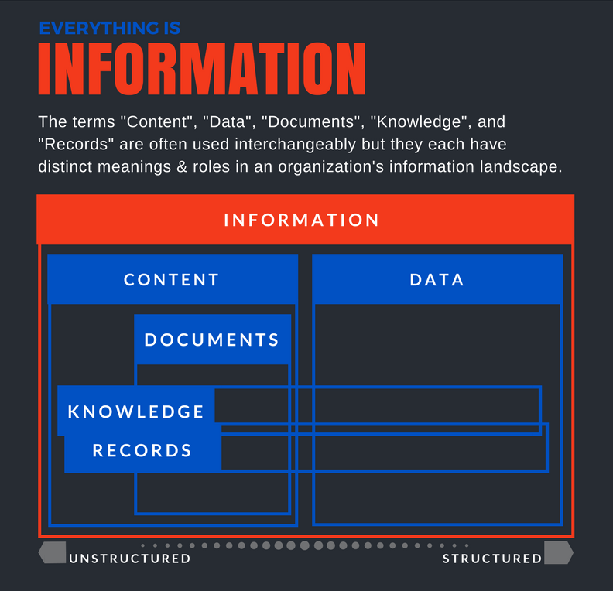
Knowledge Management vs RIM
Notes:
There is nuance here, but if you are managing information properly you are doing both!!

Slide 4
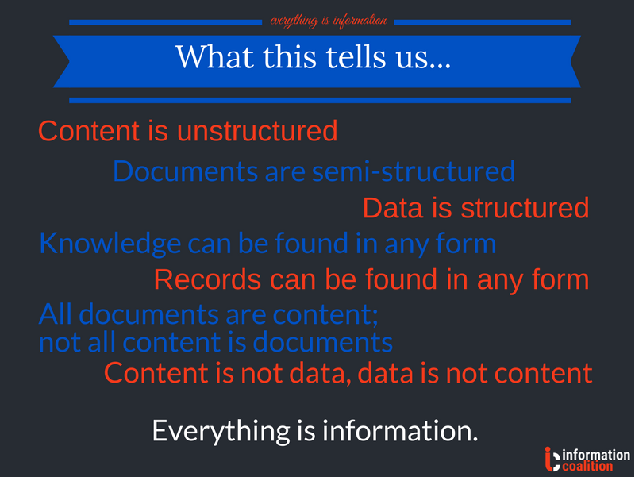
KM vs RIM – What this tells us …
"Knowledge management is a discipline that promotes an integrated approach to identifying, capturing, evaluating, retrieving, and sharing all of an enterprise's information assets. These assets may include databases, documents, policies, procedures, and previously un-captured expertise and experience in individual workers."
Source: Koenig, M. E. (2018, January 15). What is KM? Knowledge Management Explained. Retrieved January 16, 2018, from http://www.kmworld.com/Articles/Editorial/What-Is/What-is-KM-Knowledge-Management-Explained-122649.aspx

Slide 5

The Meaning of End-to-End Automated RIM
M-12-18 Managing Government Records Directive (August 24, 2012)
  “Viable automated records management solutions”
  NARA Audits coming up starting 2019
NARA Strategic Plan (draft)
  By December 31, 2022, NARA will, to the fullest extent possible, no longer accept transfers of permanent or temporary records in analog formats and will accept records only in electronic format and with appropriate metadata.
Notes:
Automated is in the M-12-18 Regulation, what does automated mean
Print and File, then Scan is not automated
Dump scanned into an electronic location is not automated
Storage is not automated
Can only submit the records to NARA if they are properly tagged, if not tagged, then it's not automated

Slide 6

RIM as a Program NOT a Project
Project. A temporary endeavor undertaken to create a unique product, service, or result
Program. A group of related projects, subprograms, and program activities managed in a coordinated way to obtain benefits not available from managing them individually.
GETDT: Governance, Engagement, Technical Development, Digitization, Training
Source: A Guide to the Project Management Body of Knowledge (PMBOK guide) (Fifth ed.). (2013). Newtown Square, PA: Project Management Institute, Inc.
Notes:
Like Privacy, need to include RIM in IT Modernization meetings. Need to have RIM control gates. Talk about the RIMCert process in another agency as an example. Also, RIM involvement in Office 365 move
RIM as a Program across the organization
Need to define the Business Architecture, from Capture, defining internal/external stakeholders, to defining processes and the end state of the information
Helps define the Information lifecycle
RIM advisor on the RIM business side: RIM advocacy/white paper, this person has experience with RIM and IT
IV&V Team to ensure compliance of implementation
NARA's audits coming up starting 2019
Required areas of consideration for establishing a successful RIM Program (Governance, Training…) Need to list the 5 areas.
CFR - says we must plan for obsolecence and in some cases for the information to outlast the system
THE PROGRAM: Governance, Engagement, Technical Development / Automation, Digitization, Training / Adoption

Slide 7

The RFP / RFI
Tips for acquisition
NARA’S Maturity Model
Optional Tasks
RFI to try new tools/Pre-selection
How to Structure your team
The Plan versus the Technology
Control gates for Information Architecture
Own your data
CTA
Avoid massive Single Source awards
Notes:
NARA's Maturity Model as a Tool (why you're doing what you're doing)
Creating Optional Tasks in the RFP to allow for flexibility
The RFI should result in the demo of the tools and for the government to try the tool in the vendor's environment or to get a trial version
The RFI should result in oral presentations The RFI could result in the selection of a tool to issue an RFP to conduct a pilot
The pilot will allow the government to install the product internally and determine if it will work in a government environment
If it doesn't and it requires adjustments to get it working in the government environment, then the gov will know sooner if the vendor is willing to make adjustments to their software to get it working in government
Massive single source contract/IDIQ that has everything - you loose the expertise, and loose the ability to monitor and control - You can fall back on your RIM IV&V Team
How to structure your team while leveraging your existing resources and bring RIM expertise
Own the metadata and taxonomy
Control gates for information architecture
Leverage CTA's to purchase the product from the software vendor and the services from the implementation services team, that way you have 2 primes to reach to that specialize in their area and they are both accountable for delivery of their product or services
Provide as much information as possible in the RFP: TB, size, format, types of storage, # of processes, # units/departments, # boxes and what's in each box, volume of physical and electronic records Information would help draft a project plan that is realistic and attainable
Require a Project Plan that defines who's doing what, and use a tailed Agile approach to the project

Slide 8

The Vendor Selection & Assessment
Systems Integrators (SI) that have a partnership with the software vendor
SI's support resources are trained
SI is aware of the software roadmap
Selection of Vendor that understands government
Experience implementing with government
Notes:
Systems Integrators that have partnership with the software vendors. Benefits are:
SI's support resources are trained
SI is aware of the software roadmap as well as government constraints - cannot live outside the firewall (educate our software partners) key
Selection of Vendor that understands government and can adapt to the government environment - examples of on-prem vs. SaaS solutions, and how the software roadmaps can affect government because of the fast changing technology and platforms
Experience implementing with government

Slide 9
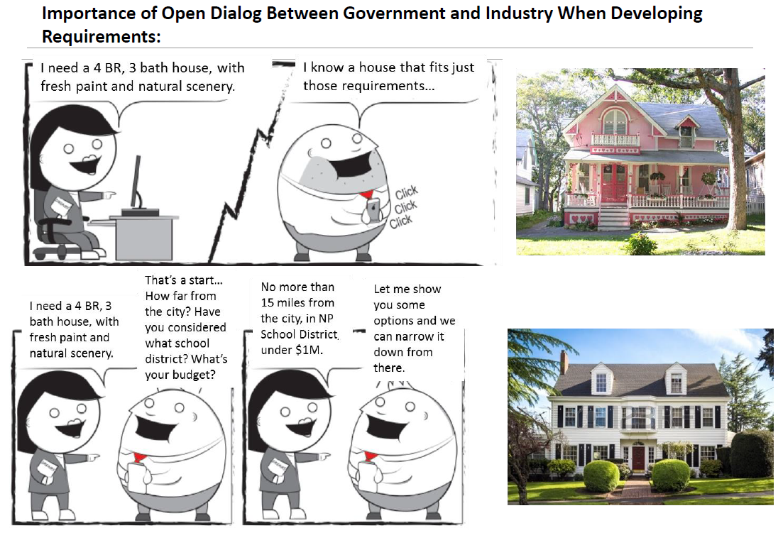
Increase the Dialogue between Government and Industry
The more interaction industry is offered with government, the better defined requirements are.

Slide 10

Contact Us
Amina Elgouacem
President & CEO
NEOSTEK
amina.elgouaceman@neostek.com
Justin Head
RIM Program Manager
NEOSTEK
justin.head@neostek.com

