Slide 1

Fairfax County Courthouse Tour and
Year End Wrap Up
Fairfax Historic Courthouse and
Burger Night at Ornery Beer Company
Wednesday, June 19, 2019

Slide 2
Today’s
Agenda www.arma-nova.org
Times | Agenda
5pm – 6:15pm | Registration and Tour of Historic Courthouse
6:15pm – 6:30pm | Walk to the Ornery Beer Company
6:45pm – 8pm | Business Meeting Year End Wrap Up Recognition to our sponsors Recognition to our departing Board Members New Officers Raffle for ARMA Conf Registration

Slide 3
Year End Wrap
This year the board took on an ambitious mission to partner with other chapters and organization increase our outreach throughout the region.
We had eight events co-hosted with Metro MD, our sponsors and other partners:
Privacy Bytes - GDPR – hosted by Edge Digital in DC
Auto-classification showcase – a free, half-day session sponsored by Gimmal, Neostek, Concept Searching and Active Navigation and hosted by Grant Thornton in Arlington
Tour of the U.S. Capitol Building and a Holiday Social at the Capitol Hill Presbyterian Church Fellowship Hall co-sponsored with Metro MD, ARMA DC and AIIM

Slide 4
Year End Wrap
Archives & Records in Justice and Human Rights- free event co-sponsored with Metro MD and hosted by Catholic University to introduce our chapters to students studying information management
Managing Risky Records: Evolving Privacy Best Practices - third sold-out seminar co-sponsored with Metro MD and hosted by Drinker Biddle
Participated in two local Info Gov events with booths and speakers from our chapters - DGI and at DC Live! (sponsored with Active Navigation)
Presidential Libraries and Records with Metro MD
ICRM Workshop – hosted by Grant Thornton and co-sponsored with Metro Maryland
Approximately 300 attendees for all eight events and many of non-ARMA members and new to our organization. Offered 14 hours of CRM, IGP and CIP maintenance credits and trained 12 CRM candidates in taking the tests

Slide 5
Year End Wrap
Our efforts have paid off - we had approximately 300 attendees for our eight events with many of them being non-ARMA members or new to our chapter
By catering many of our events, we were able to pass on lower registration costs to our attendees as well as offer two free events
Partnered with Metro MD and co-sponsored five events together
Provided 14 hours of CRM, IGP and CIP maintenance credits
Prepared approximately 20 candidates in taking ICRM exams for certification

Slide 6








We greatly appreciate the support of our sponsors in making our educational programs possible
PLATINUM
GOLD
SILVER

Slide 7
Service Recognition
We wish to thank our outgoing board members for their dedication and service to the NOVA Chapter of ARMA:
President – Sabrina Lozano
Vice President – John Cofrancesco
Secretary – Dan Beard
Education Director – Liane Cooper
Director at Large – Donna Martonik
Past President – Mary Beth Weaver
And also acknowledge our continuing board members for their commitment and service
Elizabeth Atkins – Past President
Elisabeth Butler – Membership Director, Webmaster
Carolyn Offutt – Treasurer
George Darnell – Past President

Slide 8
Officers Installation
Chair Mary Beth Weaver will swear in our new 2019-2020 board members of the Northern Virginia Chapter of ARMA:
President – Dan Beard
Secretary – Jack McFarlane
Program Director – Elizabeth Adkins
Director at Large – Liane Cooper
They join fellow board members:
Membership Director – Elisabeth Butler
Treasurer – Carolyn Offutt

Slide 9

Raffle – Registration to the ARMA InfoCon in Nashville
As a way of thanking our NOVA chapter members, at the end of the year, we raffle off a free registration to the year’s ARMA Conference. Each time a NOVA member attends an event, he/she is entered once into the raffle. So, the more you come, the better your chances.
Our lucky winner this year is Dan Beard (first runner up is Mary Beth Weaver, and second runner up is Sabrina Lozano)

Slide 10
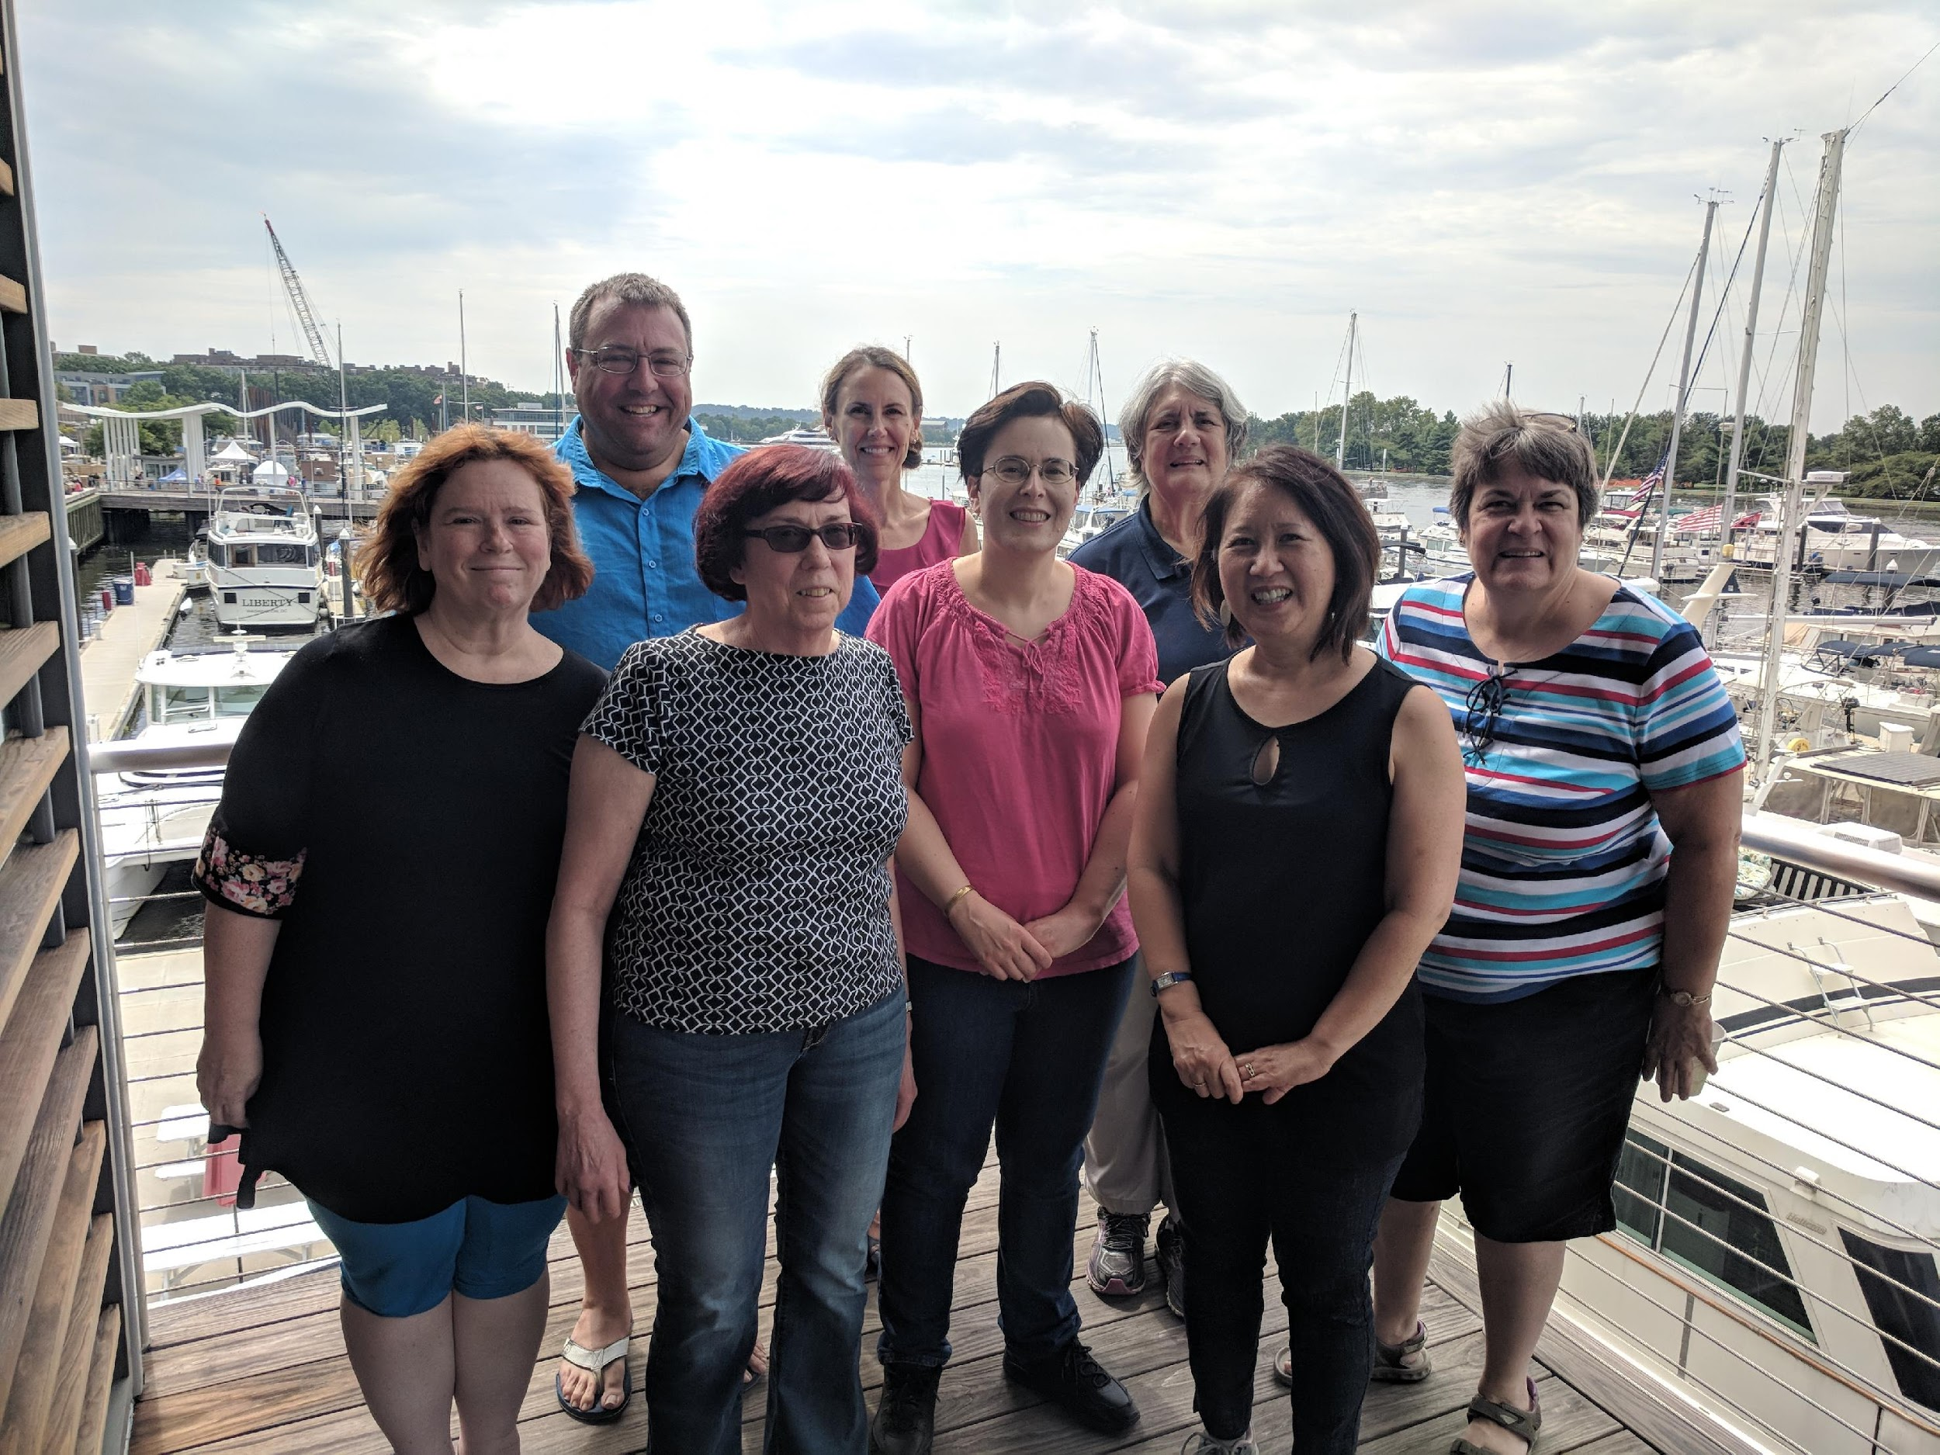

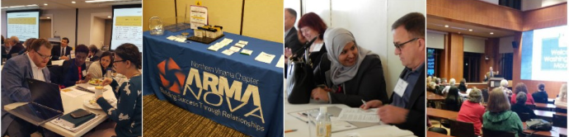
About the
NOVA Chapter
Visit us at www.arma-nova.org and follow us on Twitter
Learn, Network and Get Educational Credits
Attend our meetings and stay current on records and information governance topics with colleagues and leaders in the field
Build your network and find opportunities for career advancement and certifications
ARMA Membership is $175/yr for individuals and $25/yr for students
ARMA NOVA membership is $25/yr and is free for students
First time NOVA Chapter members qualify for one free event within first year
Many events qualify for CRM, CIP and IGP certification maintenance credits
ARMA NOVA’s members include records and information governance professionals, archivists, corporate librarians, imaging specialists, legal professionals, IT managers, consultants, and educators working in commercial, government and educational industries.
ARMA NOVA fosters collaboration and relationship building while promoting research, education, training, and networking programs.

